Slide 1
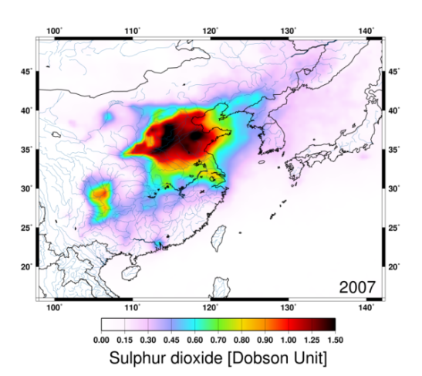
DOAS workshop 2015, Brussels, July 2015
Sulfur dioxide vertical column DOAS retrievals from OMI: 10 years of global observations and comparison to ground-based and satellite data
N. Theys¹, I. De Smedt¹, J. van Gent¹, T. Danckaert¹, F. Hendrick¹, T. Wang², M. Van Roozendael¹, R. van der A ³
Belgian Institute for Space Aeronomy (BIRA-IASB)
Institute of Atmospheric Physics (IAP)
3. Koninklijk Nederlands Meteorologisch Instituut (KNMI)
SO₂ plume from Holuhraun, 02-09-2014

Slide 2
Outline
OMI SO₂ algorithm
Examples for volcanic SO₂
Anthropogenic SO₂:
* SO₂ from ships
* Validation over China
* Time evolution over selected regions
Conclusions

Slide 3
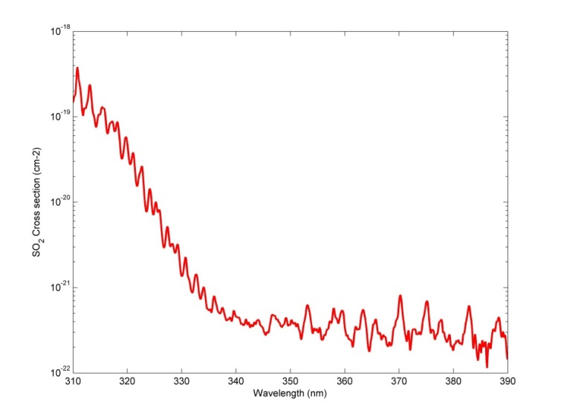
SO₂ Algorithm (1)
Algorithm developed in preparation of TROPOMI (S5P)
DOAS fit
Adaptation to OMI:
- Wavelength calibration based on Fraunhofer solar lines
for each of the 60 detector rows
- Daily earthshine reference spectra: one per detector row
- Spikes removal
Spectra for SO₂, O₃ (Pukite et al. approach) and Ring effect
3 fitting windows:
- 312-326 nm (baseline)
- 325-335nm (volcanic eruption, SCD>40 DU)
- 360-390 nm (extreme cases, SCD>250 DU)
Baseline
Volcanic eruption
Extreme case
More details in:
Theys, N., et al. (2015), J. Geophys. Res. Atmos., 120,
doi:10.1002/ 2014JD022657

Slide 4
SO₂ Algorithm (2)
2. Background correction
Automatic detection and removal of the detector rows affected by the row anomaly issue
Background correction dependent on: time, cross-track position and measured O₃ slant column

Slide 5
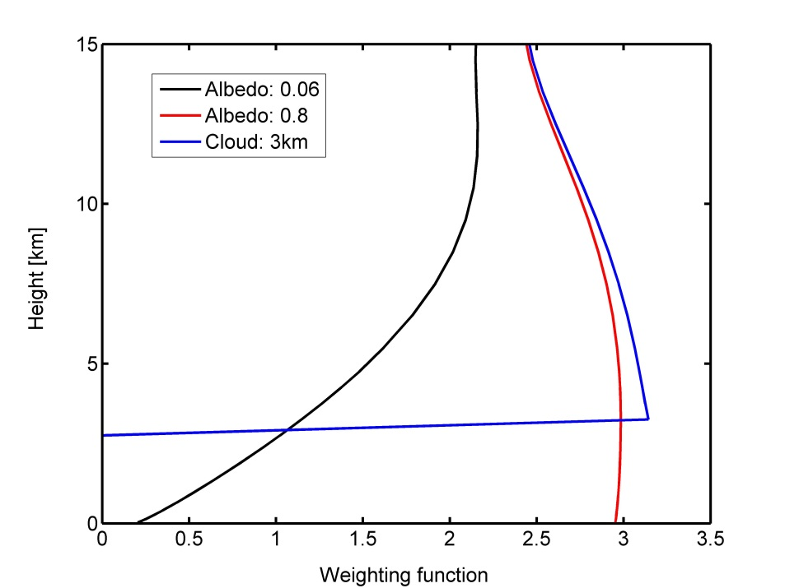
SO₂ Algorithm (3)
3. Air mass factors
Box-AMFs LUT (LIDORT v3.3) with dependences for viewing geometry, albedo (Kleipool et al, minimum surface reflectance dataset), surface/cloud height, wavelength, O₃ column
4 different a-priori profiles: 3 box profiles of 1km thickness: 0-1km a.g.l. and centered at 7 km and 15km altitudes (volcanic plumes), SO₂ profiles from the IMAGES model (BIRA-IASB)
+error analysis and averaging kernels calculation

Slide 6
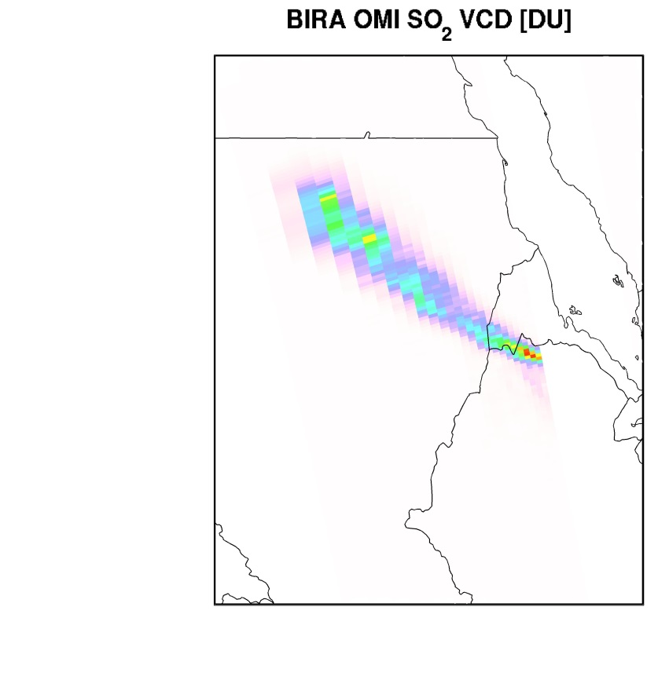
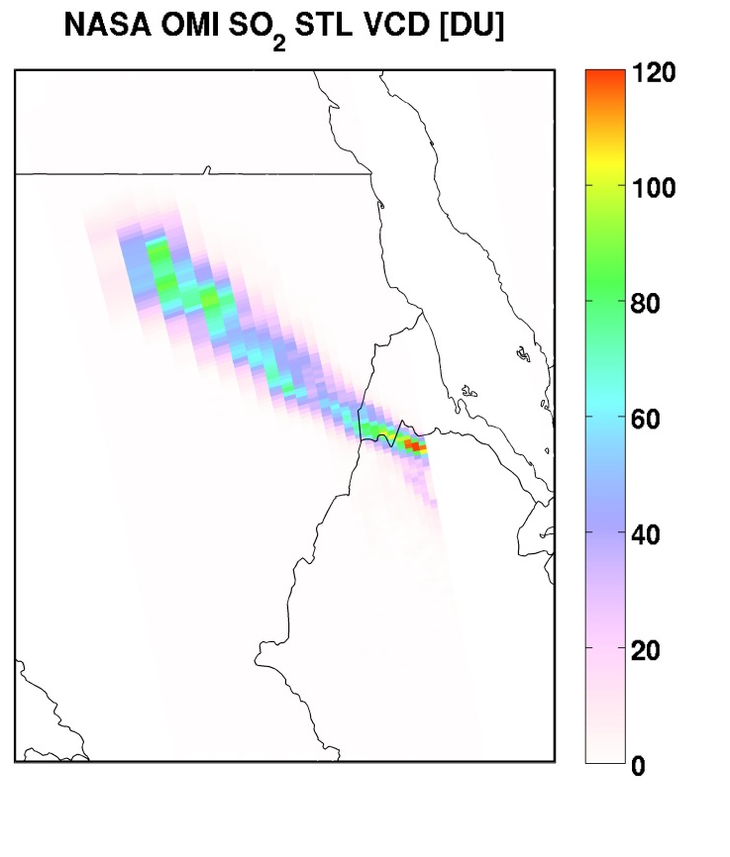
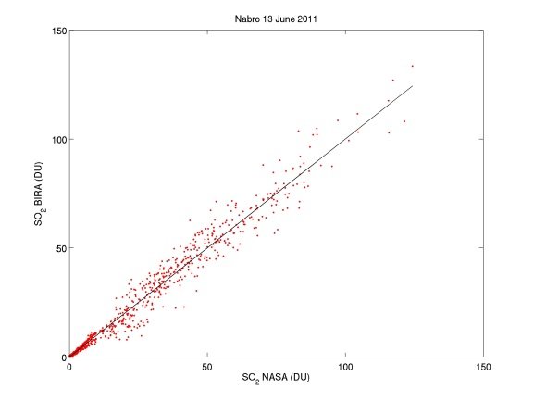
Nabro

Slide 7
Kasatochi

Slide 8
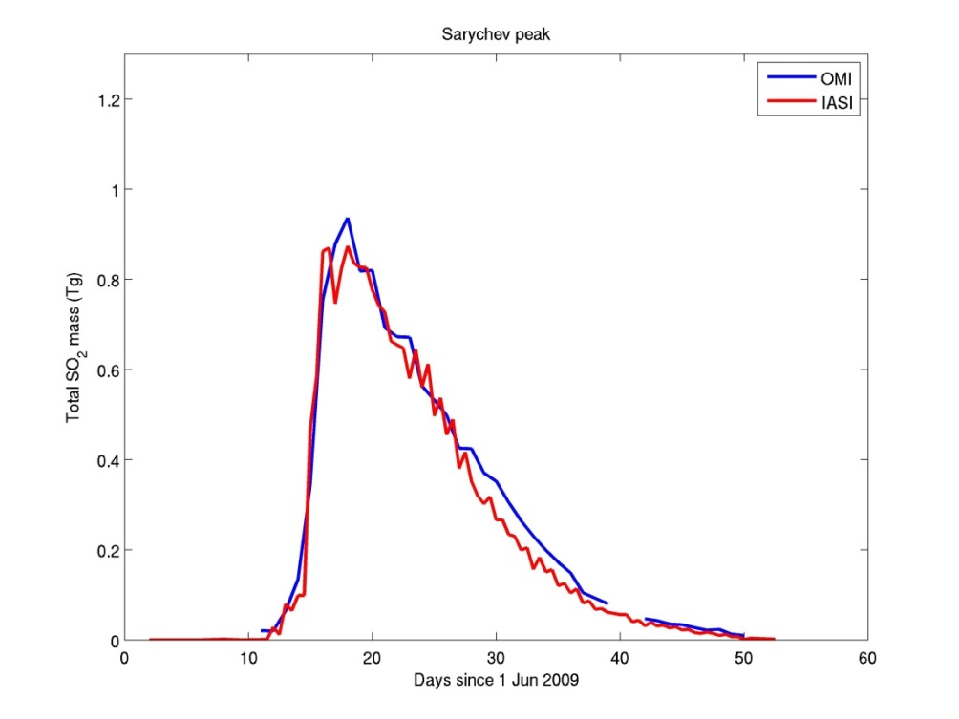
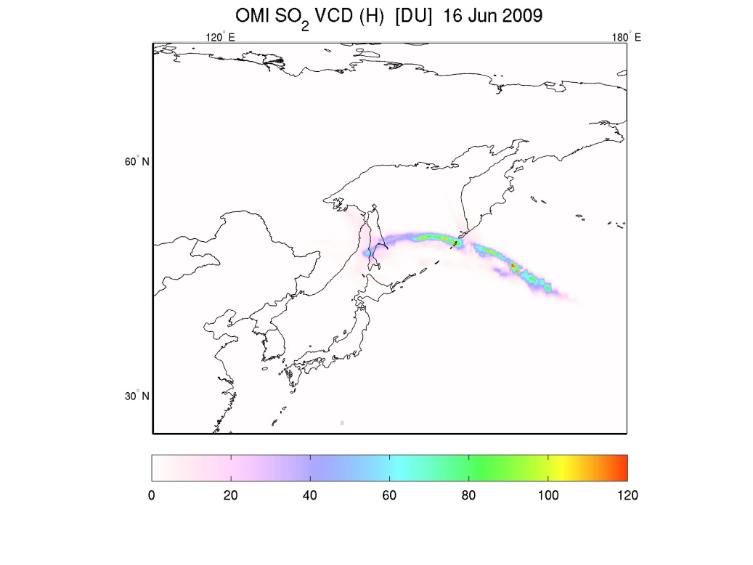
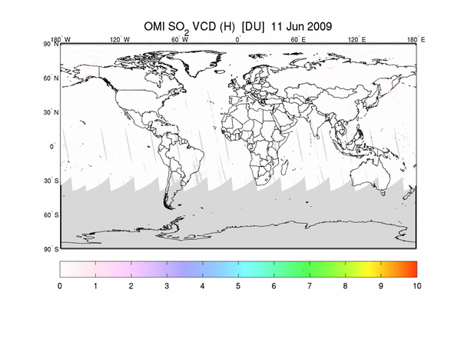
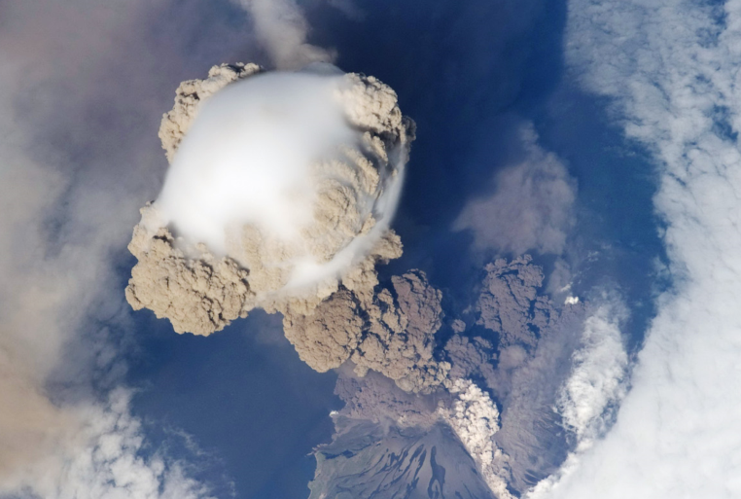
Sarychev peak eruption: June 2011

Slide 9
Global SO₂ distribution as seen by OMI

Slide 10
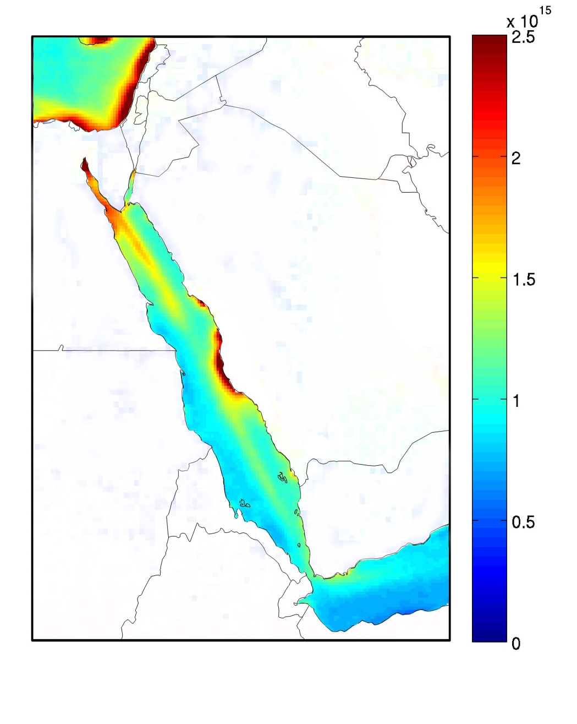
SO₂ from ships
OMI SO₂ VCD [DU] OMI tropo. NO₂ VCD [molec.cm⁻²]
2005-2009

Slide 11
SO₂ from ships

Slide 12
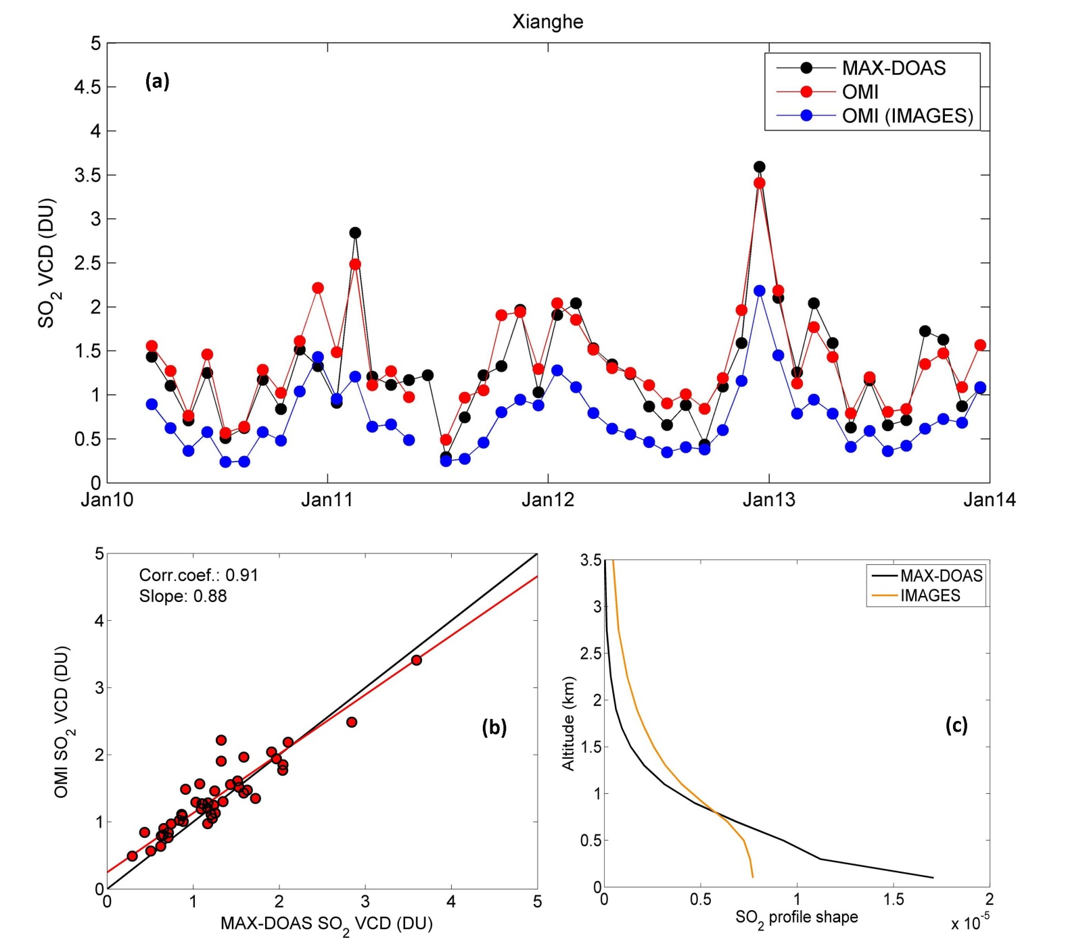
Validation: China
Xianghe: sub-urban site
50 km radius
Clear-sky pixels
No volcanic SO₂
SZA<65°

Slide 13
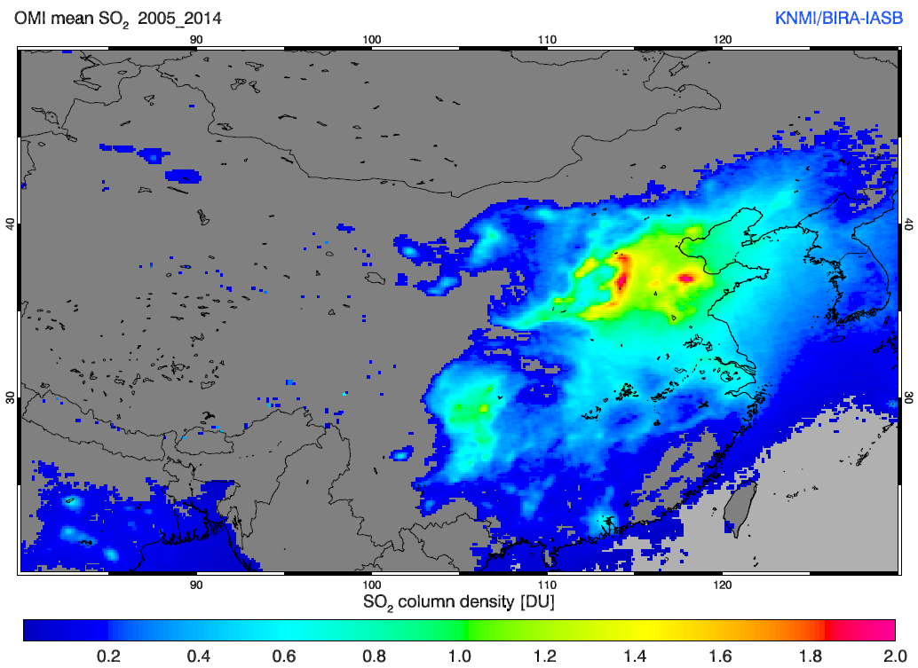
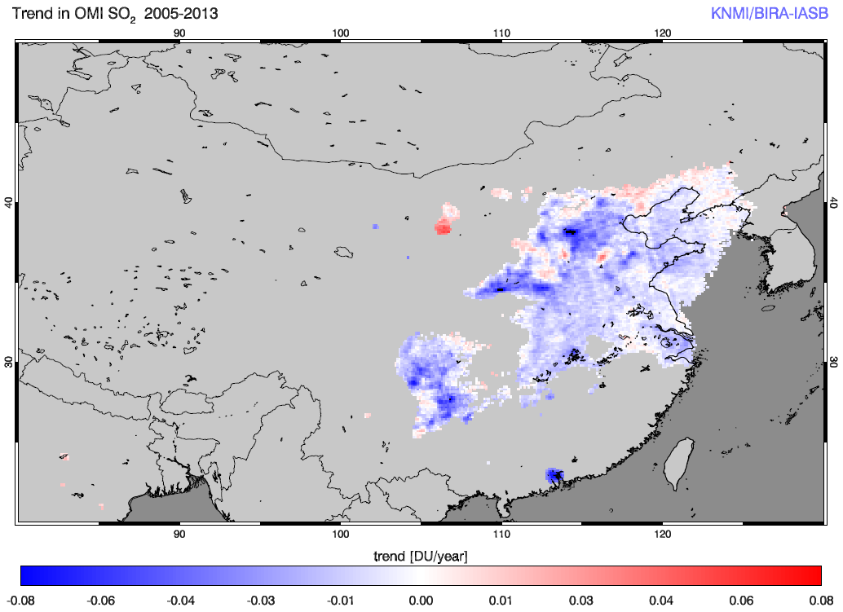
Trends over China
Filtered for clouds (>50%), viewing angle (<50°) and solar zenith angle (<80°)
Gridded to monthly means (1/8 degree resolution)
Linear fit of SO₂ over the years 2005-2014
Grid cells with less than 0.1 DU on average are not plotted and grid cells less than 0.5 DU are not fitted.

Slide 14
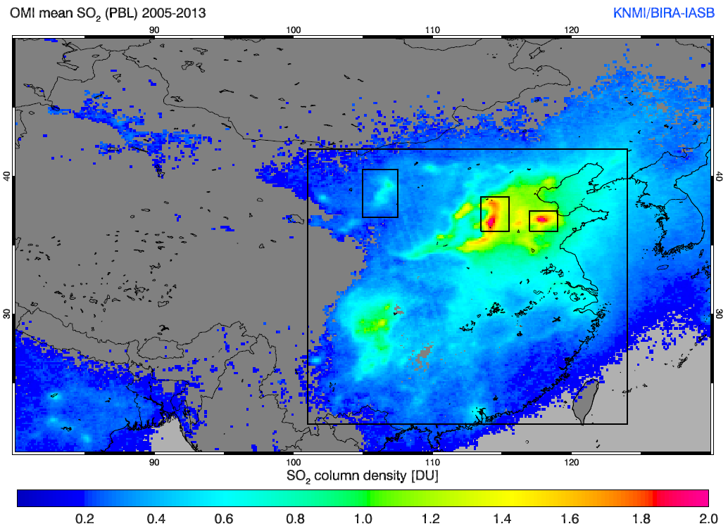
Trends over China
Relative trends (time series) for some key areas

Slide 15
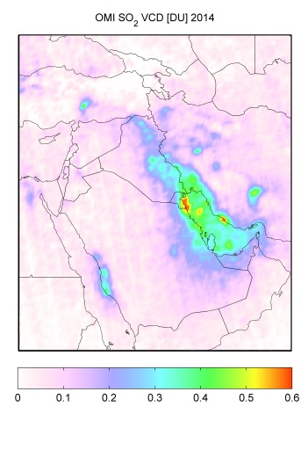
Oil industry: Iraq
blogs.platts.com

Slide 16
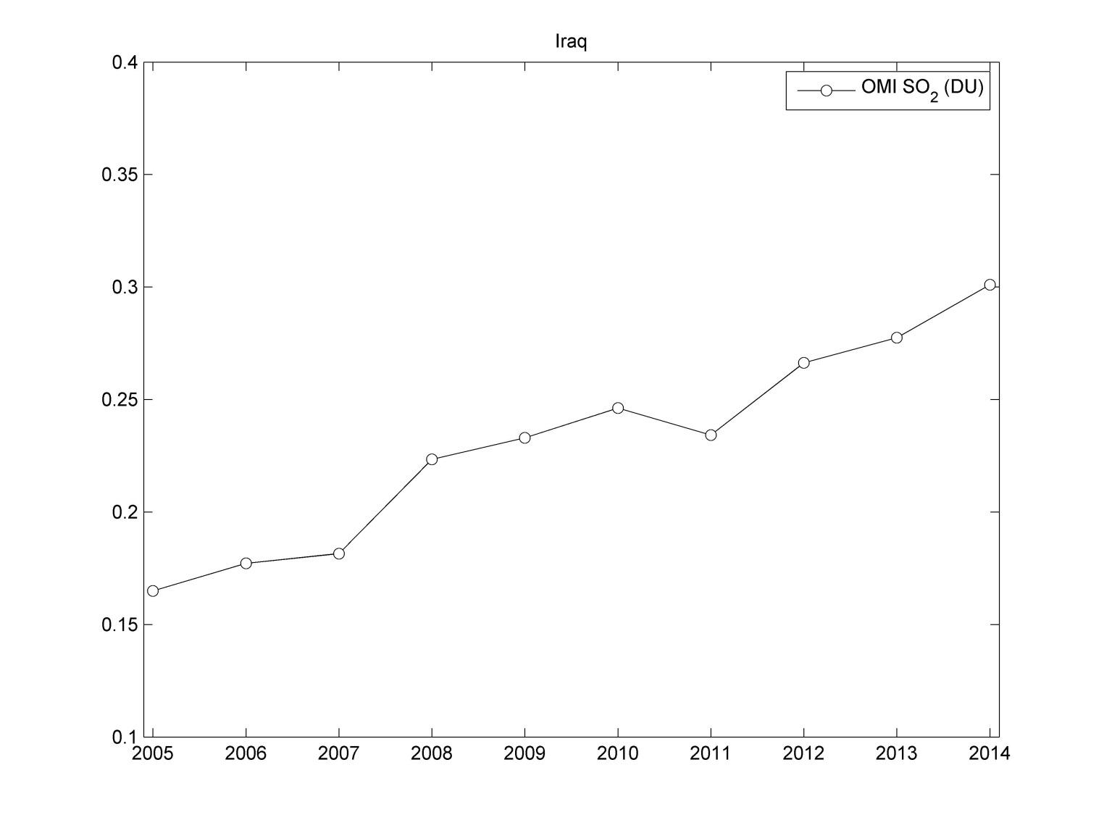
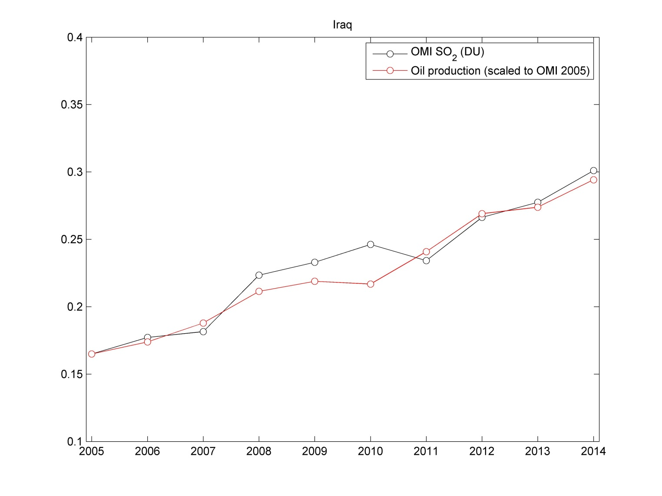
Oil industry: Iraq
(source: OPEC)
2005:
1.8 M bbl/day

Slide 17
Summary
Development of a DOAS SO₂ algorithm (S5P prototype) succesfully applied to OMI.
Volcanic SO₂: the algorithm is able to cope with large SO2 columns and is consistent with other satellite products.
Anthropogenic SO₂:
-Very weak sources are detected in long-term averages (e.g. shipping SO₂)
-Excellent agreement with MAX-DOAS measurements in Xianghe
-Contrasting time evolution depending on selected regions
The 7°x7° spatial resolution of TROPOMI, combined with a SNR equivalent (or even better) than OMI, is expected to significantly improve the SO₂
observations.

Slide 18
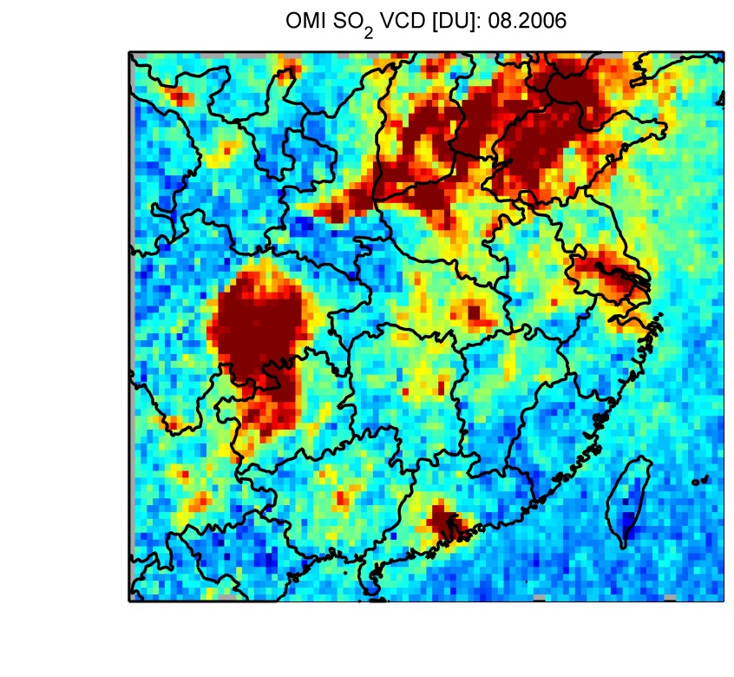
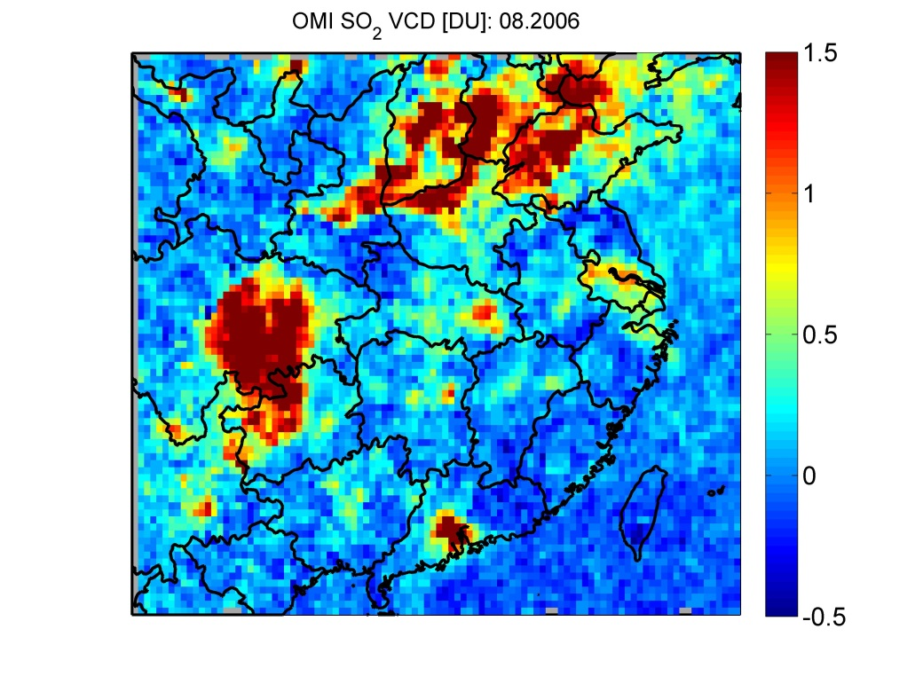
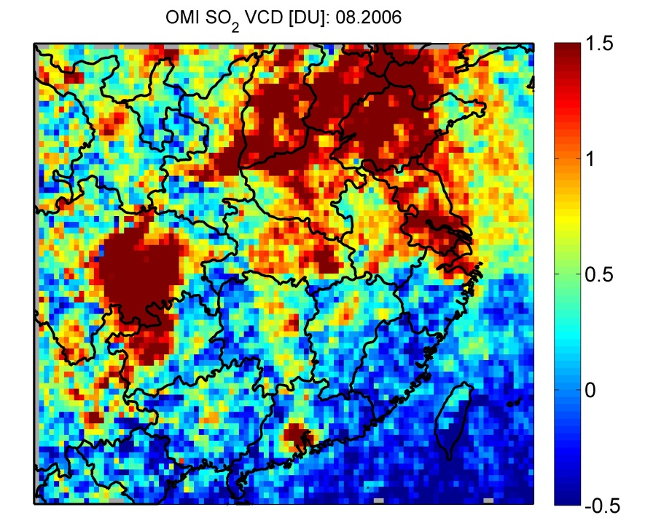
China
DOAS
PCA
BRD

