Slide 1
An improved retrieval of tropospheric NO₂ from space over polluted regions using an Earth radiance reference Jasdeep S. Anand (jsa13@le.ac.uk), Dr Roland J. Leigh, Prof Paul S. Monks Earth Observation Science, Dept. of Physics and Astronomy University of Leicester
Physics and Astronomy
www.le.ac.uk

Slide 2
Outline
Introduction - Tropospheric NO₂ from space
Using an Earth radiance reference to remove the stratospheric component (ERrs-DOAS)
Application to OMI data
Remaining biases
Application to TROPOMI measurements

Slide 3
Tropospheric NO₂ and urban air quality
“NO₂ is one of the best indicators of air quality.” – DEFRA
Anthropogenic emissions significant source of tropospheric NO₂
Health concerns include impaired lung function, cardiovascular disease, etc.
Also source of secondary products like O₃ & PM.
Satellite instruments (e.g. OMI) can provide continuous global coverage…
… but are hampered by revisit time and spatiotemporal resolution.
Hilboll et al, AMT, 2013

Slide 4
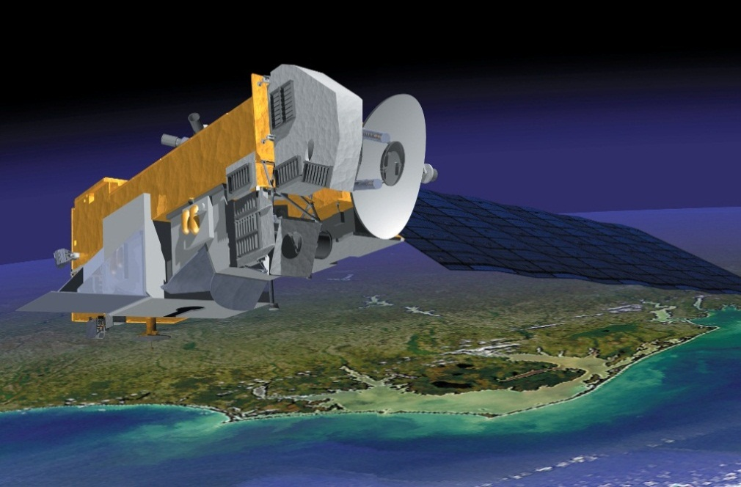
The Ozone Monitoring Instrument (OMI)
Joint Dutch/Finnish/USA instrument. Launched aboard AURA (NASA) in 2004.
“Push-broom” along-track scanner
UV-VIS
350 - 500 nm (~ 0.6 nm resolution)
Near-polar orbit (98.52° inclination), 1-day full coverage
Local overpass time ~ 1330
2600 km swath binned to 60 across-track pixels
Nadir pixel size: 13 x 24 km²

Slide 5
Measuring tropospheric NO₂ from space
DOAS fit reflectance spectra between 400 - 500 nm to obtain total SCD
Possible contamination due to solar irradiance measurements (e.g. striping in OMI)
Removing the stratospheric component (dependent on a priori assumptions):
Model assimilation (e.g. DOMINO)
Spatial filtering (e.g. OMNO2)
Limb-nadir matching (SCIAMACHY)
All methods can be affected by SCD precision, instrumental biases, etc.

Slide 6
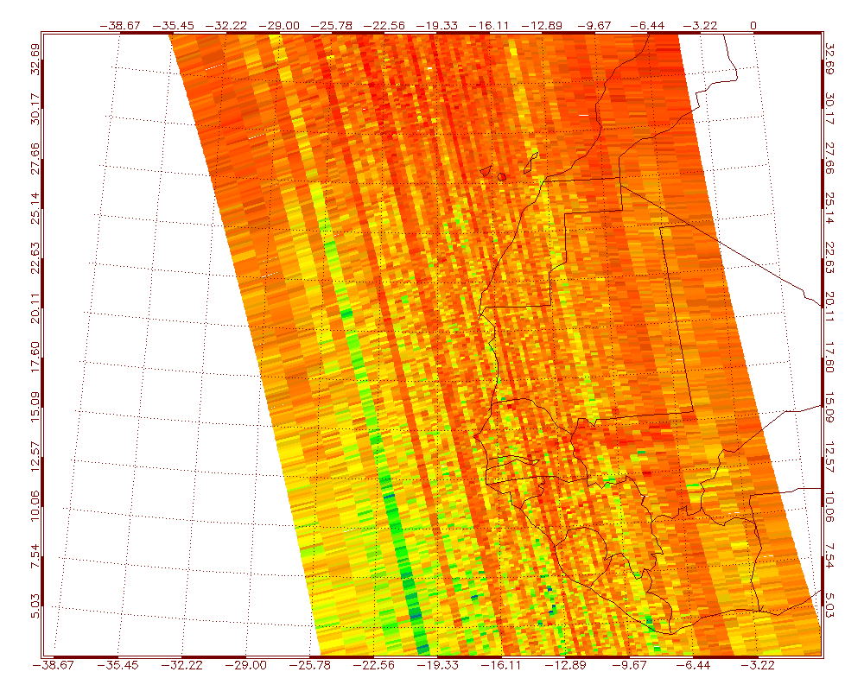
Across-track striping
Veihelmann and Kleipool, 2006
Solar diffusor features & dark current can lead to inconsistent noise along the OMI CCD
Result: stripes that need to be empirically removed after the DOAS retrieval

Slide 7
The Earth Radiance reference sector DOAS (ERrs-DOAS) algorithm
Can tropospheric NO₂ be purely empirically retrieved via DOAS using unpolluted Earth radiance spectra as a reference?
Earth radiance spectra previously used as a DOAS reference for IO and CH₂O retrievals
Improves retrieval error, but complicated by reference sector contamination
Primarily stratospheric NO₂ exists over the Pacific compared with continental urban areas – possible reference sector
Black: China
Red: Pacific

Slide 8
Reference sector selection
Daily reference spectrum taken over remote Pacific over cloud-free scenes (CF < 0.25, to avoid cloud top height biases)
Binned for each across-track pixel to avoid viewing angle biases
Stratospheric NO₂ assumed to be longitudinally invariant
Due to changing SZA, stratospheric NO₂ will have latitudinal dependence:
Solution: bin daily spectra measured over reference region to 1° latitude bands

Slide 9
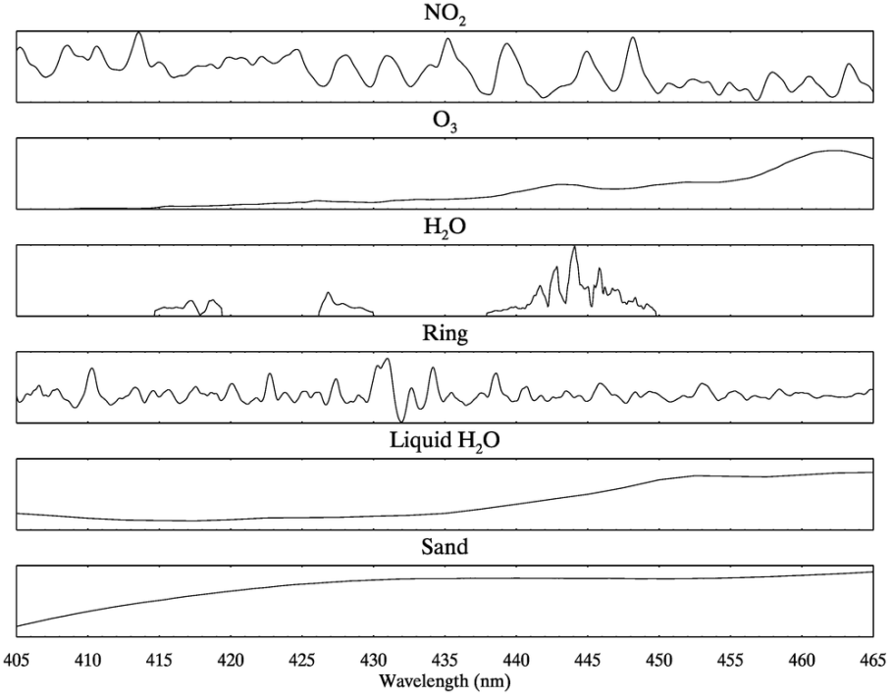
DOAS retrieval
Retrieval performed with QDOAS, with comparable settings to operational OMNO2A algorithm
405 – 465 nm fitting window
Species | OMNO2A | ERrs-DOAS
NO₂ (220 K) | Vandaele et al. (1998) | Vandaele et al. (1998)
O₃ | Bass and Johnsten (1975) | Bass and Johnsten (1975)
H₂O | Rothman et al. (2005) | Rothman et al. (2005)
Ring | Chance and Spurr (1997) | Chance and Spurr (1997)
Polynomial | 5th order | 3rd order
H₂O (liquid) | N/A | Pope and Fry (1997)
Sand | N/A | Richter et al. (2011)

Slide 10
Retrieval algorithm bias
QDOAS fit:
OMNO2A fit:

Slide 11
Total SCD (solar reference) bias estimation (June 2005)
Average SCD bias ~ 1.0 x 10¹⁵ molec cm⁻² – similar to other comparisons (see van Geffen et al, AMT, 2015)

Slide 12
Total SCD (solar reference) bias estimation
orbit no. 06644, Oct. 2005
Solution: Only use pixels where total SCD bias < 5%; assumed to be representative of what OMNO2A software would retrieve

Slide 13
Tropospheric NO₂ SCD comparison (June 2005)
ERrs-DOAS
Bias
High correlation with DOMINO trop. SCDs:
Global: r² = 0.85
China: r² = 0.96
China (SCDs > 1.0 x 10¹⁶ molec cm⁻²): r² = 0.99
DOMINO
Stratospheric NO₂ (DOMINO)

Slide 14
Presence of liquid H₂O and sand
Spatial features similar to those found in GOME-2 retrievals (Richter et al, 2011)

Slide 15
Impact of liquid H₂O and sand on retrieval
RMS: -11%
SCD: +6.3%

Slide 16
Chinese urban transect comparison (June 2005)

Slide 17
Striping reduction over remote Pacific
orbit no. 04741, June 2005

Slide 18
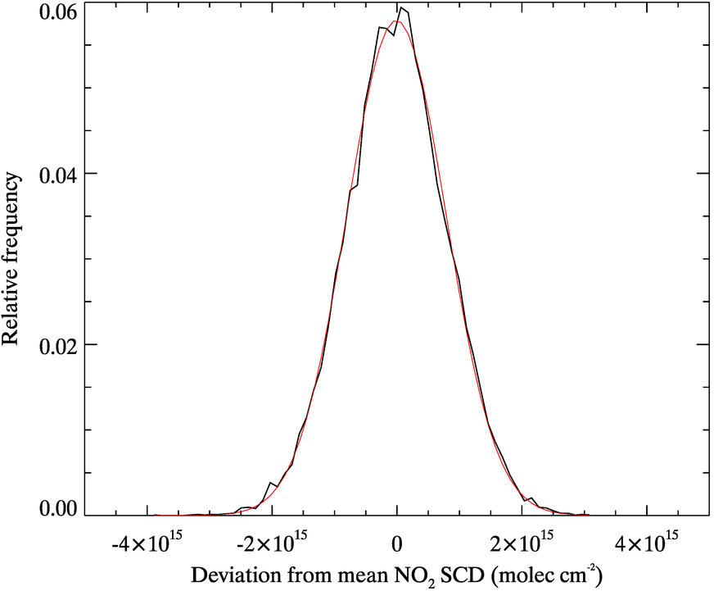
Error analysis over remote Pacific (June 2005)
Pacific assumed to be unpolluted, so spread of SCDs should be comparable to retrieval precision due to random error.
SCD uncertainty:
OMNO2A: 1.1 x 10¹⁵ molec cm⁻²
QDOAS emulation: 1.0 x 10¹⁵ molec cm⁻²
ERrs-DOAS: 0.8 x 10¹⁵ molec cm⁻²
~27% reduction in random error possible using an Earth radiance reference – mainly due to striping reduction?

Slide 19
Resilience to instrument degradation
Error analysis repeated for 2005 – 2008
Linear trend with 2nd order harmonic oscillation gives best fit for data – solar insolation dependence?
OMNO2A fits poorer than ERrs-DOAS – consequences of static solar reference?
Linear trends (molec cm⁻² mnth⁻¹)
OMNO2A: 5.8 x 10¹³
ERrs-DOAS: 1.5 x 10¹³

Slide 20
Application to TROPOMI? OMI Super-zoom data (2004)

Slide 21
MACC – II reanalysis data

Slide 22
Conclusions
ERrs-DOAS produces tropospheric NO₂ SCDs which are comparable to DOMINO with greatly reduced striping and random error.
Liquid H₂O and sand absorption cross sections improve the DOAS fit over N. Africa
Residual biases from longitudinal variations in stratospheric NO₂ remain an issue – retrieval efficacy may be limited to very polluted urban areas
Potential application to reanalysis of Sentinel 5 data

Slide 23
Acknowledgements
Supervisors: Dr Roland Leigh, Prof Paul Monks
Data made available by KNMI/NASA
MACC-II data provided by ECMWF
Special thanks to the OMI team (F. Boersma, J. van Geffen, M. Sneep, P. Veefkind) for their assistance in understanding the retrieval algorithms.
And you!

Slide 24
Publications
Anand, J. S., Monks, P. S., and Leigh, R. J.: An improved retrieval of tropospheric NO₂ from space over polluted regions using an Earth radiance reference, Atmos. Meas. Tech., 8, 1519-1535, doi:10.5194/amt-8-1519-2015, 2015.
Anand, J. S., Monks, P. S., and Leigh, R. J.: High spatial resolution NO₂ tropospheric slant columns retrieved from OMI spatial-zoom spectra using an earthshine reference, Proc. SPIE 9229, Second International Conference on Remote Sensing and Geoinformation of the Environment (RSCy2014), doi:10.1117/12.2066154, 2014

