Slide 1
IAGOS water vapour and RH_ice products for the Global troposphere and extratropical tropopause regions
S. Rohs, H.G.J. Smit, A. Petzold
Forschungszentrum Jülich GmbH, Institute of Energy and Climate Research 8 – Troposphere, Jülich, Germany
Contact: s.rohs@fz-juelich.de or www.iagos.org

Slide 2
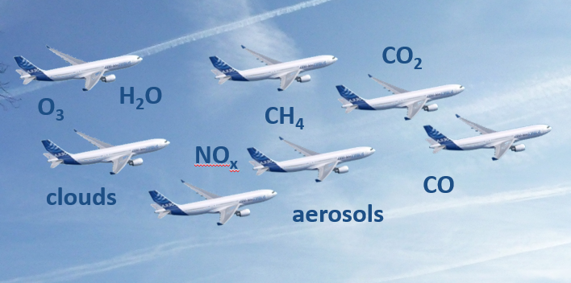
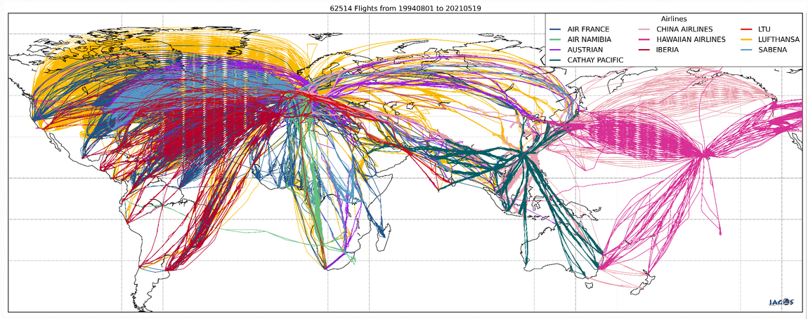
Global-Scale Atmospheric Composition Dataset from Instrumented Passenger Aircraft by MOZAIC and IAGOS
European Research Infrastructure for Earth observation by passenger aircraft since 2014 (historical MOZAIC: 1994 - 2014)
Regular in situ global-scale monitoring of essential climate variables
Long-term deployment envisaged (> 20yrs)
7 long-haul aircraft (IAGOS-CORE) and one flying laboratory (IAGOS-CARIBIC)
Open data policy; visit www.iagos.org

Slide 3
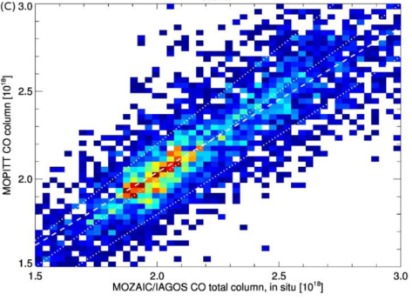
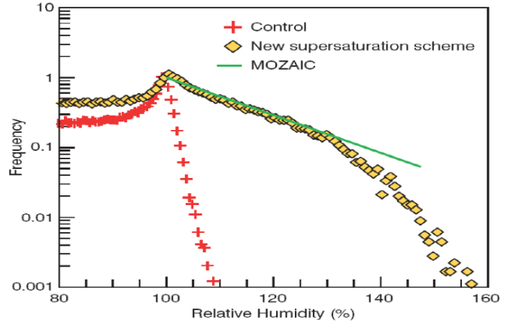
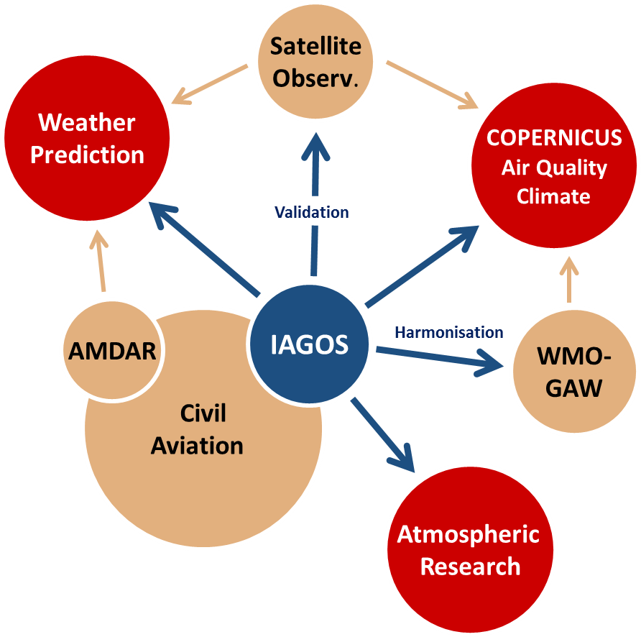
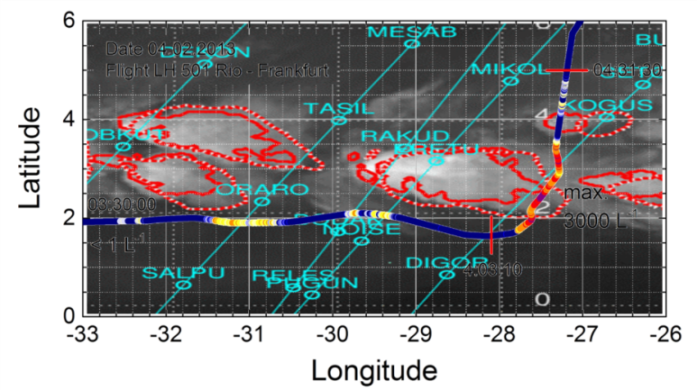
In-service Aircraft for a Global Observing System
Association Internationale sans but lucratif
Validate satellite products by IAGOS in-situ observations
de Laat et al. 2014
CAMS provides:
Daily information on the global atmospheric composition
Daily production of NRT European air quality analyses and forecasts
Global Reanalyses for tracking atmospheric composition over several years
IAGOS provides:
IAGOS near real time data for operational validation of climate and air quality models of CAMS
Improve representation of RH in numerical weather prediction systems
Tomkins et al. 2007
Use IAGOS cloud data for safe routing of aircraft around thunderstorms
Regions of ice-supersaturation and cirrus clouds:
Vertical distribution
Seasonal variation
Trends

Slide 4
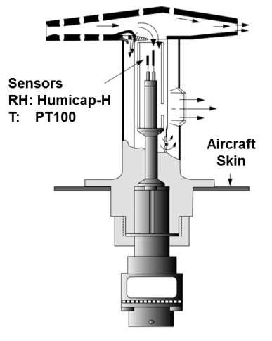
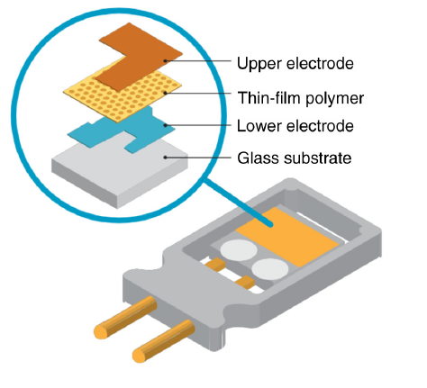
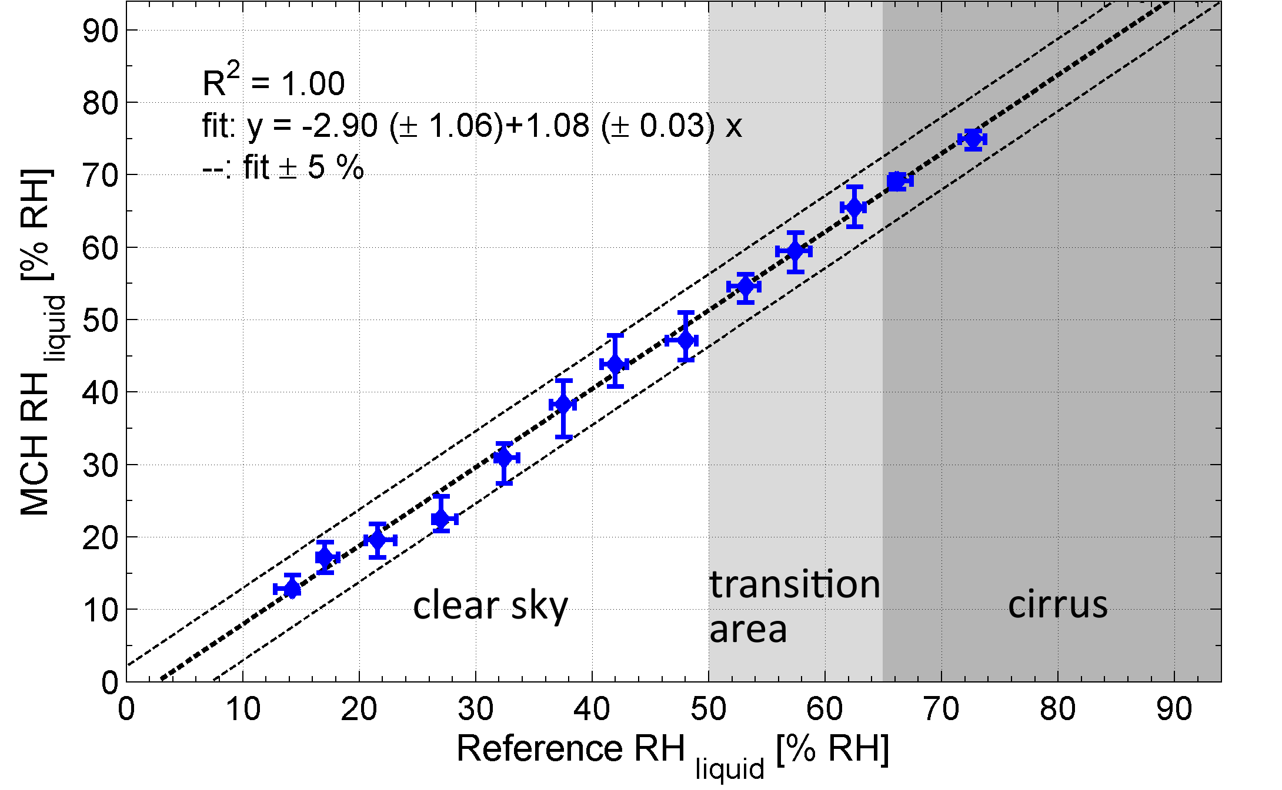
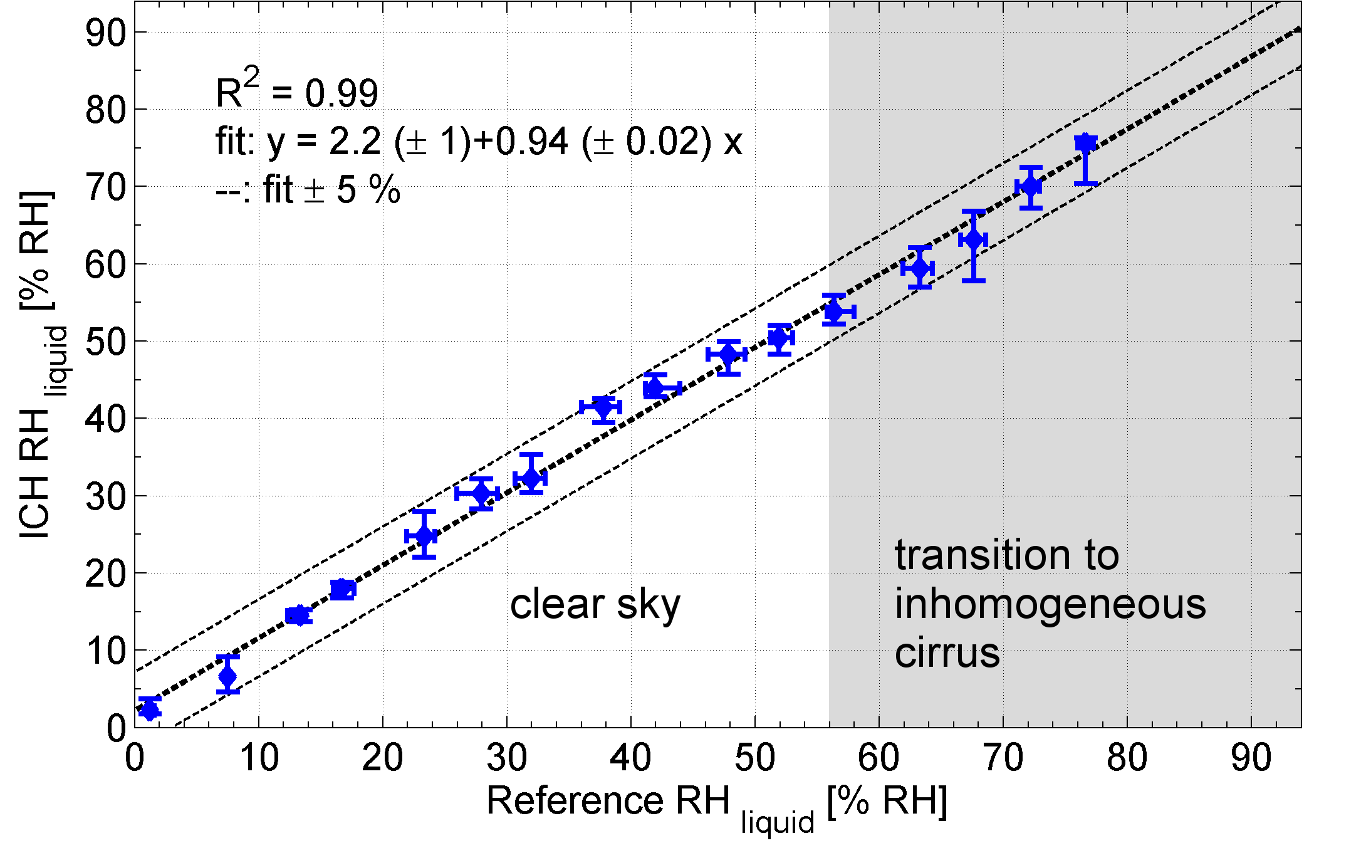
MOZAIC/IAGOS Capacitive Hygrometer (MCH/ICH)
References (MOZAIC):
CIRRUS-III
Out of clouds:
FISH (Ly-α)
In clouds:
OJSTER (TDL)
Hydroactive Polymer Film which adsorbes H2O
Capacitance depends on relative humidity (RH);
Calibrations traceable to frost point mirror
Low maintenance requirements
In-flight blind intercomparison: 5% RH_{liquid} uncertainty,
LOD approx. 10 ppmv
Change of sensor design of MCH into ICH has no impact on measuring capabilities
References (IAGOS):
AIRTOSS-ICE
Out of clouds:
FISH (Ly-α)
In clouds:
SEALDH (TDL)
Helten et al., JGR 1998; P. Neis,et al., Atmos. Meas. Tech.; 2015, P. Neis et al., TellusB, 2015

Slide 5
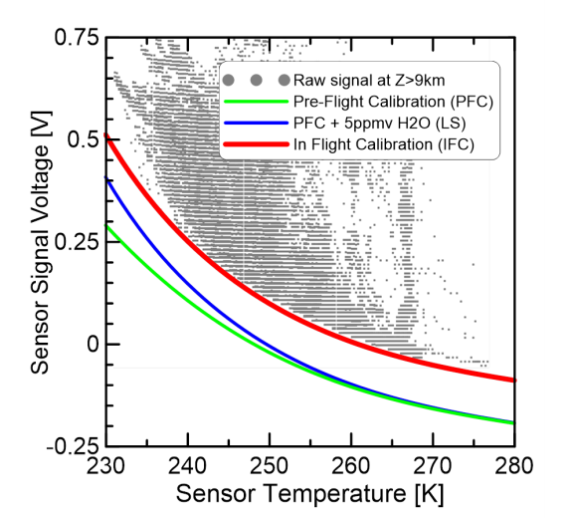
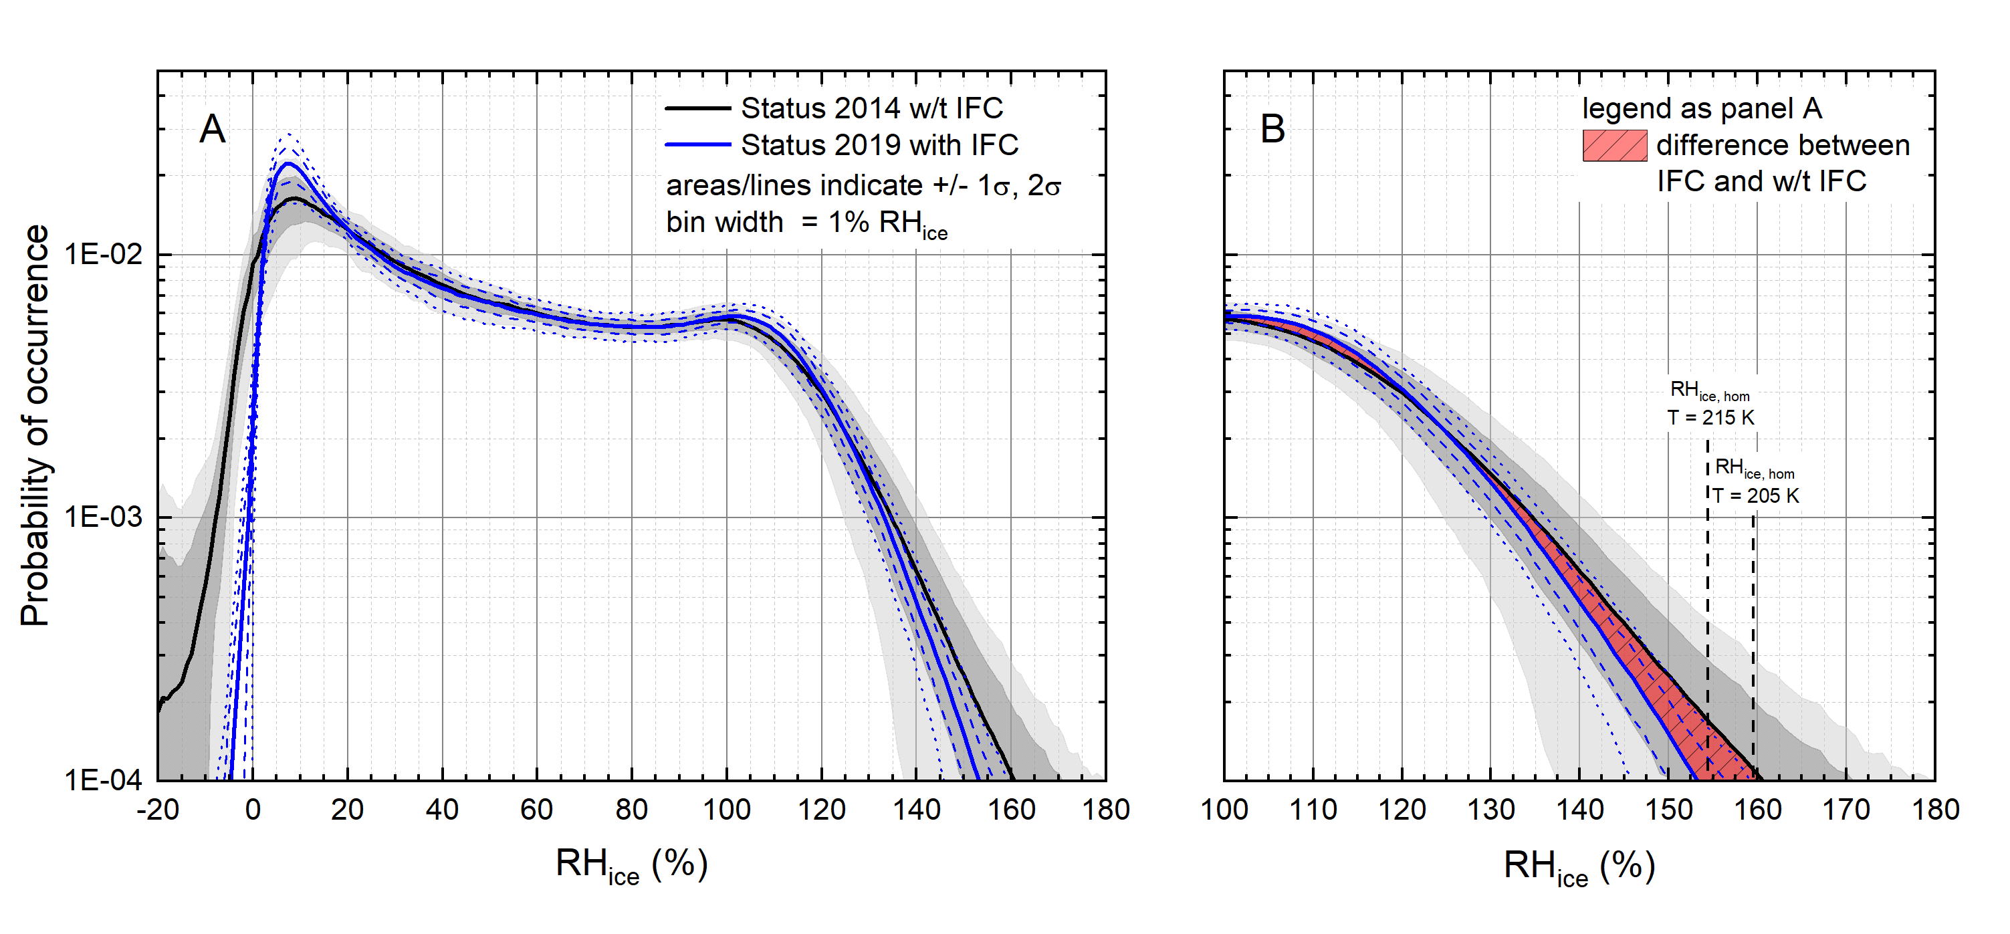
In Flight Calibration (IFC) Method
Raw signal of humidity sensor as function of sensor temperature
Averaged probability density functions of RH_{ice} for MOZAIC period (1995 to 2010)
The 2σ - variability of observed ISS at 10⁻⁴ occurrence probability: - max. 180% RH_{ice} (without IFC) - max. 155% RH_{ice} (with IFC).
With IFC: values fit into the range of homogeneous freezing thresholds at typical extratropical tropopause conditions (RH_{ice,hom} = 158% at 205 K; RH_{ice,hom} = 154% at 215 K, Koop et al., 2000).
Without IFC: values exceed the homogeneous nucleation threshold.
MCH/ICH show drift during operation
In-flight Calibration (IFC): Flight sequences in dry air masses (RH < 10%) are used to correct for drift
IFC applied to MOZAIC reanalysis (2014)
Smit et al., JAOT, 2008; Smit et al., ACP 2014 ; Petzold et al., ACP, 2020
Notes:
=> The 2σ - variability of observed ISS at 10⁻⁴ occurrence probability reduces from max. 180% RH_{ice} (without IFC) to 155% RH_{ice} (with IFC). This fits into the range of homogeneous freezing thresholds at typical extratropical tropopause conditions of RH_{ice,hom} = 158% at 205 K to RH_{ice,hom} = 154% at 215 K (Koop et al., 2000). Respective values without IFC applied exceed the homogeneous nucleation threshold significantly.

Slide 6
Automated QC for IAGOS H2O
Automated IAGOS RH data processing:
version control
storage of meta data
INPUT
raw data with
calibration coefficients in the header
import and preprocess manager
import raw data
preprocess data
QC check: voltage range…
default settings
calibration manager
using IFC method
QC:
flag list + test limits
QC manager
ImpossibleTime
GlobalRange
RegionalRange
VerticalSpike
Rate of change
Stationarity
Accuracy
RH specific tests
Flag inheritance test
OUTPUT
Quicklook
NRT:
netcdf data after automated QC
usually in less than 2 h
(manual QC)
finalise data
L1, L2: IAGOS database
6

Slide 7
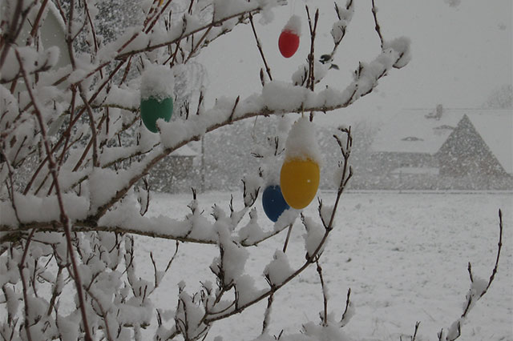
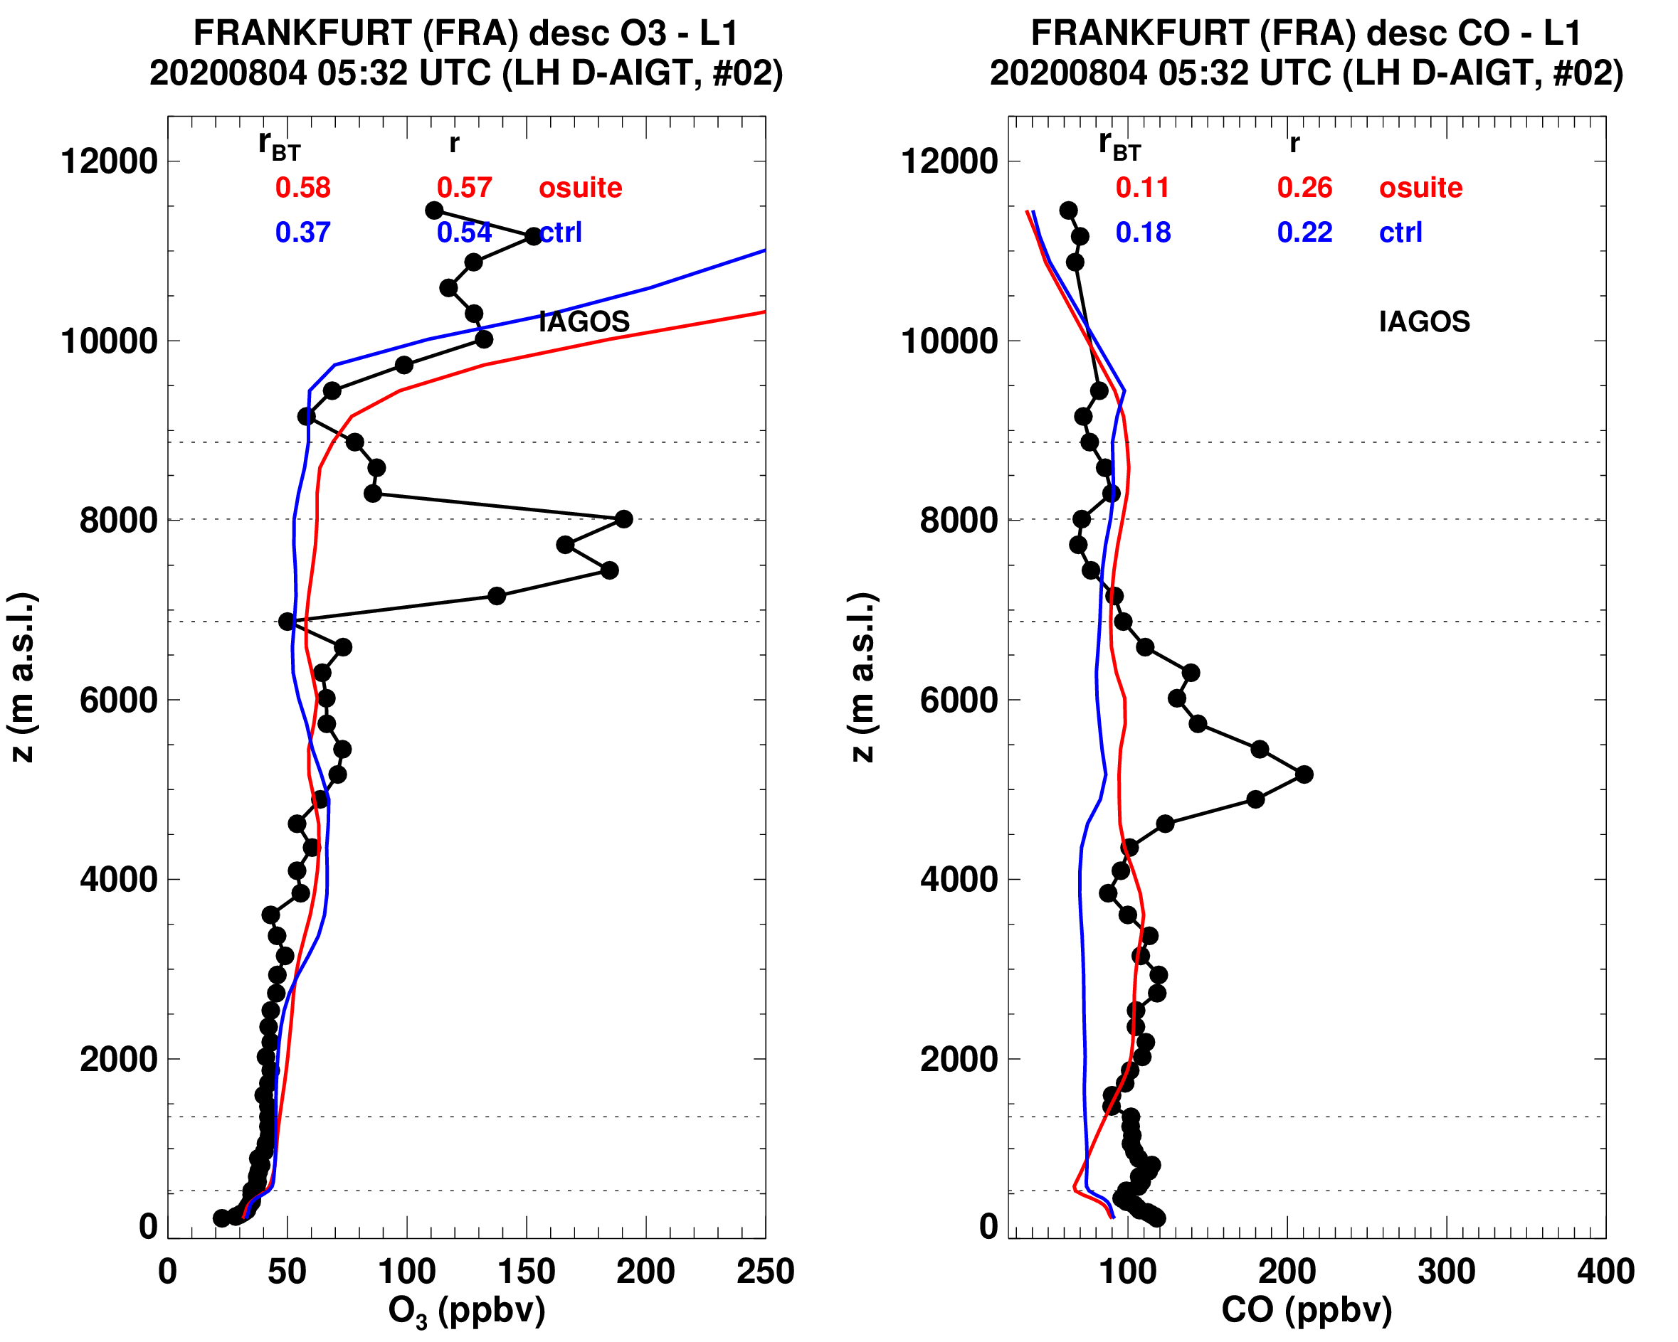
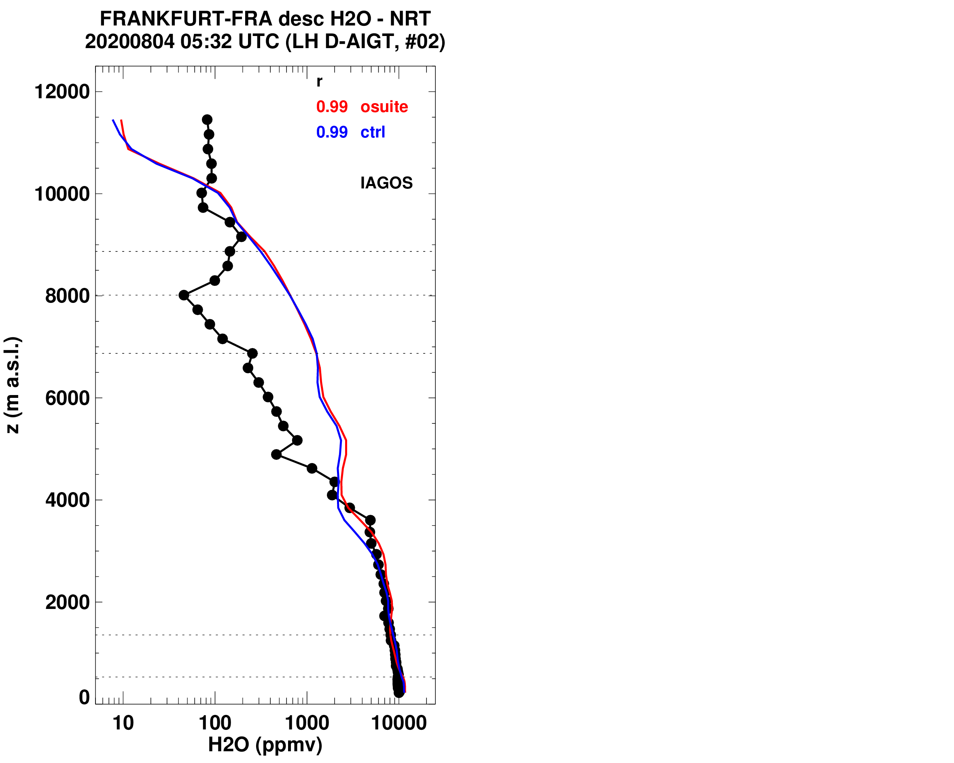
Validation of the chemical transport models of CAMS in NRT
Easter 2021: cold spell in Europe
Photo: Steffen Miehrig
Extremely cold and dry at 7000 m altitude:
T = -44.7 °C RHL = 8 %
Photo: Annamaria Luongo
Transport event: plume from Siberian forest fires, August 2020
Cap of stratospheric air
Intrusion of stratospheric air
Forest fire plume
http://www.iagos-data.fr/cams/

Slide 8
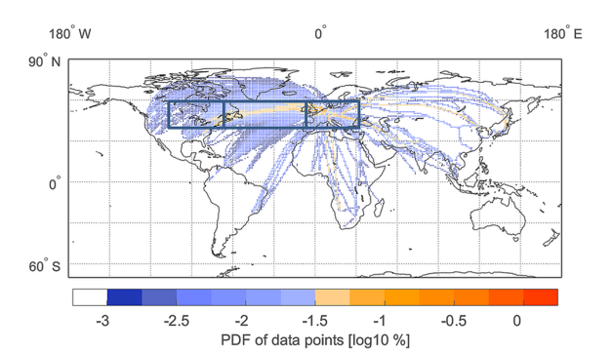
Ice-supersaturated air masses in the northern mid-latitudes from regular in-situ observations by passenger aircraft: vertical distribution
H2O VMR: Clearly visible moistening of the LMS in summer
Eastern North America
North Atlantic
Europe
RH_{ice}: distribution patterns are similar for all regions
15-year averaged annual cycles of RH_{ice} for latitudes 40 °N to 60 °N and for the regions Eastern North America, North Atlantic and Europe.
Distribution relative to the WMO thermal tropopause height z_{TPH}
Petzold et al., ACP, 2020

Slide 9
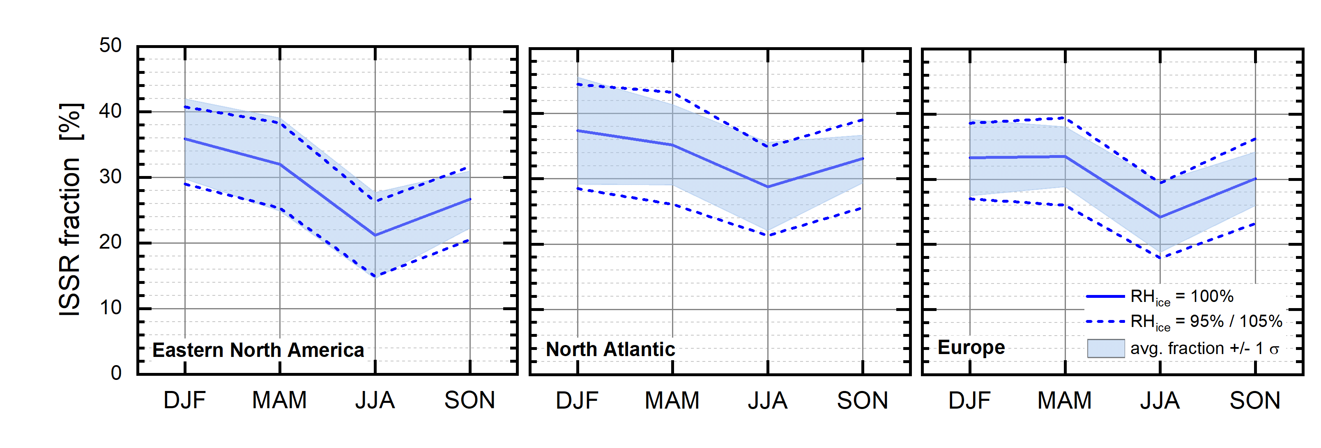
Seasonal Variation of ISSR Fraction
Annual cycles of ISSR occurrence (for the top two UT layers) shown as occurrence probability for RH_{ice} > 100% (1995 to 2010)
Shaded areas represent probabilities for the average value (thick lines) ±1σ
Short-dashed lines represent average fractions for RH_{ice} = 95% and 105%
Detailed seasonality of ISSR occurrence over different regions.
Petzold et al., ACP, 2020

Slide 10
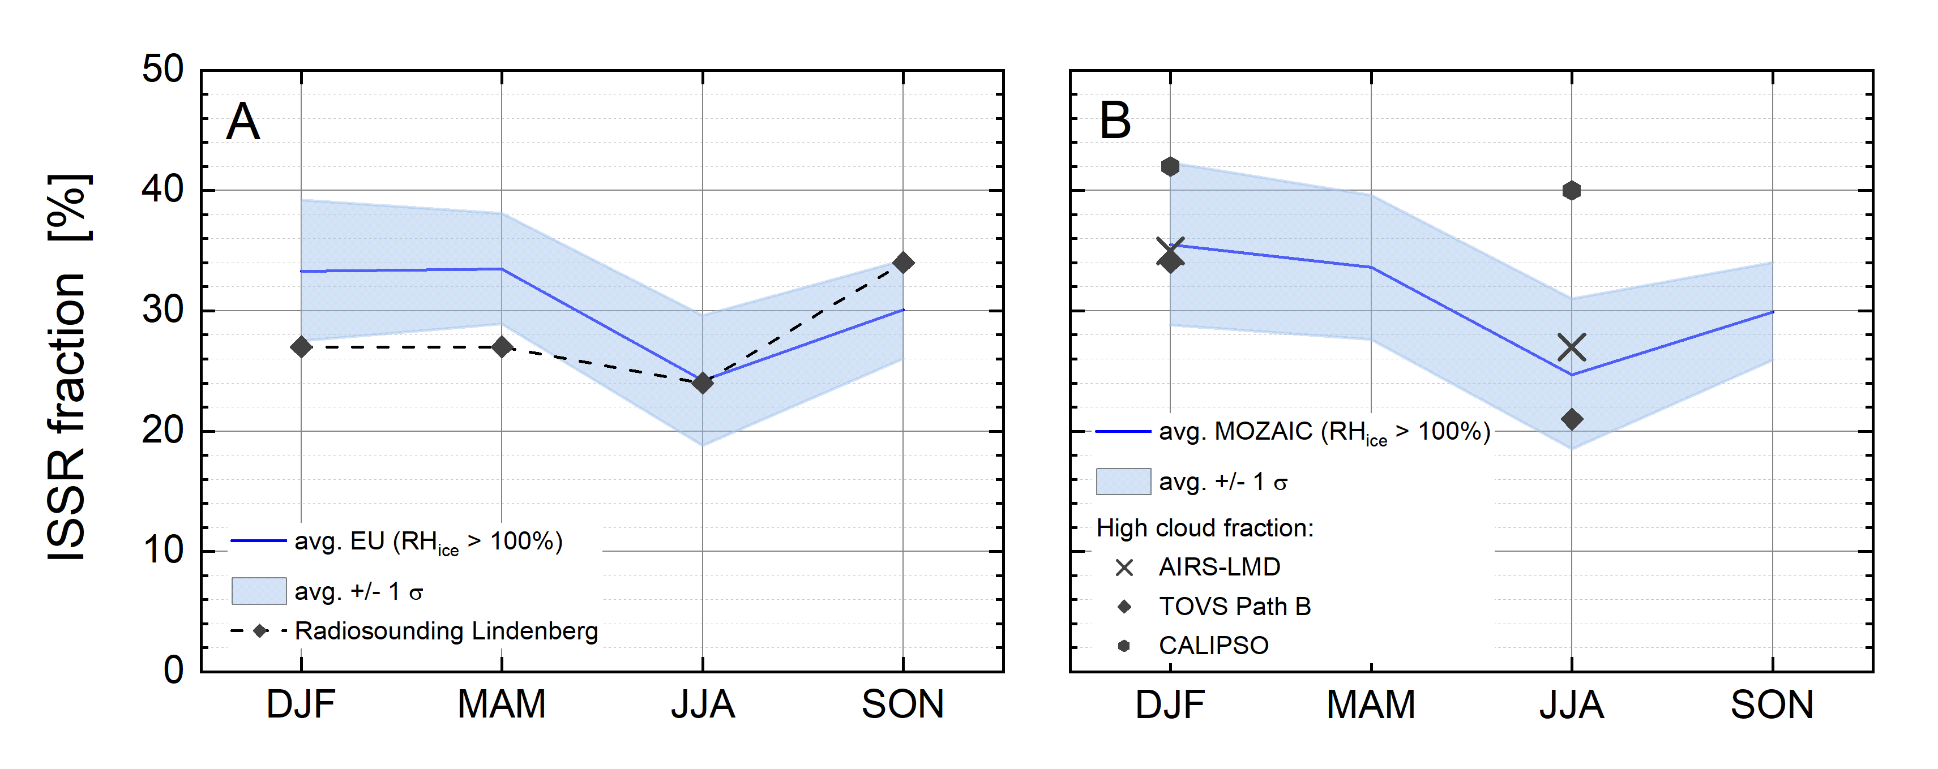
Seasonal Variation of ISSR Fraction
A Seasonal cycle of ISSR occurrence probability, i.e. p(RHice > 100%) for Europe (1995 to 2010) symbols show annual cycle of Lindenberg sounding (2000 – 2001) from Spichtinger et al. (2003)
B Seasonal cycle of ISSR occurrence probability, as p(RHice > 100%) for Northern ML (1995 to 2010) symbols represent high cloud fractions from cloud climatology by Stubenrauch et al. (2010)
=> Close agreement between the different observations of seasonal cycles of ISSR occurence.
Petzold et al., ACP, 2020

Slide 11
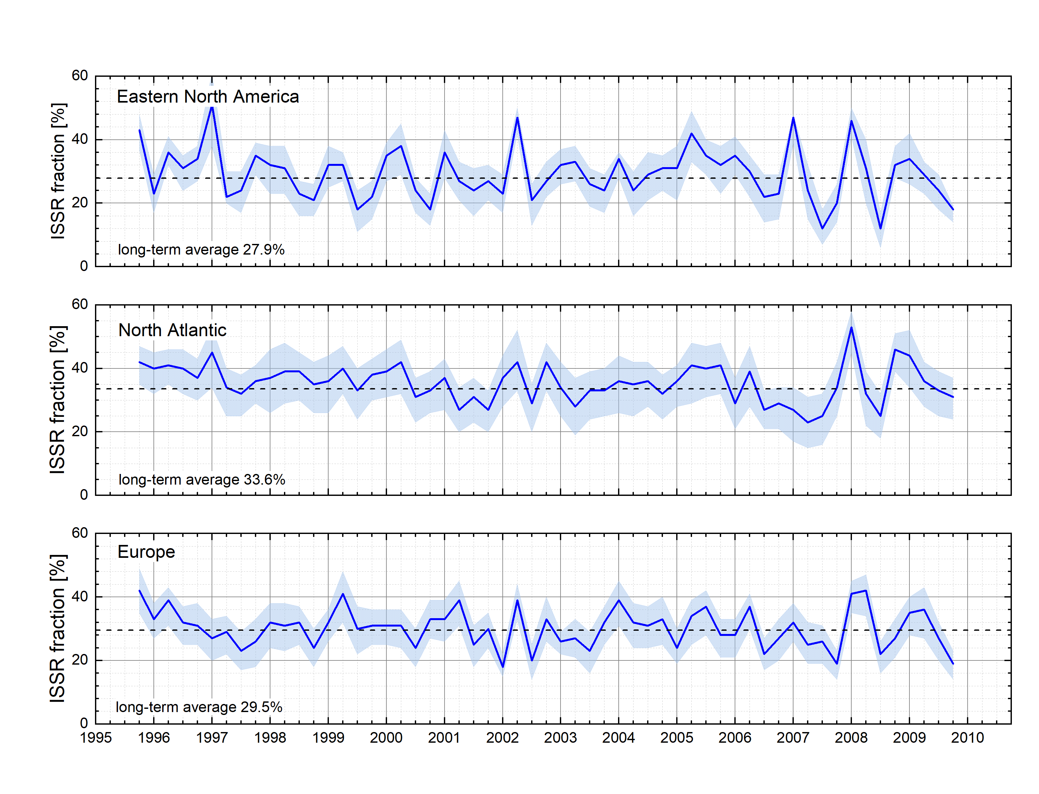
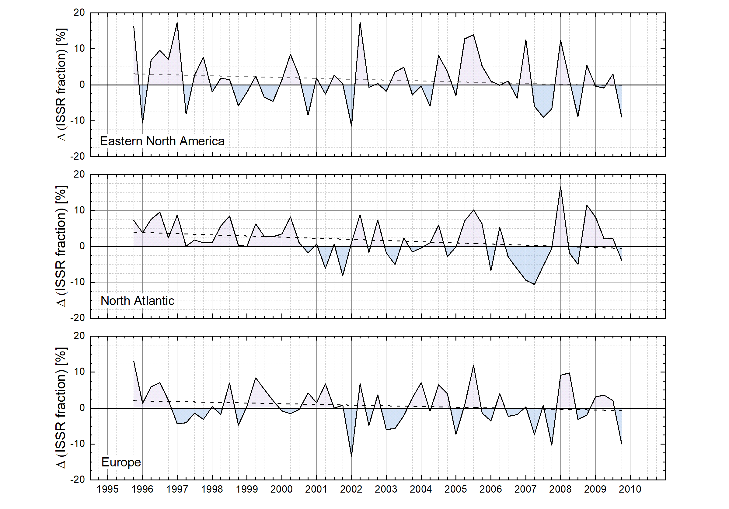
Time Series of ISSR Fraction
Time series of ISSR fraction
De-seasonalised time series of ISSR fraction
Solid lines: average fraction for RHice = 100%.
Shaded areas: average fractions for RHice = 95- 105%.
=> Over the investigated period of 15 years, no significant trends are observed, neither for the occurrence of ISSR nor for the deviation of seasonal ISSR occurrence probabilities from the long-term average.
Petzold et al., ACP, 2020

Slide 12
Summary
MCH => ICH no impact on measuring capabilities, uncertainty: ± (5-6)% RH
IFC @ MOZAIC data set RH_{ice} distribution within physical boundaries:
RH_{ice, min} ≥ 0% , RH_{ice, max} ≤ RH_{ice, hom}
NRT (< 3 days) Data provision for operational validation of CAMS models
Seasonality of ISSR occurrence highest/lowest probability in late winter/summer:
⇒ very good agreement with radio soundings
⇒ very good agreement with high cloud fraction from satellites
15 years data record no significant trends in RH_{ice} and ISSR fraction for all study areas
We aim to use the opportunity of this workshop to identify synergies between CDRs and the IAGOS water vapour products.

