Slide 1
IMPACT ON RADAR
Kapt Vincent Kartodikromo
Brussels
24 Nov 2022

Slide 2
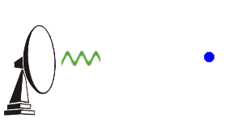
outline
DIY assignment!
RAdio
Detection
And
Ranging
Notes:
On the 4th of November 2015 a Solar Radio Burst caused severe malfunction of ATC radars in Sweden. At the same day several solar flares and a geomagnetic storm were observed. Several experts discussed a supposed impact by these flares and storm, while ignoring the SRB at first. A few weeks later, during the European Space Weather Week (ESWW), prof. Opgenoorth gave an interesting presentation about the incident, focussing on the SRB as well as discussing the flares and geomagnetic storm. The SRB was an obvious cause for those who know a bit about the operation of radars. This is our motivation to elaborate on this topic.

Slide 3
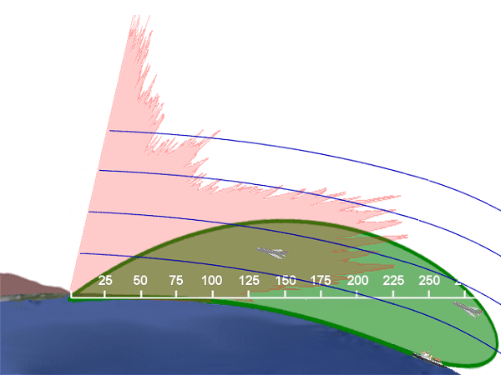
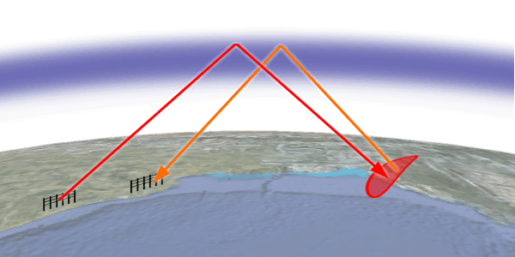
Question 1
HF (3-30MHz)
What frequency band(s) is are used for over the horizon radar? What is the principle behind it?
Certain frequencies can be refracted by the ionosphere
Coverage pattern of OTH Radar (green) vs En-Route Radar (Red)
Principle of Over-The-Horizon Backscatter Radar
Notes:
OTH: range up to 2000NM! (Ducting and multiple “hops”)

Slide 4
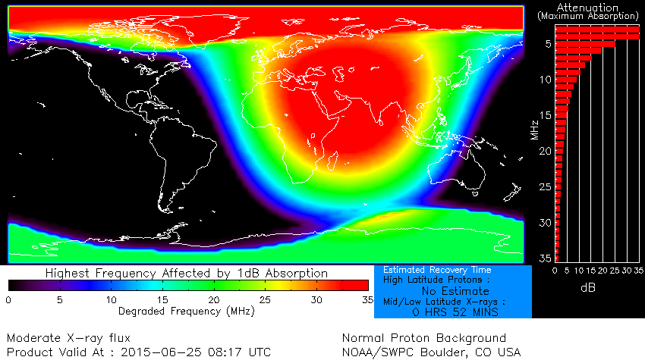
Question 2
What kind of solar phenomenon might impact this type of radar and why?
PCA
Solar Flare

Slide 5
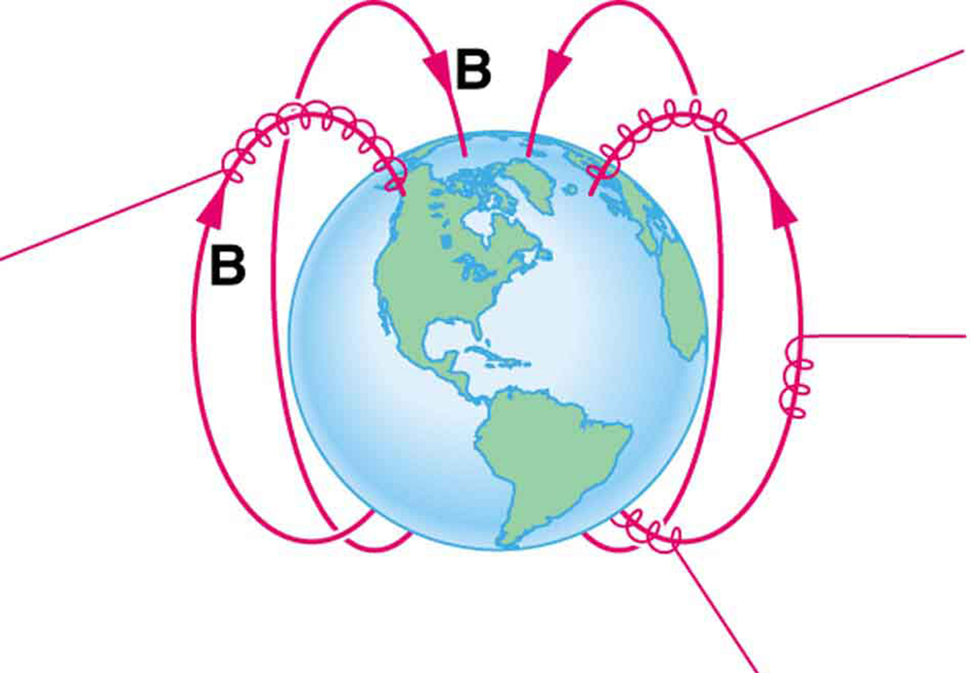
Reminder
Remember Polar Cap Absorption?
Charged particles follow fieldlines to the poles

Slide 6
Reminder
What kind of solar phenomenon might impact this type of radar and why?
PCA
Solar Flare
D-layer ionization results in a HF-blackout.
Solar flare effects may last up to (tens of) minutes to several hours
PCA effects may last up to several days!

Slide 7
Question 3
What frequencies (roughly) are suitable for missile defense and why? What happens below and above these frequencies?
EM-waves below HF are reflected by the ionosphere
EM-waves above the UHF band (above 3000MHz) start to suffer from Tropospheric scatter (attenuation of the signal). Increasing frequency → increasing power needs!

Slide 8
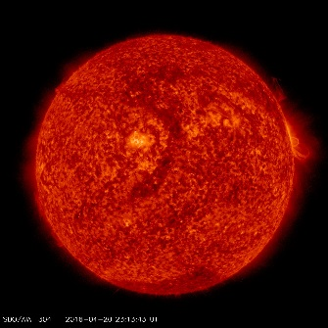
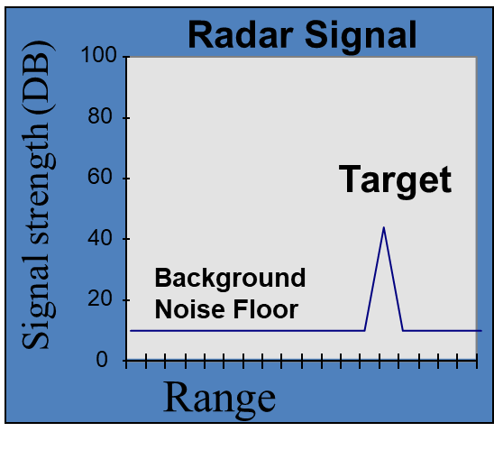
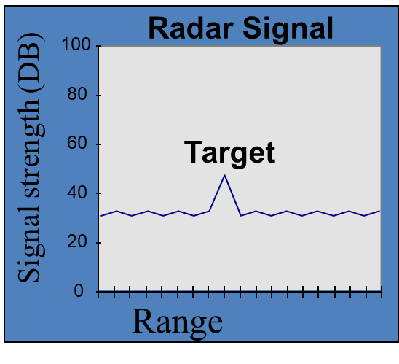
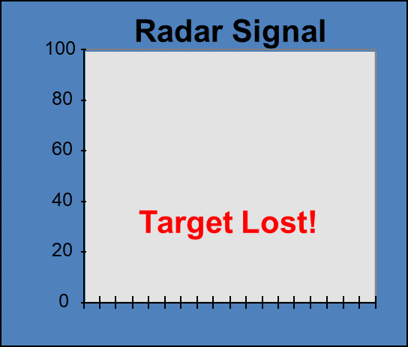
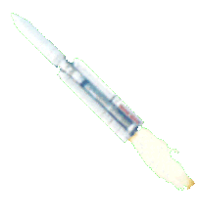
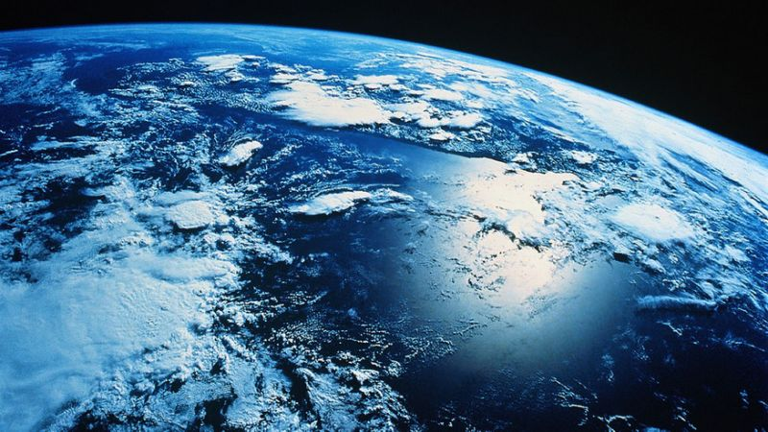
Question 4
What effects do Radars that track satellites suffer from?
Sun emitting
background
UHF radio noise
Solar radio burst at
UHF frequencies
Notes:
Radio bursts can cause the amount of radio wave energy emitted by the sun to increase dramatically over certain Very High Frequencies (VHF) and Super High Frequencies (SHF). This can produce direct radio frequency interference on missile detection or space tracking. In this example a radar receiver is tracking a missile with normal background conditions.
Middle picture: A small radio burst affects transmission of radar frequency causing some noise but no severe effects.
Right picture: Severe radio bursts can cause the radar receiver to lose track of the missile.

Slide 9
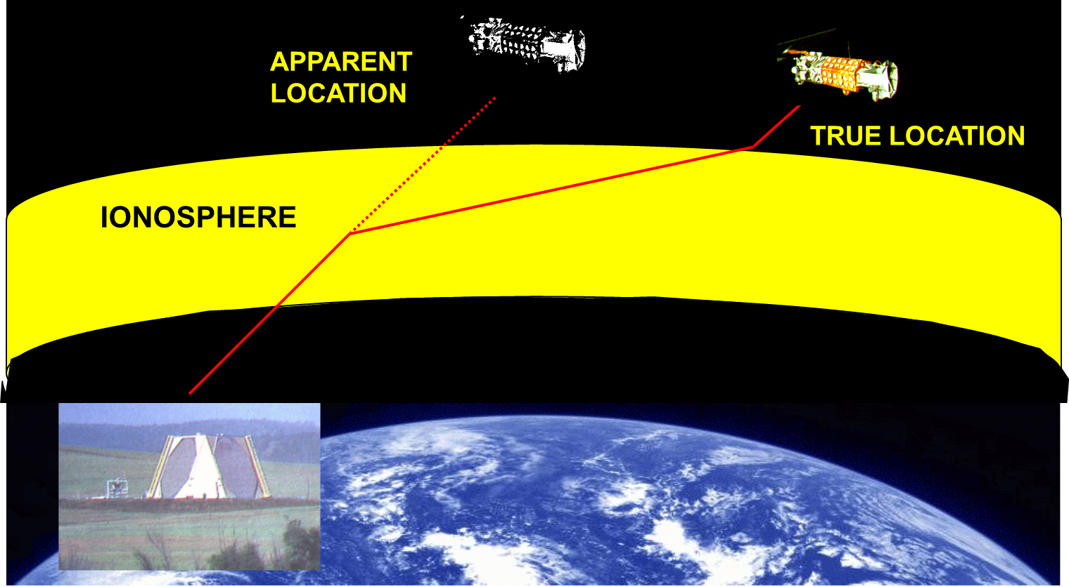
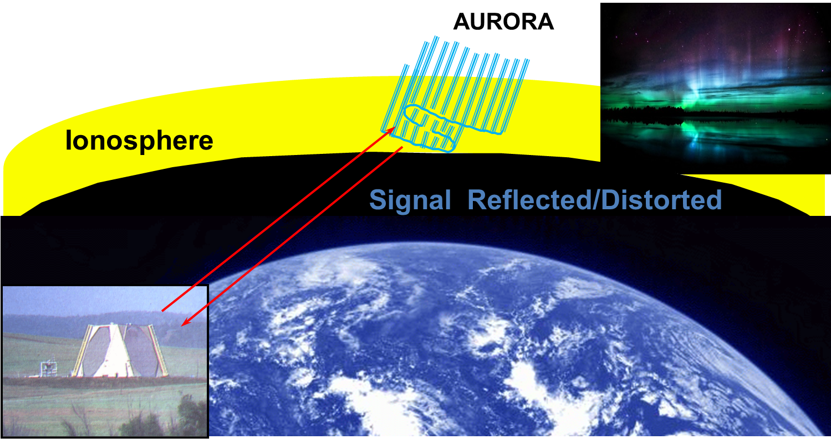
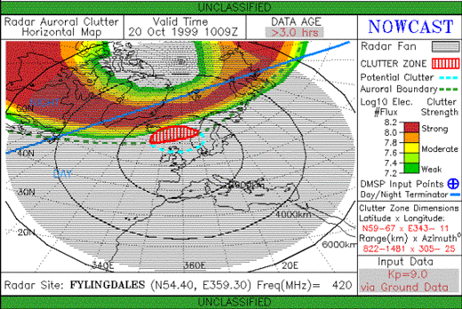
Reminder
Signal Bending (refraction)
Radar Auroral Clutter (RAC)
Notes:
Refraction
The presence of free electrons in the ionosphere causes UHF and SHF radio waves from missile detection and space track radars to be bent (or refracted), as well as slowed (or retarded) somewhat from the speed of light. These effects will produce unacceptable errors in target bearing and range. The bearing (or direction) error is caused by signal bending, while the range (or distance) error is caused by both a longer path length for the refracted signal and a slower signal speed. (NOTE: For range errors, the effect of longer path length dominates for UHF signals, while slower signal speed dominates for SHF signals.)
Radar operators routinely try to compensate for these errors by applying correction factors derived from the predicted ionospheric Total Electron Content (TEC) along the radar beam’s path. These TEC values are based on time of day, season, and the overall level of solar activity. Unfortunately, individual solar and geophysical events will cause unanticipated, short-term variations from the predicted TEC values and correction factors. These variations (which may be either higher or lower than anticipated values) will lead to inaccurate position determinations or difficulty in acquiring targets. Real-time warnings when significant TEC variations are occurring help operators minimize the impacts of their radar’s degraded accuracy.
These bearing and range errors caused by refraction and signal retardation also affect space-based surveillance systems. For example, a space sensor trying to lock on to a ground radio emitter may experience a geolocation error.
RAC (Auroral backscatter)
Pulsed radar echoes backscatter from irregular plasma structures. This can cause abnormal radar signal back-scatter on poleward looking radars.
This happens at the aurora and is called Radar Auroral Clutter (RAC). Systems experience clutter, noise and interference in radar returns when the signal is incident on or passes through the aurora. RAC can produce false targets & tracks. The effect is most noticable when radar beam and geomagnetic field lines are perpendicular.
Eliminating the clutter is not feasible: operators identify and map the RAC as part of their SSA.
Remember: RAC is also an issue for space based radars looking to earth.

Slide 10
Question 5
What does the frequency or wavelength of a Radar system tell you about its accuracy and range?
In general:
The higher the frequency, the more accurate the position and speed of a target.
The higher the frequency, the shorter the range due to attenuation in the atmosphere. Higher frequencies become less likely to be directly impacted by SRB’s

Slide 11
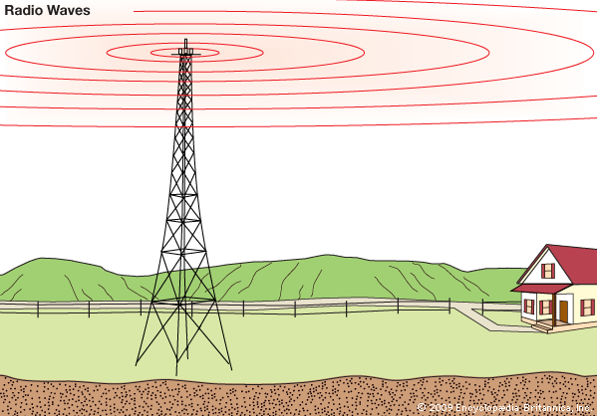
Question 6
What is the main difference between a dipole antenna and a yagi antenna? Which of the two is more susceptible to Space Weather and which Solar phenomena can affect them?
Sidelobe!
Omidirectional vs directional
Notes:
Directional antennas are very sensible in one direction, but have small chance to have the Sun in it’s opening angle.
Omni-directional antennas have a high chance of “seeing” the Sun, but are less sensitive.
Both can be disturbed by SRBs. A light SRB can easily disturb a directional antenna, (if it is in the opening angle!!).
An SRB has to be more powerful to disturb an omin-direcional antenna, but are far more likely to bee seen by the antenna.
7. The Sun can also be seen through a sidelobe!

Slide 12
Question 7
Can a car parking sensor (automotive radar) be impacted by Space Weather?
A car parking sensor works mostly horizontally!!
A car parking sensor operates at high frequencies (60-100GHz) and those signals suffer from attenuation. Signals from the Sun at those frequencies would normally not make it to the surface.

Slide 13
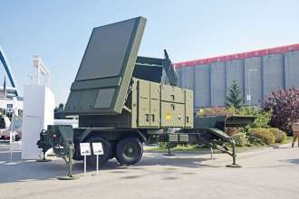
Question 8
What type of Radar does a Patriot system use and is it sensitive to SWx and if so, how is it impacted?
An AN/MPQ-65 Radar
Frequency: C-band (4-8GHz)
Range 100km
Notes:
Suffers from refraction (Tropospheric and ionospheric)
SRB’s can directly impact the Radar.
Patriot Radar = Phased Array TRacking to Intercept Of Target
~C-band (~5GHz)
Radar Set (RS) en Launcher Station (LS)
Raytheon AN/MPQ53 + TPX-46(V)1
Raytheon AN/TSM-165

Slide 14
pulse radar signals
⑥ target data (position etc.)
①
TRANSMITTER
②
②
①
②
③
DUPLEXER
③
TIMER
ANTENNA MOVEMENT
④
③
RECEIVER
θ_{ant} = 0-360°
⑤
⑤
INDICATOR
①
④
SIGNAL PROCESSING
⑥
target data (ρ,θ) or (x,y) or analog video + raster
⑥
Notes:
The information available from a radar receiver may contain as many as several million separate data bits per second. From these and other data, such as the orientation of the antenna, the indicator should present to the observer a continuous, easily understandable, graphic picture of the relative position of radar targets. It should provide size, shape, and insofar as possible, indications of the type of targets. A cathode-ray tube (crt) fulfills these requirements to an astonishing degree. The cathode-ray tube's principal shortcoming is that it cannot present a true three-dimensional picture.
The fundamental geometrical quantities involved in radar displays are the range, azimuth angle (or bearing), and elevation angle. These displays relate the position of a radar target to the origin at the antenna.
http://www.radartutorial.eu/12.scopes/sc04.en.html

Slide 15
Radar equation
$$R_{max}={\left[\frac{P_{t}∙G^{2}∙λ^{2}∙σ}{{\left(4π\right)}^{3}∙S_{min}∙L}\right]}^{1/4}$$
$$L=L_{int}∙L_{refl}∙L_{atm}$$
Notes:
Bridge between ‘Block diagram’ & ‘Specifications’. The radar equation elegantly shows the most important aspects of radar technology.
R_{max} = maximum detectable range
P_{t} = transmitted power
G = antenna gain [Remember: antenna gain is directly related to its directivity.]
𝜆 = wavelength
𝜎 = radar cross section
S_{min} = minimum detectable signal
L = losses
L_{int} = internal losses
L_{refl} = reflection losses
L_{atml} = atmospheric losses
[G^2 * 𝜆^2 = Gt * Ar = Gt * Gr * 𝜆^2 = G * G * 𝜆^2 (want Gr = Gt)]

Slide 16
Radar equation inverted
$$S_{min}=\frac{P_{t}∙G^{2}∙λ^{2}∙σ}{{\left(4π\right)}^{3}∙{R_{max}}^{4}∙L}$$
Notes:
Calculate S_{min} and compare to a strong SRB.
Assume: G=1; λ=1; σ=1; L=1; R_{max}=500km.

Slide 17
SWx impact: srb
Radar interference:
Lasts from a few minutes to hours
Generally the larger the flare, the greater intensity of the radio burst
Only affects the sun-lit side of the earth
Radio bursts directly interfere with the radar signals, causing false returns or false targeting
Notes:
SRB are associated with flares & CMEs. If they are strong enough, they are able to jam/interfere with a radar. Especially the far looking radars, as these are more sensitive. After all, the detecting threshold of the receiver ~ 1/R^4.
Don’t forget there are many other (artificial) sources that might cause inteference, e.g. jamming.
Receive systems are designed to include protective circuitry between the antenna and receiver to filter out off-frequency signals. This prevents or limits interference, desensitization, or burnout. Electromagnetic interference can be reduced or eliminated by using various suppression techniques. The amount of EMI that is produced by a radio transmitter can be controlled by limiting bandwidth, and using electronic filtering networks and metallic shielding. Depending upon the system, these protective devices may include filters, multicouplers, preselectors, and so forth. These devices can minimize interference caused by inadequate frequency separation or poor physical isolation between transmit and receive antennas.

Slide 18
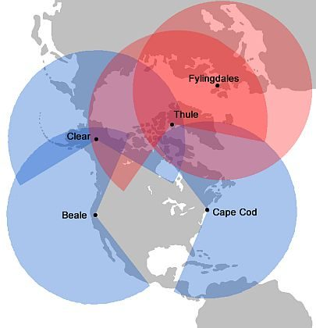
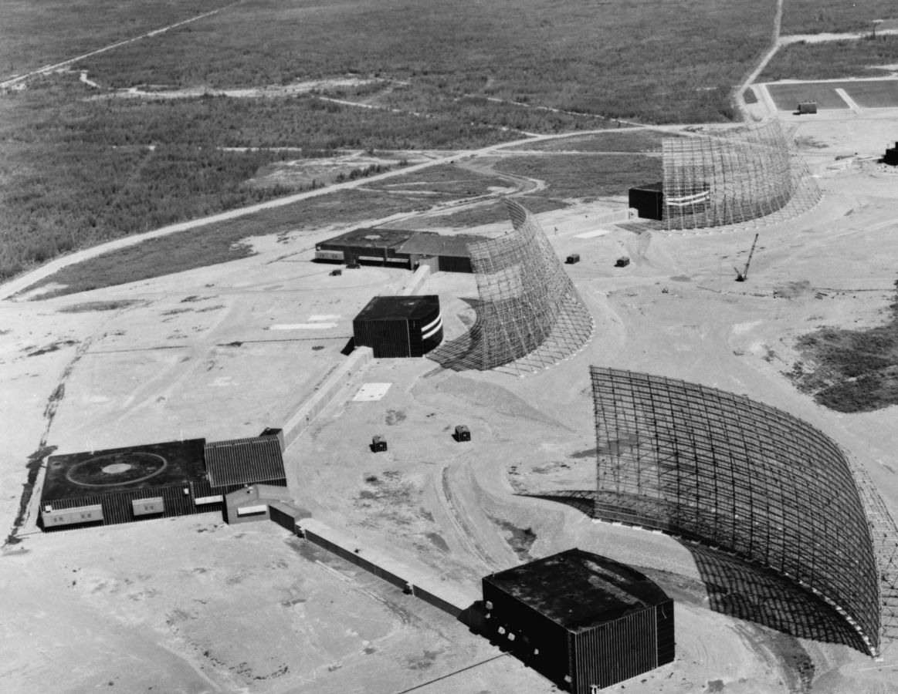
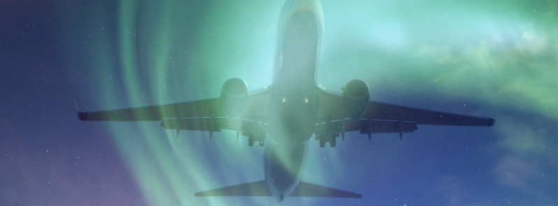
Two cases
1967
2015
Notes:
@ 1942: discovery of SRB
@ 1967: on the brink of a nuclear war
@ 2015: ATC lost control
http://www.spaceacademy.net.au/library/notes/firstsolburst.htm
https://news.agu.org/press-release/1967-solar-storm-nearly-took-us-to-brink-of-war/
https://www.lfv.se/en/news/news-2016/full-capacity-after-90-minutes-radar-loss

Slide 19
Spwx impact: Ionospheric refraction
Signal bending:
Caused by TEC gradients
Associated with geomagnetic storms
Mainly affects the night side of the earth
Notes:
TEC gradients in the ionosphere cause refraction of radar beams looking to or from space. Think of Space Object Tracking (SOT), Ballistic Missile Defense (BMD) and satellite based radars for remote sensing or surveillance.
If radar is disturbed by the ionosphere, we can use it to assess the ionosphere too. EISCAT: radar observations of the ionosphere.
https://en.wikipedia.org/wiki/EISCAT

Slide 20
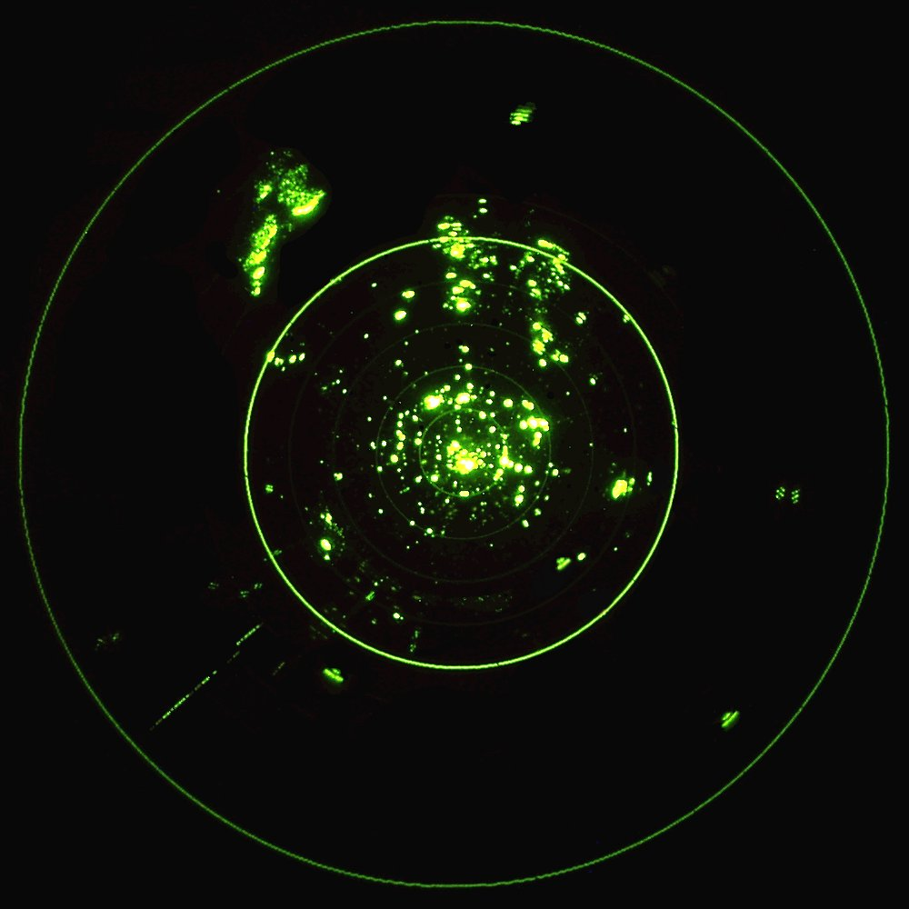
Auroral backscatter
Backscatter/clutter
Can affect BMD and SOT radars in polar areas

Slide 21
Summary
SPWX impact on radar is caused by:
Solar Radio Bursts (SRB)
Ionospheric gradients & aurora
And dependant on the radar’s:
Elevation, azimuth & beam width
Frequency & sensitivity
Circuitry & software

