Slide 1
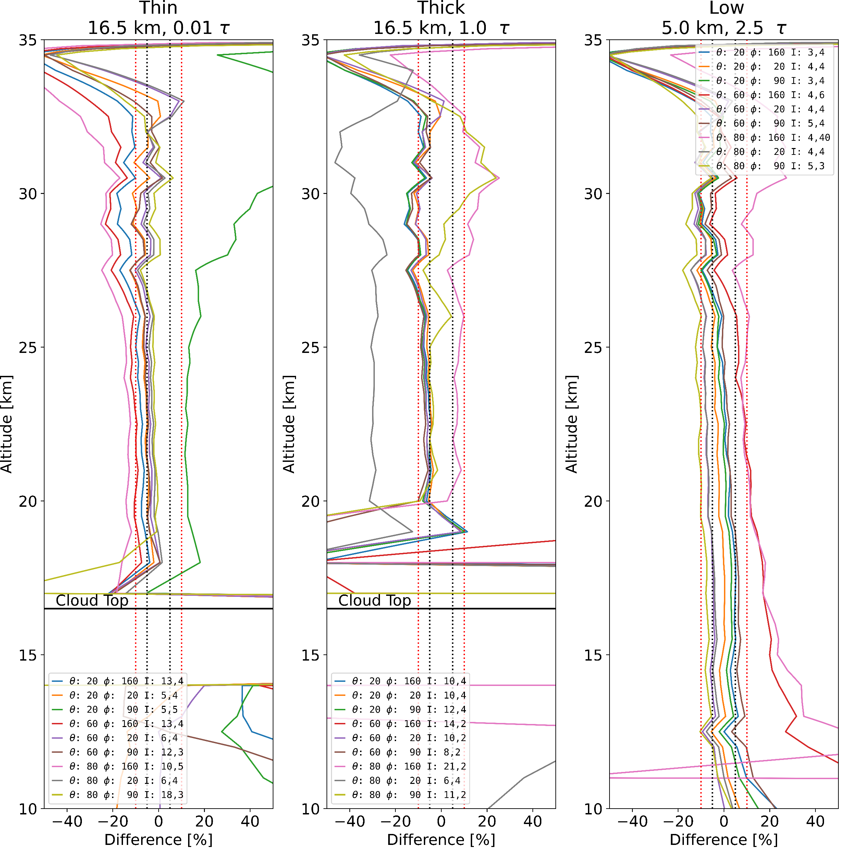
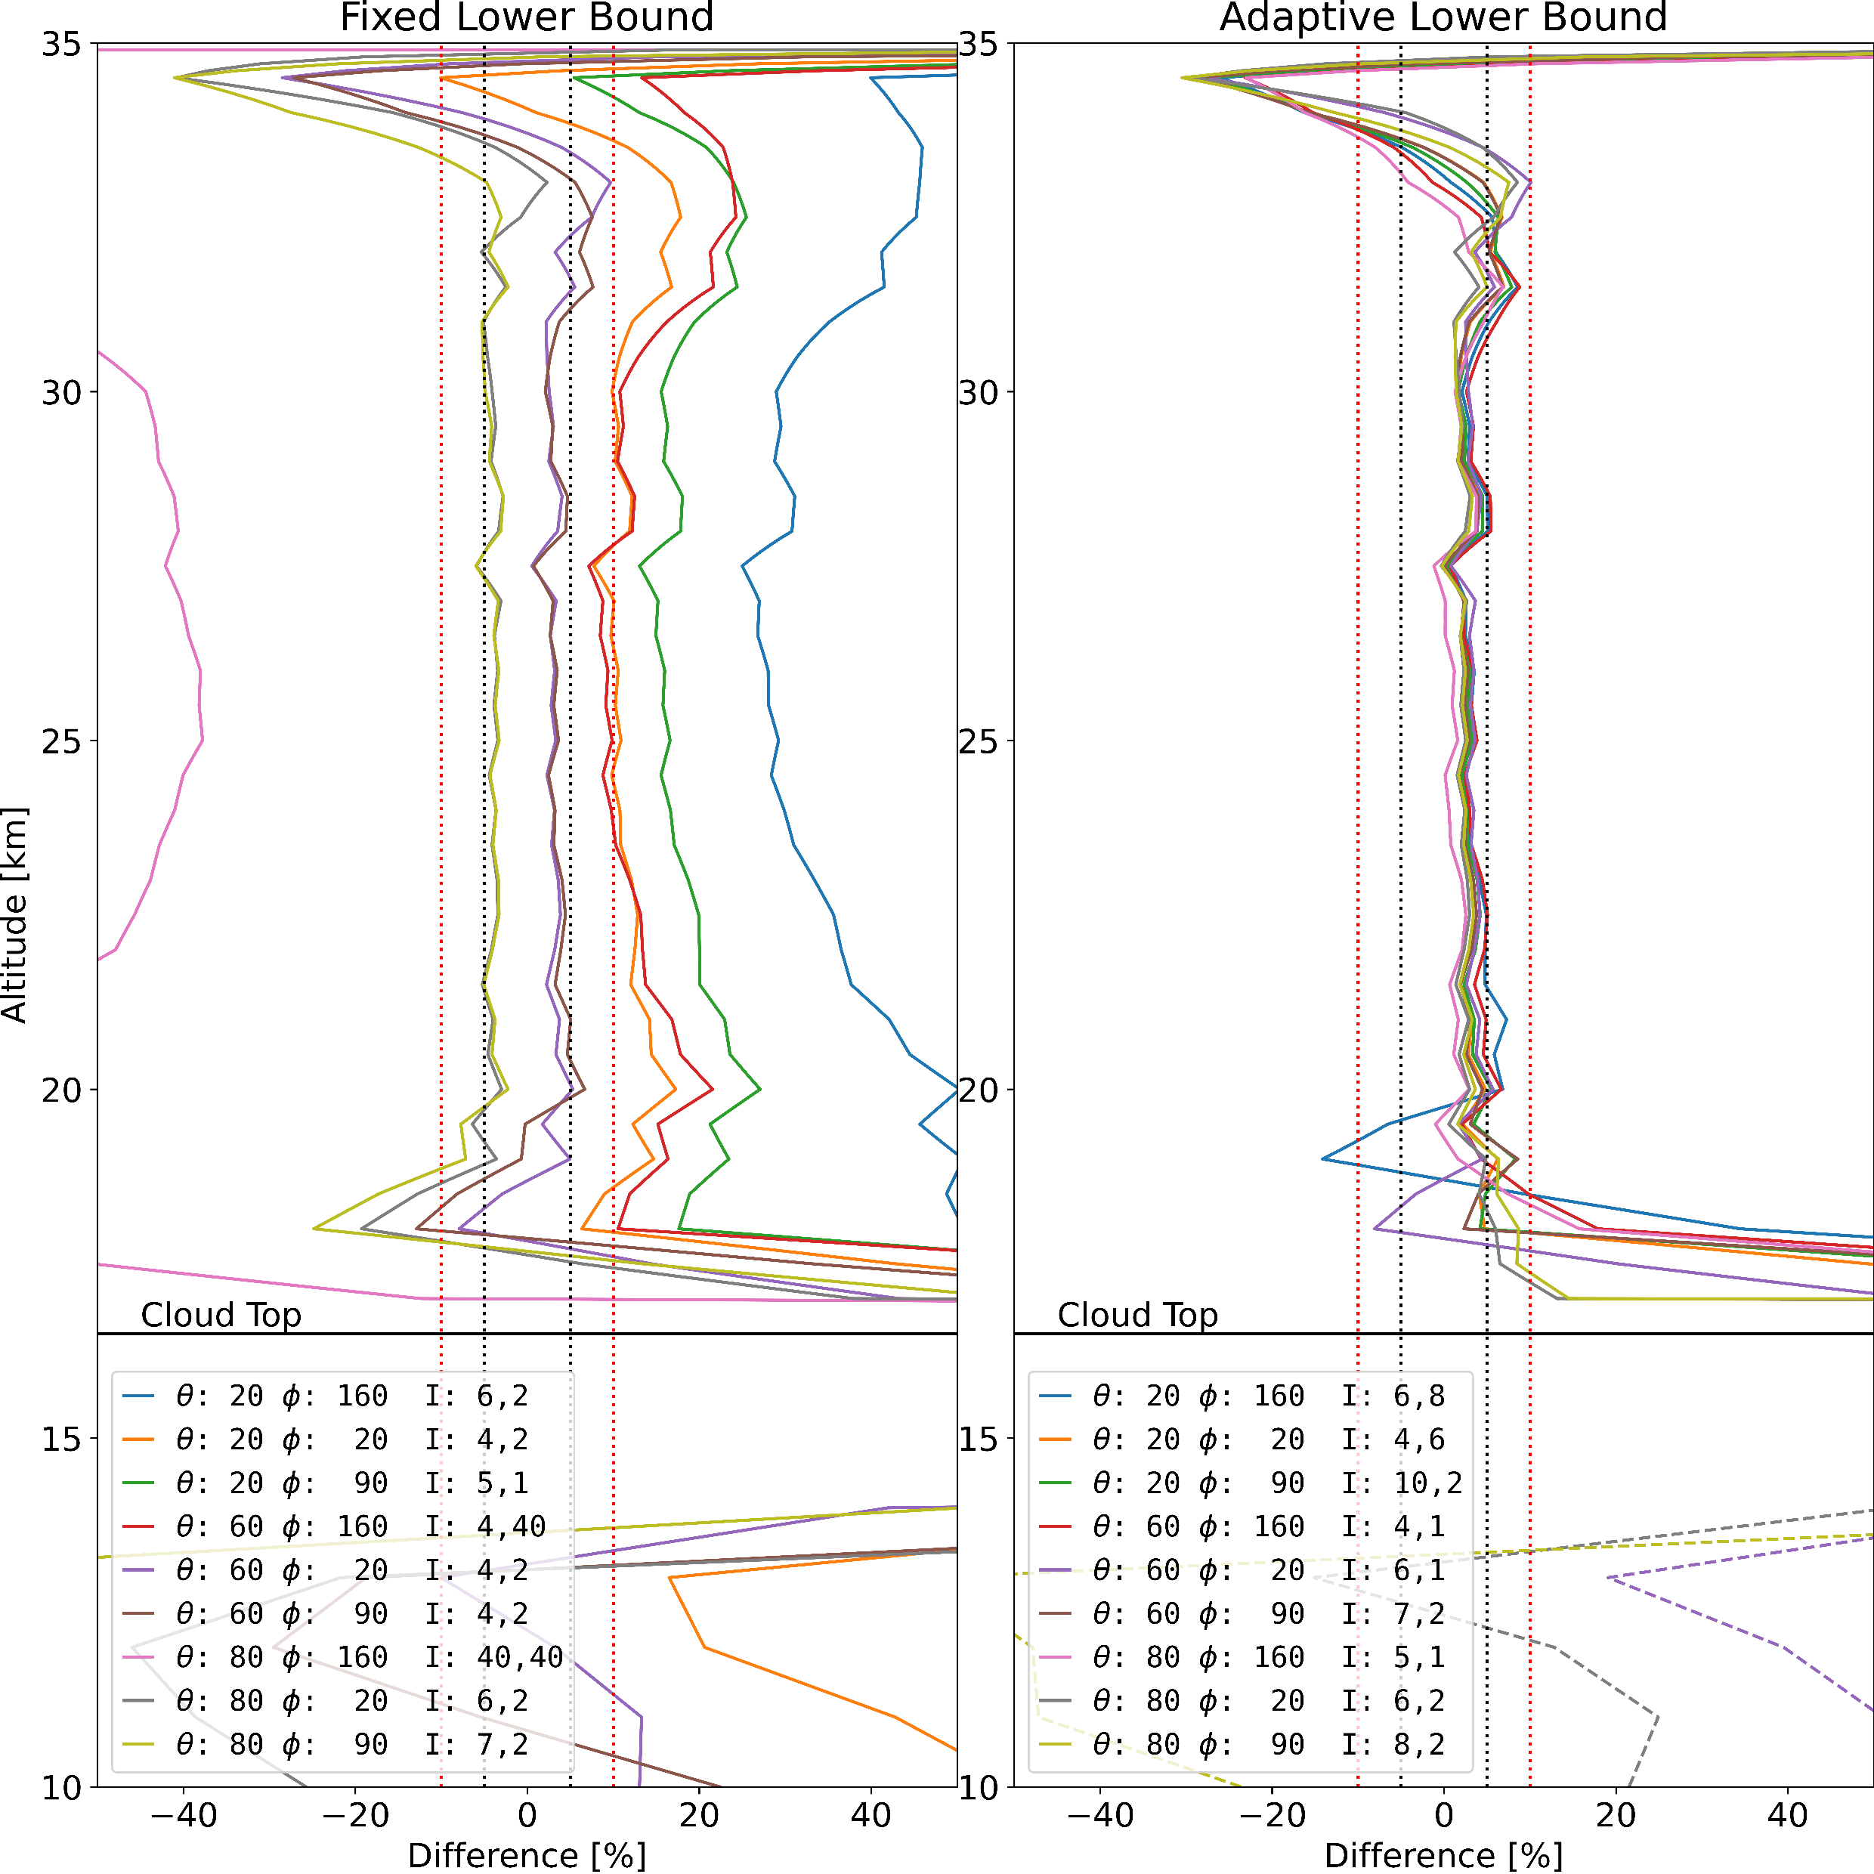
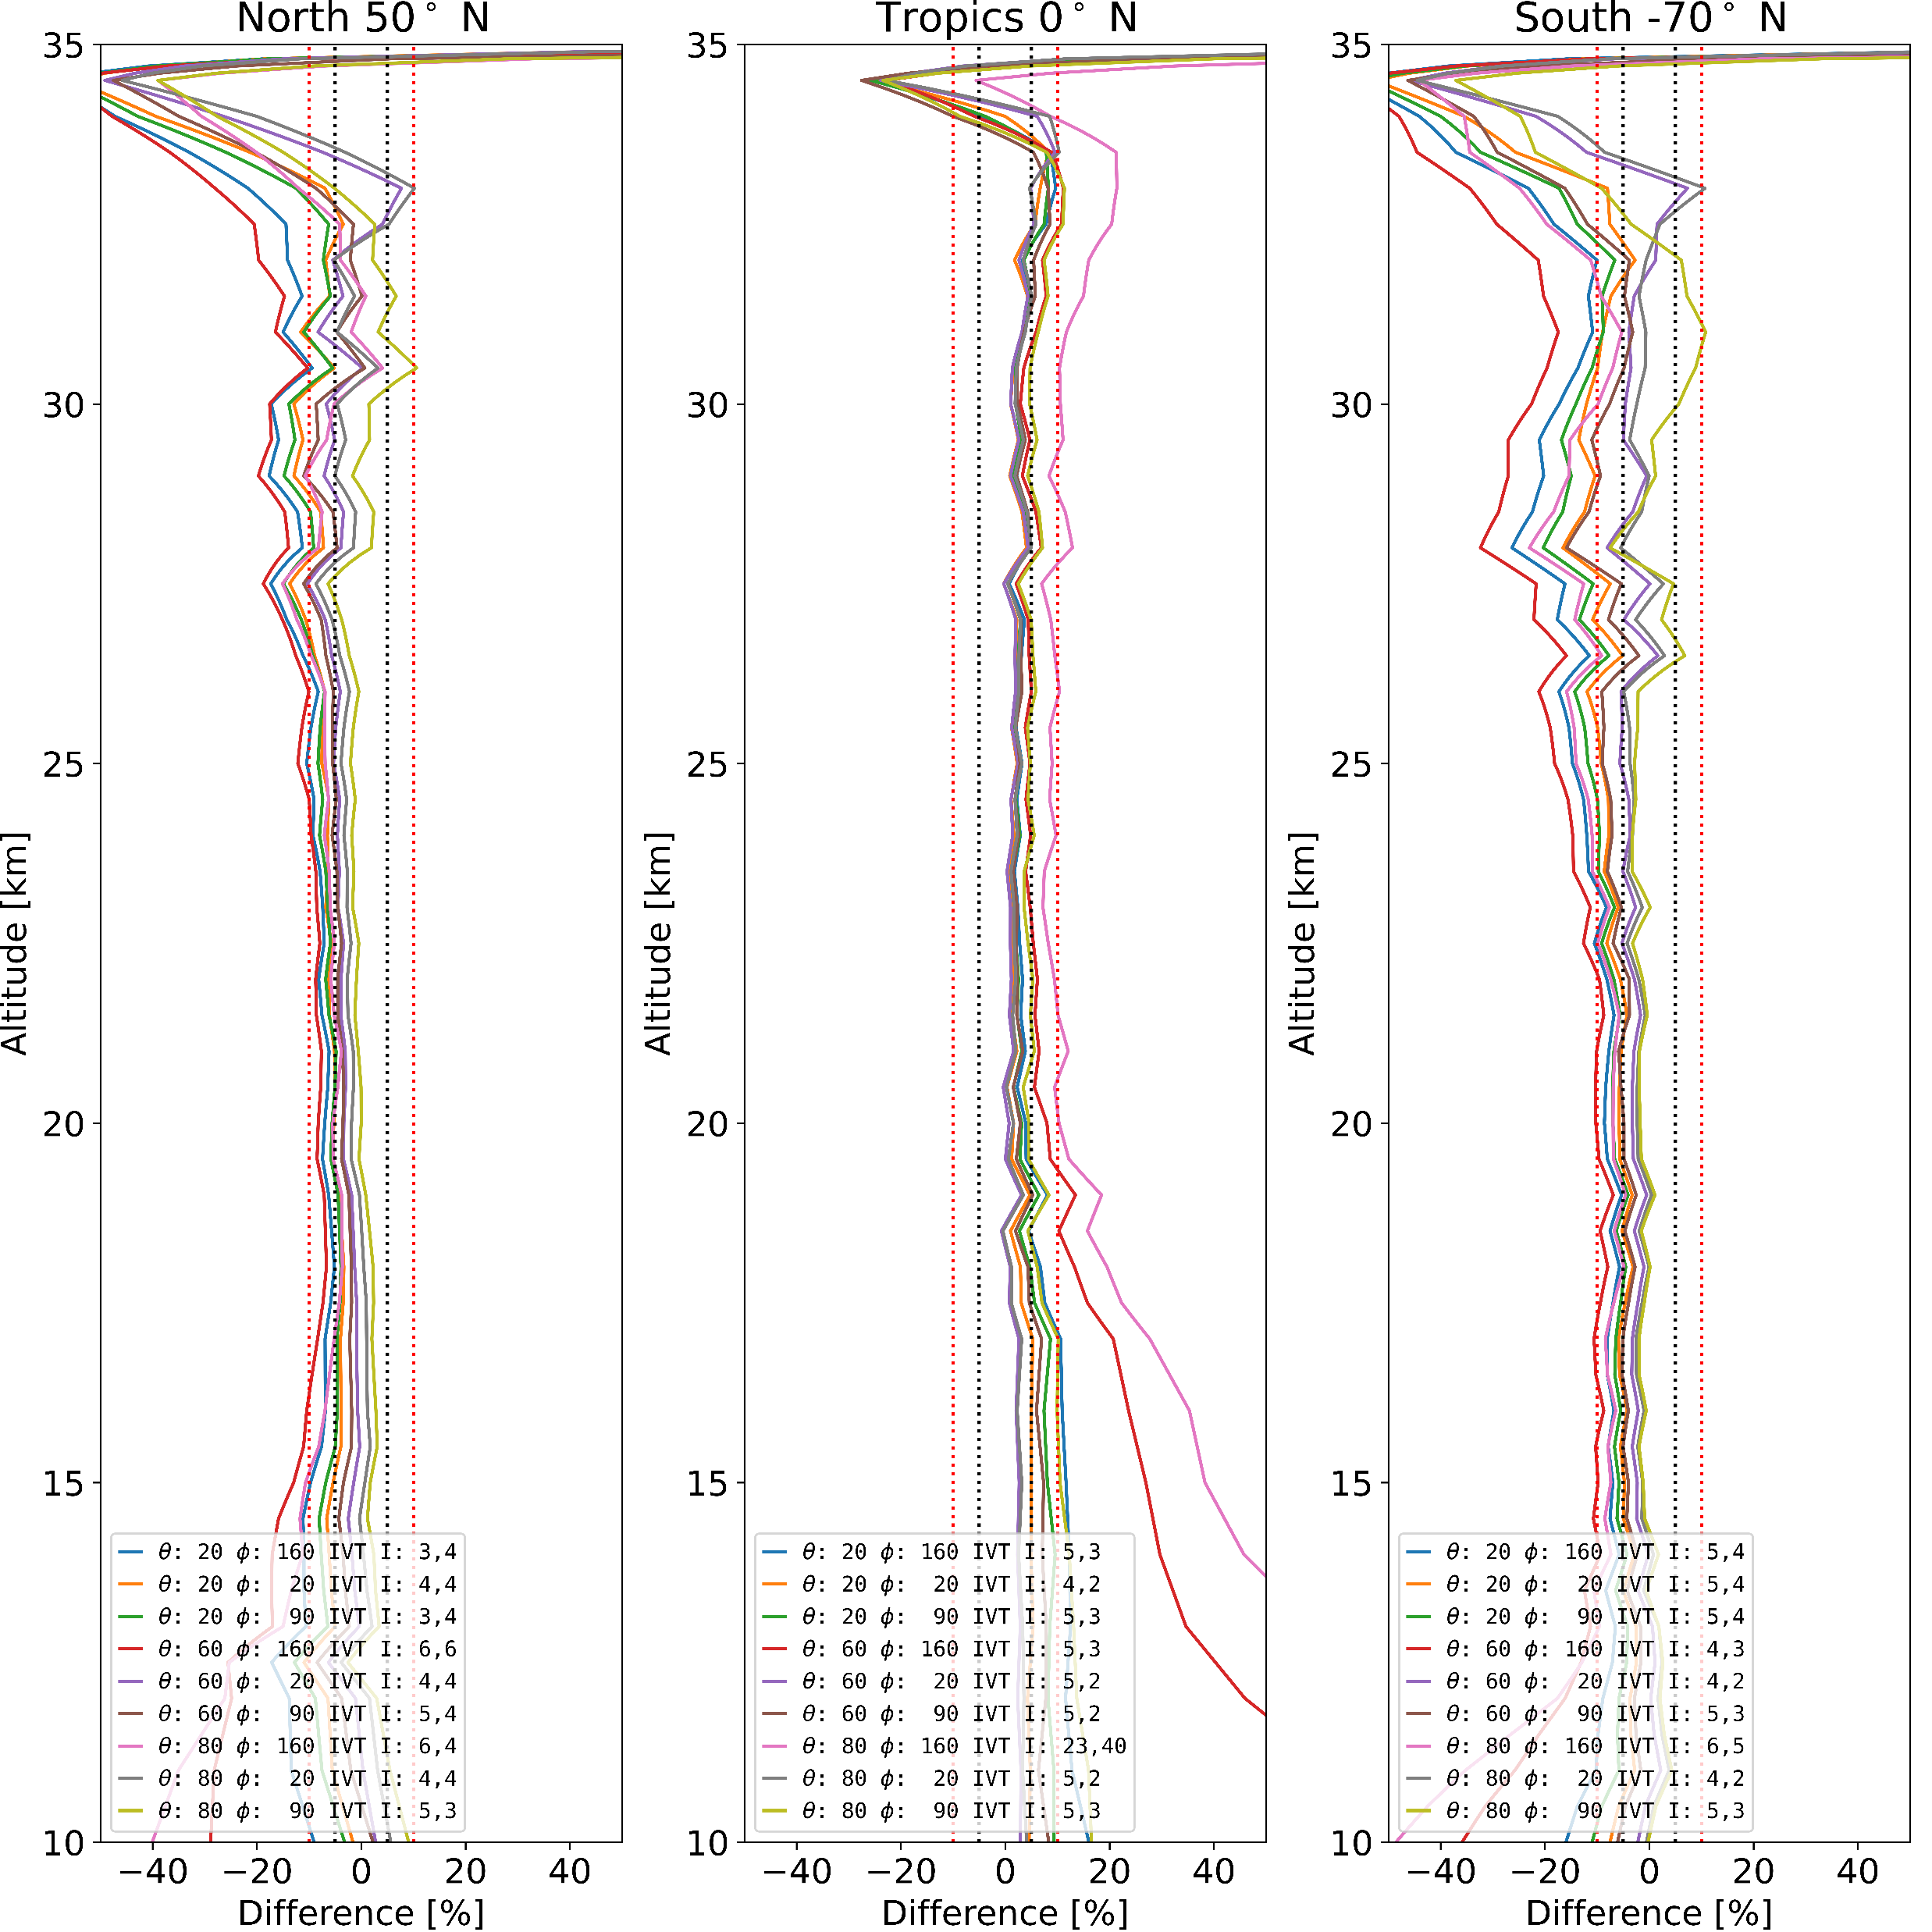
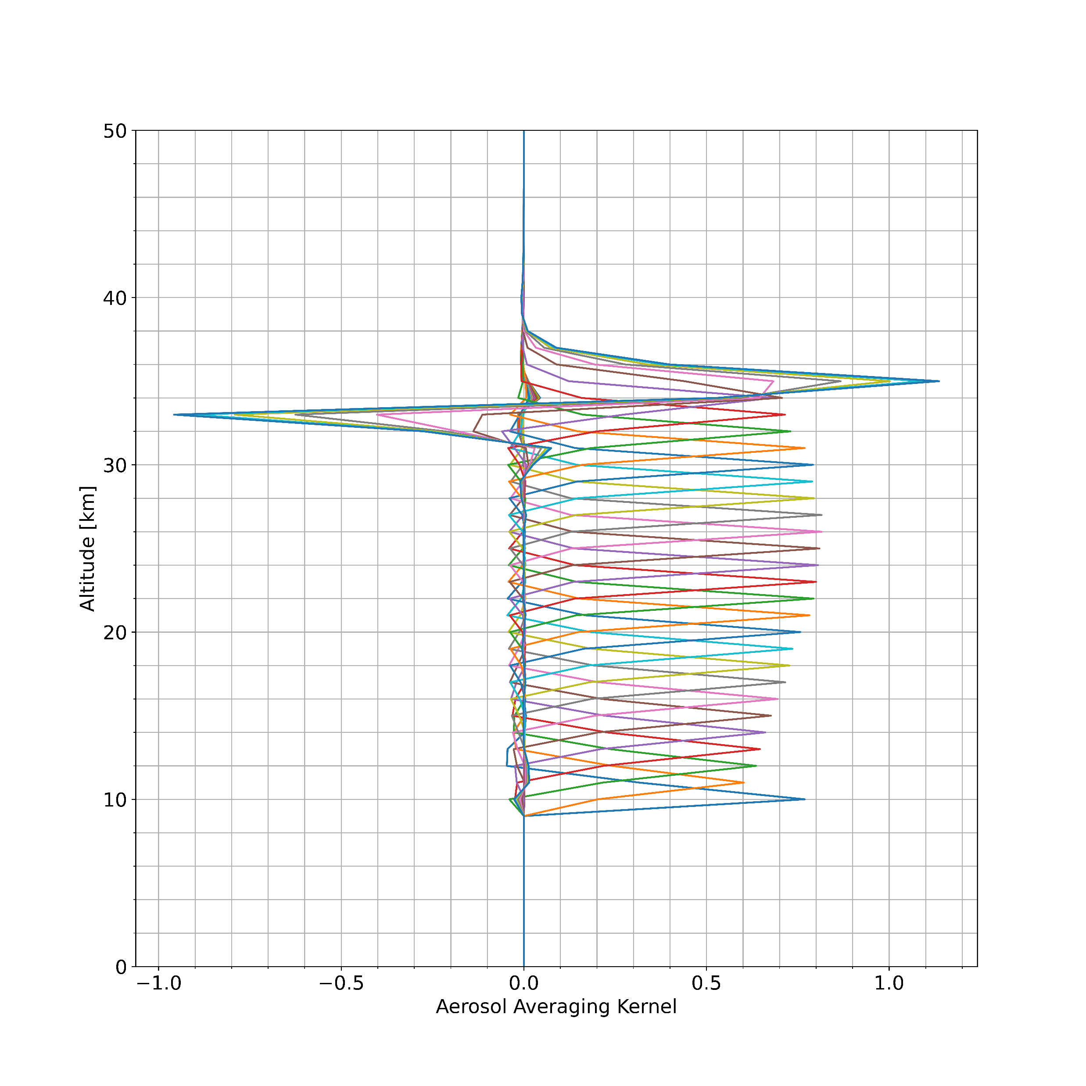
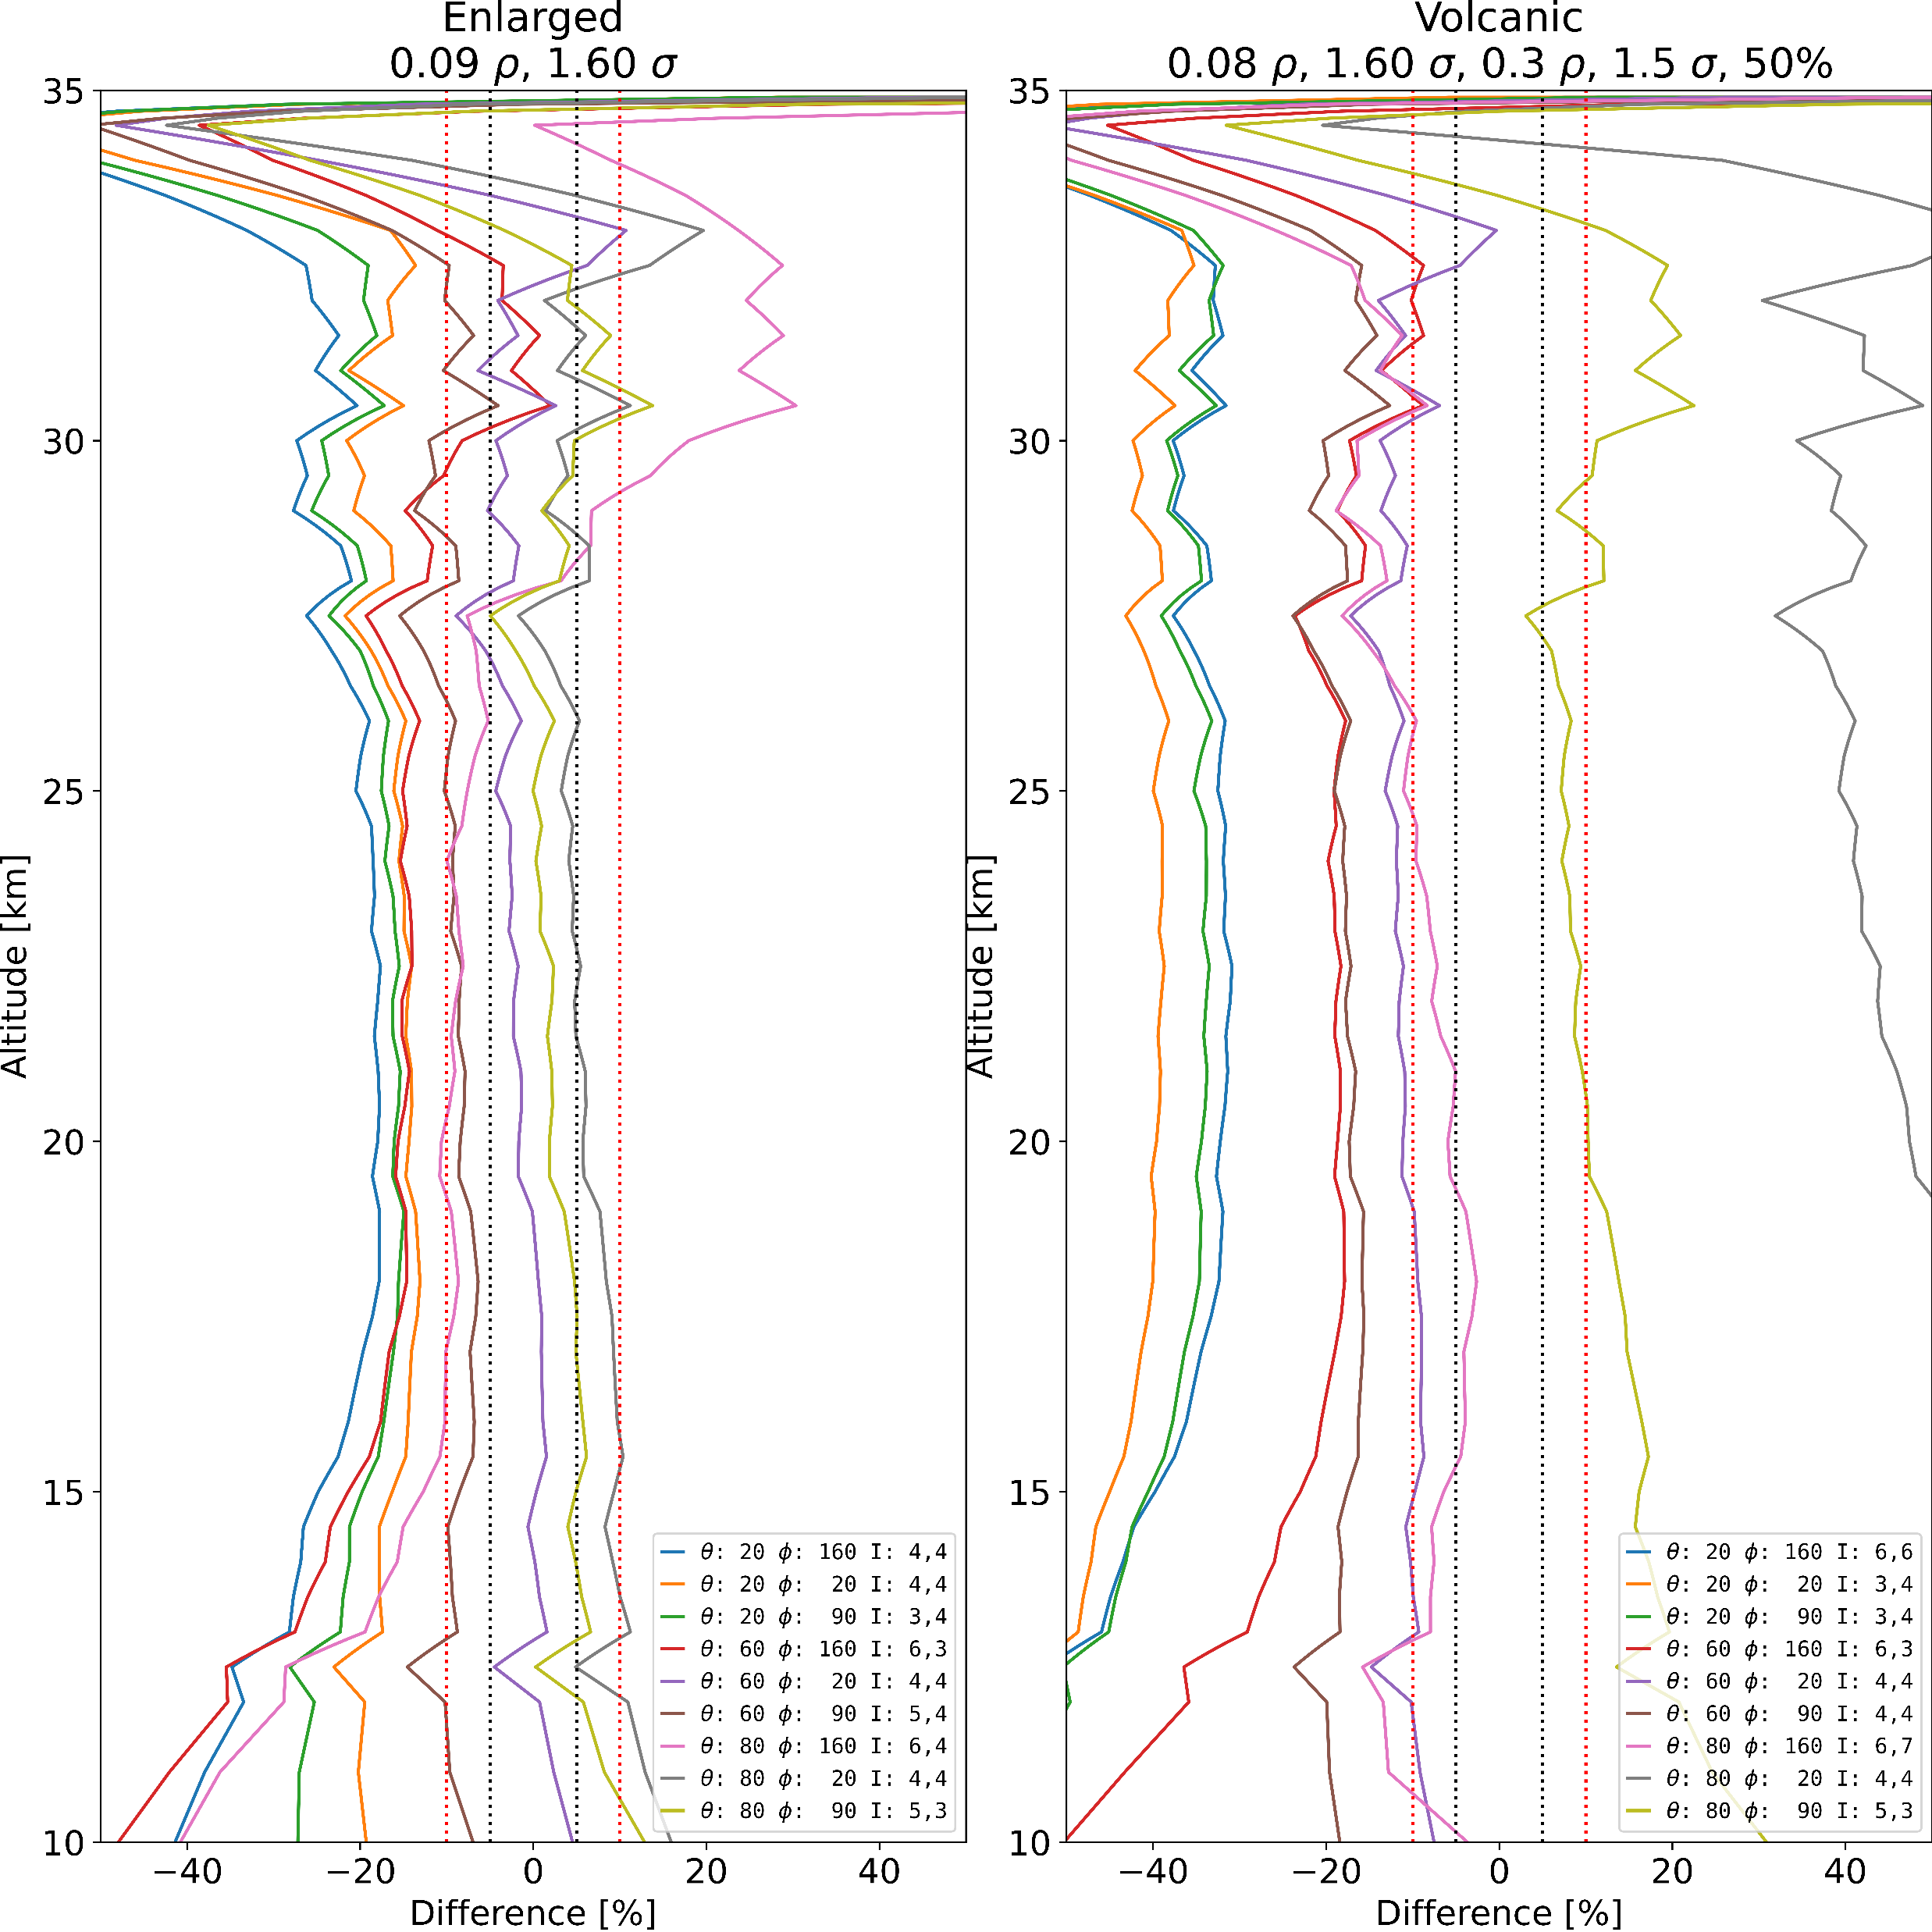
The ALTIUS Bright Limb Aerosol Retrieval Algorithm: Current Status and Future Developments
Poster Session #2
Bion Larson, Daniel J. Zawada, Adam Bourassa, Doug A. Degenstein
Institute of Space and Atmospheric Studies, University of Saskatchewan, Canada
Background
The Atmospheric Limb Tracker for the Investigation of the Upcoming Stratosphere (ALTIUS) is a high spatial resolution spectral imager designed to measure ozone and other trace species in the stratosphere. A stratospheric aerosol retrieval is included to provide input for the ozone retrieval, and an official stratospheric aerosol secondary product is expected.
Here we describe the stratospheric aerosol retrieval algorithm used in bright limb mode, expected performance and planned modifications for the official secondary product.
Algorithm and Features
The Altius aerosol retrieval algorithm is based on the OSIRIS v5 algorithm (Bourassa, et al., 2012) with a wavelength of 745 nm.
Additional features include:
Three variants of the Levenberg-Marquardt (LM) algorithm, which modifies the LHS of the retrieval equation to reduce the number of iterations until convergence. The quickest convergence has been observed with Fletcher.
Fletcher $\left(K^{T}S_{y}^{−1}K+S_{a}^{−1}+γ{Idiag(K}^{T}S_{y}^{−1}K)\right) {\vec{x}}^{′}$
Prior $\left(K^{T}S_{y}^{−1}K+(γ+1)S_{a}^{−1}\right) {\vec{x}}^{′}$
Identity $\left(K^{T}S_{y}^{−1}K+S_{a}^{−1}+γI\right) {\vec{x}}^{′}$
Two methods to check for convergence. The default method calculates the derivative of the error variance:
$\frac{\vec{x}}{\text{len}(\vec{x})}(K^{T}S_{a}^{−1}\left({\vec{y}}_{meas} −\vec{y_{rtv}}\right)−S_{a}^{−1}(\vec{x} −\vec{x_{a}}))<0.1$
The alternative method uses $χ^{2}$, calculated with and without the LM term, to determine convergence:
$1.0< \frac{χ_{LM}^{2}}{χ^{2}}<\text{convergence} \text{ratio}$
Normalization using high altitude measurements, typically from 40 km to 45 km.
Performance
Assessment of the performance of the algorithm is an ongoing process. Performance is assessed using the full instrument model, still under development, and a simulated atmosphere generated by Sasktran. The full instrument model accounts for straylight, the full spectral response function, noise and other instrument effects.
Performance with different particle profiles is tested by altering the aerosol of the simulated atmosphere while maintaining an assumed profile with a radius of 0.08 µm and a mode width of 1.60 for the retrieval. Enlarging the particle radius by 12.5% to 0.09 µm increases the percent difference to over 10% for most geometries, with forward scattering geometries affected more strongly. Simulating a volcanic eruption by using an aerosol composed equally of a large radius particle and a normal particle further degrades performance, with most geometries having a percent difference of over 20%.
$$\left(K^{T}S_{y}^{−1}K+S_{a}^{−1}\right) {\vec{x}}^{′}=K^{T}S_{y}^{−1}\left({\vec{y}}_{meas} −\vec{y_{rtv}}\right)−S_{a}^{−1}(\vec{x} −\vec{x_{a}})$$
Notable features of the aerosol retrieval algorithm include:
An adaptive lower bound on the retrieval altitudes. To improve performance in the presence of clouds, the lowest altitude included in the retrieval is dynamically adjusted, removing altitudes with exceptionally poor fit and adding them if the fit improves. Adaptive lower bound improves the retrieval agreement and convergence speed.
The percent difference between simulated extinction and retrieved extinction for a range of geometries, with the inclusion of clouds in the simulated atmosphere, using the full instrument model. Only the northern latitude (50° N) is plotted.
Performance in the presence of ice clouds is tested by simply adding them to the atmosphere. The ice clouds are given a particle size of 20 µm and FWHM of 1 km, and an optical depth defined for 750 nm.
The presence of clouds imposes a limit on lowest useful altitude of the retrieval. Thin clouds with an optical depth of 0.01 increase the precent difference by a few percent for almost all geometries. Thick clouds with an optical depth of 1.0 affect the retrieval at higher altitudes from the cloud top height, but do not significantly alter the percent difference otherwise, excepting a few geometries. Dense clouds at lower altitudes do not affect the retrieval altitude range much but increase the precent difference by up to 20%.
Planned Modifications
In order to improve the aerosol retrieval for the expected promotion to secondary product, a multi-wavelength aerosol retrieval, based on the OSIRIS v7 algorithm (Rieger et al., 2019), is planned. The goal of the multi-wavelength retrieval is to use a weighted sum of the measurements from multiple wavelengths to maximize sensitivity to extinction and minimize noise at each retrieval altitude.
Conclusions
The current ALTIUS aerosol retrieval achieves agreement of 20% difference or better under normal conditions, with a resolution of 2 km on an altitude grid of 500 m. Features such as an adaptive lower bound allow for retrievals in the presence of ice clouds. Deviations from the assumed particle radius and mode width degrade performance, especially for volcanic conditions. A multi-wavelength version of the algorithm is expected to be implemented in the future.
References
Bourassa, A. E., Rieger, L. A., Lloyd, N. D., and Degenstein, D. A.: Odin-OSIRIS stratospheric aerosol data product and SAGE III intercomparison, Atmos. Chem. Phys., 12, 605–614, https://doi.org/10.5194/acp-12-605-2012, 2012.
Rieger, L. A., Zawada, D., J, Bourassa, A. E., & Degenstein, D. A.: A multiwavelength retrieval approach for improved OSIRIS aerosol extinction retrievals. Journal of Geophysical Research: Atmospheres, 124, 7286–7307. https://doi.org/10. 1029/2018JD029897, 2019
The percent difference between simulated extinction and retrieved extinction, with stratospheric clouds, for a range of geometries with a fixed lower bound on the retrieval and an adaptive lower bound. Ɵ is the solar zenith angle, Ø is the solar azimuth angle and I indicates the number of iterations taken. The black line indicates a 5% difference, and the red dotted line indicates 10% difference. Made using a simplified instrument model.
The percent difference between simulated extinction and retrieved extinction for a range of geometries, using the full instrument model.
Sensitivity to solar geometry and latitude is assessed using an atmosphere without clouds, an albedo of 0.3, and an aerosol profile in the 50th percentile. The aerosol is modelled as a single size with a radius of 0.08 µm and mode width of 1.60. The retrieved profile is within 20% of the simulated atmosphere for most geometries, with some bias evident.
Tikhonov regularization using 2nd derivative terms for the main altitudes and 1st derivative terms to constrain the retrieved profile shape in the high altitudes. A typical resolution is 2 kilometers for a retrieval grid of 500 m.
Averaging kernel weights from a retrieval using standard settings and the full instrument model. For clarity only every third row of the matrix is plotted.
The percent difference between simulated extinction and retrieved extinction for a two different particle size profiles, using the full instrument model. Only the northern latitude (50° N) is plotted.
Atmospheric Limb Workshop 2023 - Brussels, Belgium bil104@usask.ca

