Slide 1
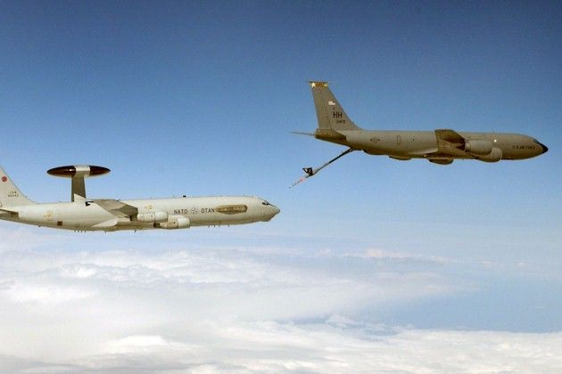
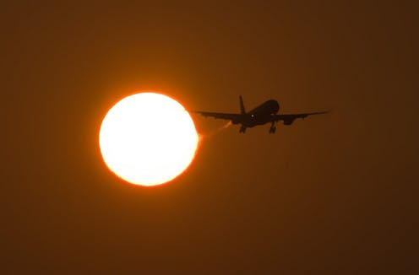
Impact on Aviation
Focus on radiations
Capt Bastien Van Belleghem
Brussels
25 May 2023
Notes:
As you can expect, space weather can perturb the aviation sector in many ways. On this chapter I will focus mainly on the effect of solar radiation on aviation.

Slide 2
Outline
Introduction
  Radiation
    GCR
    Solar Energetic Particles
  Radiation Regulation
Impact of radiation on aviation
  Impact on Crew and Passengers
  Impact on Avionics
Indirect impacts of SWx
Conclusion
Notes:
Here is the outline of this course. I will start with a quite long introduction about the sources of radiation and the regulations relative to this hazard.
In a second part, I will introduce why the aviation sector is subject to hazard linked to solar radiation. I will describe the impact of space weather on the crew, the passengers and the avionics on-board.
At the end of the course I will finish with the indirect impacts of space weather and a short conclusion.

Slide 3
Radiation
Radiation
  GCR and Solar particles
  Penetrate the atmosphere
    Latitude
    Altitude
  Effective dose
    Measured in Sievert (Sv)
    Linear correlation with risk of cancer
Notes:
Radiation in Earth atmosphere originates from Galactic Cosmic Rays and Solar particles. Those particles will penetrate the Earth atmosphere at various altitude and latitude.
Most of the particles will be trapped in magnetic field line (Van Allen Radiation Belts). Particles untrapped will penetrate Earth firstly in Polar Regions. The particles will follow GeoMagnetic Field lines up to the Poles.
High-energy cosmic rays and solar particles incident on the Earth spawn a multitude of other high-energy particles through nuclear interactions in the upper atmosphere. These high-energy particles generate secondary particles that reach a maximum flux at about 18 km and are then progressively attenuated by the atmosphere so that only the most penetrating component can be measured on the ground. Typically, at aircraft cruising altitudes the flux of ionising
radiation is ~ 300 times higher than at sea level and consequently these particles can have an impact on aircraft passengers and crew because of the increased exposure to ionising radiation.
The effective dose, which is the absorbed dose weighted for the radiosensitivity of each organ and the type/energy
of radiation. The effective dose is measured in Sieverts (Sv) and the probability of cancer and hereditary effects is
believed to correlate linearly with the effective dose, with 1 Sv corresponding to a 5.5% increase in lifetime risk of fatal cancer. Aside from severe accident and emergency situations, these are the risks to human health that are generally of concern.

Slide 4
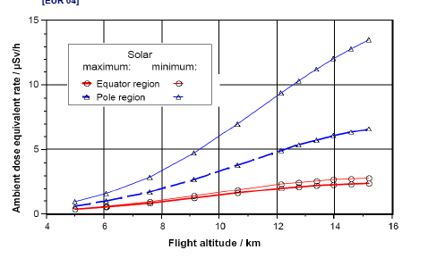
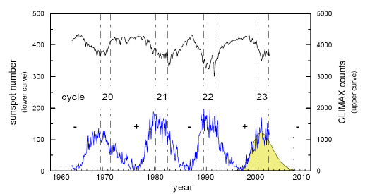
Galactic Cosmic Rays
Notes:
Let’s talk about the first source of radiation, the GCR. These GCR form the background radiation received at Earth. These rays comes from far into space, from outside our solar system. As introduced at previous slide, the equivalent dose linked to those GCR is function of the latitude and the altitude. This is once again depicted on the graph on the left. In red, low latitude and in blue high latitude. On the x axis the altitude of flight.
Then one extra variation is the sun activity. In bold the solar maximum values, in light, the solar minimum values.
Over the course of a solar cycle the solar wind modulates the fraction of the lower-energy GCR particles such that a majority cannot penetrate to Earth near solar maximum.
Near solar minimum, in the absence of many coronal mass ejections and their corresponding magnetic fields, GCR particles have easier access to Earth. Just as the solar cycle follows a roughly 11-year cycle, so does the GCR, with its maximum, however, coming near solar minimum. Visible on the graph on the right, the anti-phase between the GCR radiation on Earth and the solar cycle.
Unlike the solar cycle, where bursts of activity can change the environment quickly, the GCR spectrum remains relatively constant in energy and composition, varying only slowly with time.

Slide 5
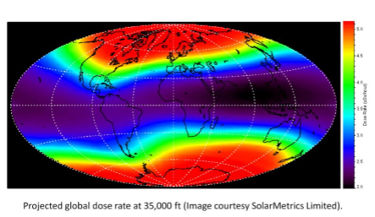
Galactic Cosmic Rays
Notes:
This picture shows the dose rate at a fix altitude of 35,000 feet. The dose is here in µSv per hour. We can clearly see that the magnetic field protect earth quite effectively at low latitude but not at high latitude.
This picture shows a normal/quiet situation so only the GCR component of the radiation. During solar storms, the dose can be much higher.

Slide 6
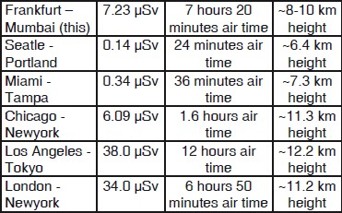
Galactic Cosmic Rays
Doses per flight examples
Notes:
On this table you can see some example of doses received by crew and passengers during various flights.
This doses will vary from flight to flight in function of
Altitude
Latitude
Duration
Day to day solar radiation levels.
In the examples here above, no storms were ongoing. It’s the ‘normal’ situation.

Slide 7
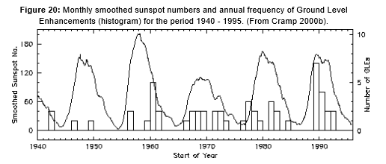
Solar Energetic Particles
Linked to solar activity
  CME
  Flares
Measured at ground level
  Ground Level Enhancement (GLE)
  In phase with solar activity
Notes:
The second source of radiation comes from the Sun. the solar Energetic Particles. These particles are linked to the Sun activity and have a more eruptive character.
Solar radiation storms occur when a large-scale magnetic eruption, often causing a coronal mass ejection and associated solar flare, accelerates charged particles in the solar atmosphere to very high velocities. The most important particles are protons which can get accelerated to large fractions of the speed of light. At these velocities, the protons can traverse the 150 million km from sun to Earth in just 10’s of minutes or less. When they reach Earth, the fast moving protons penetrate the magnetosphere that shields Earth from lower energy charged particles. Once inside the magnetosphere, the particles are guided down the magnetic field lines and penetrate into the atmosphere near the north and south poles..
Largest events are seen as GLE observed by ground based neutron detectors. Unlike the GCR, the SEP are in phase with the solar activity.

Slide 8
Regulations
Radiation Regulations
  ICRP : International Commission on Radiological Protection
    Thresholds for exposition
      Professional
      Medical
      Public
  European Commission
    Assessment when above 1mSv
    Adjusment of work schedules to remain under 6mSv
Order of magnitude
Background @ MSL : 2,5 mSv
Professional threshold : 20 mSv
Pregnant aircrew : 1mSv
General Public Threshold : 1mSv
Xray medical check : 14µSv
Computerised tomography of chest : 6mSv
Notes:
Let’s now talk about the regulations to protect professionals from the risk of radiation.
The field of radiation protection is overseen by the International Commission on Radiological Protection (ICRP), which produces periodic recommendations on all aspects of the field.
The ICRP divides radiation exposures into occupational/professional , medical and public, with different recommendations applying to each category. On the right you can see some values to get the order of magnitude.
The European Commission is more strict with regard to the exposure to radiation and request work schedules adjustment to remain under 6mSv/ year for aircrew.
Specific rules are in force for pregnant aircrew
ECA (European Cockpit Association) As Low As Reasonably Achievable (ALARA),
Flight crews should be provided with regular information of actual and forecasted solar activity on the Operational Flight Plan (OFP) and via SIGMET-type information.

Slide 9
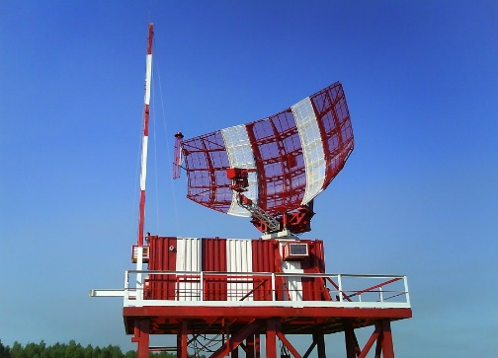
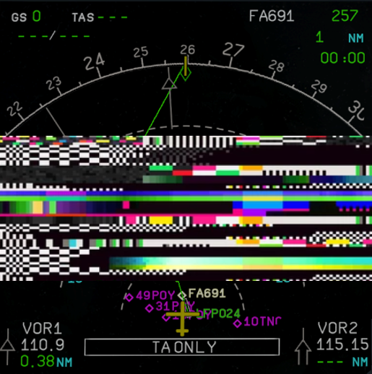
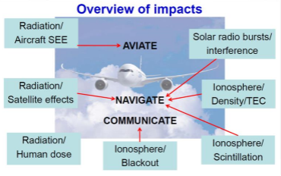
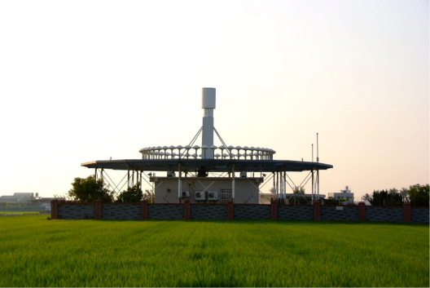
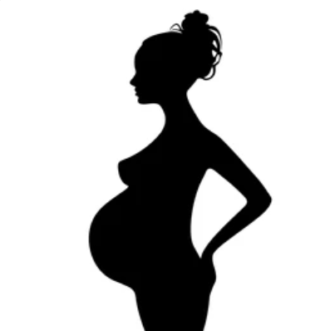
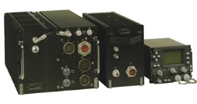
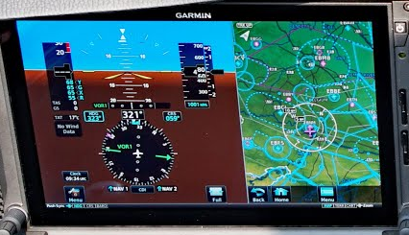

Impact on Aviation
Notes:
In order to travel safely with an airplane, three actions are needed.
Someone should effectively fly the plane.
The plane should be able to communicate with ground stations and control stations, with ATC operators.
The plane need a navigation system to follow the right path.
SpWx can impact those three domains in many ways. We will now discuss the most important ones.
SEE : single Event Effect: High energetic particles (>10MeV) penetrate aricraft shielding and cause disruption in some systems, such as screen glitches.

Slide 10
Impact on Aviation
Solar Event | Solar Flare |  |  |  | Coronal Mass Ejection |  | Solar Wind | Galactic Cosmic Rays
Sdecondary Effect | X-ray emission | UV emission | Radio burst | Solar Energetic Particles (SEP) | Plasma | SEP | Enhances Radiation Belts
Impact on Earth systems | Increase Ionosphere Density | Ionospheric Disturbances |  | Geomagnetic Storm |  |  | Aurora | Radiation | Ionospheric Scintillation
Air Crew & Passengers |  |  |  | X | X | X |  | X
Avionics |  |  |  | X |  | X |  | X
HF Coms | X | X |  | X | X | X |  |  | X
GNSS | X | X | X | X | X | X | X |  | X
SatCom | X | X | X | X | X | X | X | X | X
LF Coms | X |  | X |  | X
ATC Facilities |  | X | X |  | X |  | X
NexGen/SESAR | X | X | X | X | X | X | X | X | X
Notes:
This table shows an overview of all effects of space weather on aviation systems and sub systems.
On top of the table we have the solar Event. Just underneath we find the secondary effects. On the third row we find the effect on Earth system.
This chapter really focus on the two first rows of the aviation related systems but the entire table is of importance to get the vulnerability of air systems with regard to space weather.
NextGen / SESAR are Air Traffic Management systems in support of the International Civil Aviation Organisation (ICAO) Global Air Navigation Plan (GANP) and its Aviation System Block Upgrade (ASBU) programme

Slide 11
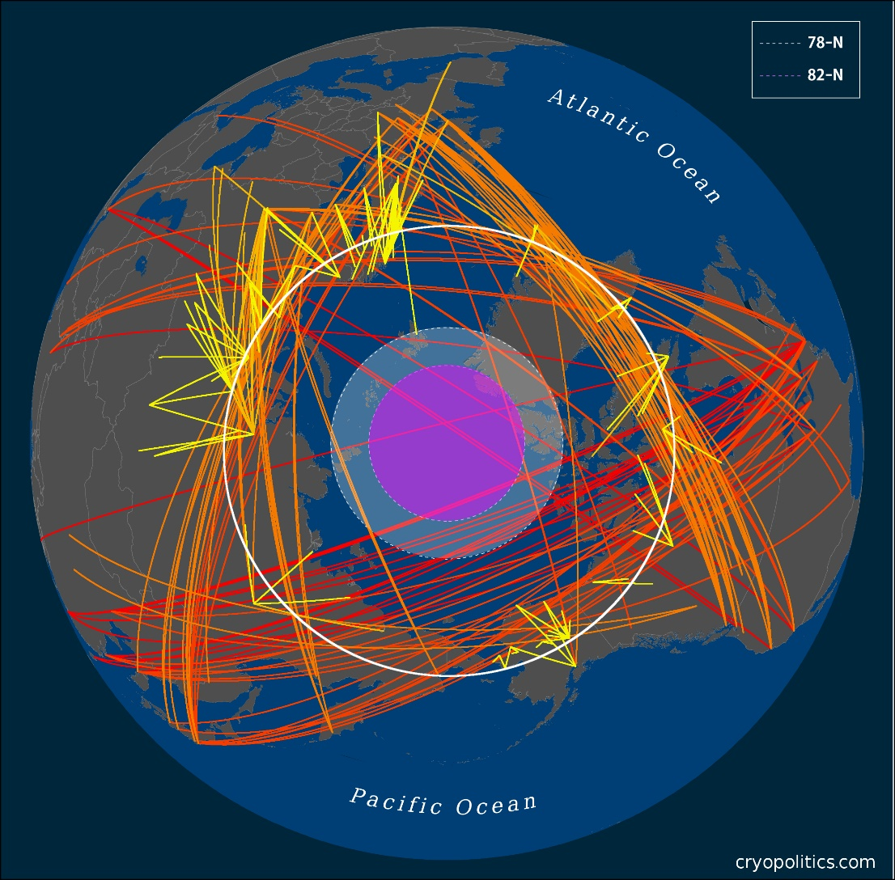
Flight Routes
Notes:
Concerning the radiation, because this is really the focus of this course, we discussed the fact that higher altitude and latitude are more prone to radiation than the rest of the Earth. The aviation sector presence in polar regions is constantly increasing.
In twenty years the operations in these regions increased by 15 to 20 with now thousands of flights crossing this region. These routes are shortcuts and allow to reduce the emission of greenhouse gas.
Prior to 1999 virtually no flights passed over the North Pole or across the High Arctic. During the Cold War, overflights over what was then-Soviet territory were off limits. Since a limited number of demonstration flights began in the late 1990s traffic across the region has grown exponentially. Along four major polar routes up to several hundred flights per week travel from Asia to North America or vice versa. By 2012 more than 5,000 flights crossed the North Pole annually, bringing with them increased greenhouse gas emissions to the region and the dangers of black carbon to the Arctic sea ice below.
In addition to flights over or near the North Pole, up to a thousand flights between Europe and Asia and Europe and North America traverse the Arctic Circle per week. In total more than 50,000 flights entered the Arctic each year by 2010.
Number of flights crossing polar regions in 2019 (TBD)

Slide 12
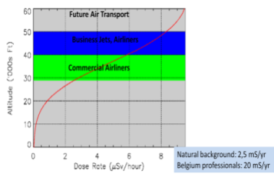
Impact on Crew and passengers
Storm activity
  Higher Radiation
    Short lived
      Minutes to hours
    Localized
      Generally Polar Regions
      Occasionnally at lower latitude
  Risk for long duration flights
    AAR
    AWACS crew
    U2 pilots
Notes:
We saw in the previous slides that GCR forms a background level of radiation and solar storms will add a variable component to this level. The high latitudes are particularly at risk but economically interesting for the aviation sector.
During a storm the dose level will rise up to high levels. With a strong storms, a level of 50-80µSv/hour at FL300 is reachable.
Luckily, these variations are short lived and quite localized. Polar Regions, less protected by the GMF are firstly hit but with geomagnetic storming the GMF will be perturbated and won’t drive particles effectively towards the Poles. In these circumstances, lower latitudes will also be impacted.
With the current air traffic density worldwide, we can expect thousands of people to be impacted by this kind of event.
Changing altitude can be a rapid mitigation measure but this should be coordinated by ground stations. If not this can lead to dramatic results.
The higher dose is one part of the equation, the second part is the duration of exposure. A high dose for a long duration will force aircrew to adapt work schedule.
In a military context, some assets are flying for sometimes more than 8 hours long. Think at the Air to Air Refueling crew, AWACS (Airborne early Warning And Control Station) personnel and high altitude observation flights. Those people, if deployed at high latitude will face high level of radiation. They are also forced to fly at very high altitude to remain out of reach.

Slide 13
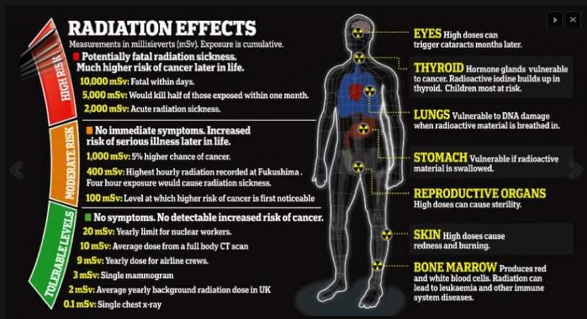
Impact on Crew and passengers
Notes:
So we talk about the risk for the aircrew and the passengers but what are the risks of radiation
This picture shows the possible effects of radiation on the human body. Many effects exist and they are function of the radiation level.
Radiation from solar origin won’t reach the red zone of course but accumulation of doses by aircrew can present a risk of developing sickness years later. (moderate zone)
The principal health concerns to aircrew and astronauts who have frequent low-dose exposure to ionizing radiation are:
Increased risk of cancer
Increased risk for genetic defects to a developing fetus during pregnancy
Increased risk for genetic defects to future offspring
Degeneration of tissues – Cataracts and possibly other medical conditions

Slide 14
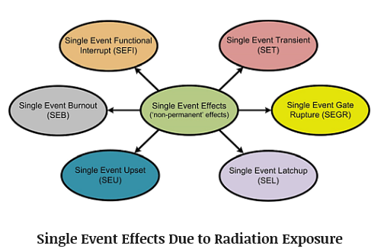
Impact on Avionics
Particles ionization effects
  Risk for the avionic (SEE)
      Fly by wire
      Autopilot
      Flight warning
      Communication
      Displays
      …
Mitigations
  Shielding
  Redundancy
Notes:
Not only affecting the crew but also the avionic due to Single Event Effects.
SEE are caused by single energetic particles and can take many forms. Pulse in logic circuitry, bitflips in memory cells. Can be potentially destructive
Non-destructive : SEU (Single Event Upset), SET (single event transients), MBU (Multiple Bit Upsets), SHE (single-event hard error)
Destructive : SEL (single event latchup), SEGR (single event gate rupture), SEB (single event burnout)
The particles will induce lattice displacements creating lasting damages. They will also have ionization effects creating transient glitches and soft errors. Low energy particles unable to create lattice effects are able to have ionization effects.
Various aviation systems will be impacted. Fly-by-wire technology, autopilot, flight warning, communication (voice and data), displays, FADEC (Full authority Digital Engine Control), any other aircraft system containing electronic components could be impacted.
Shielding can be a remedy. Substrate hardening will be used to reduce the effect of a projected particle. Clock bias voltage chip, can mask the effects of the particle event.
Note also that polymers, ceramics and metals can be affected by particles.

Slide 15
NOAA scale for Radiation
Notes:
NOAA Scale for solar radiation storms. The scale is based on flux level of 10MeV particles. When departing from the background level we rapidly reach the minor storm level. The scale is then logarithmic.
Based on this scale, warnings will be issued.

Slide 16
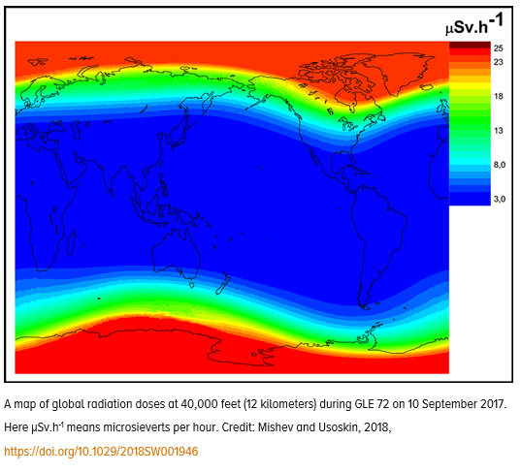
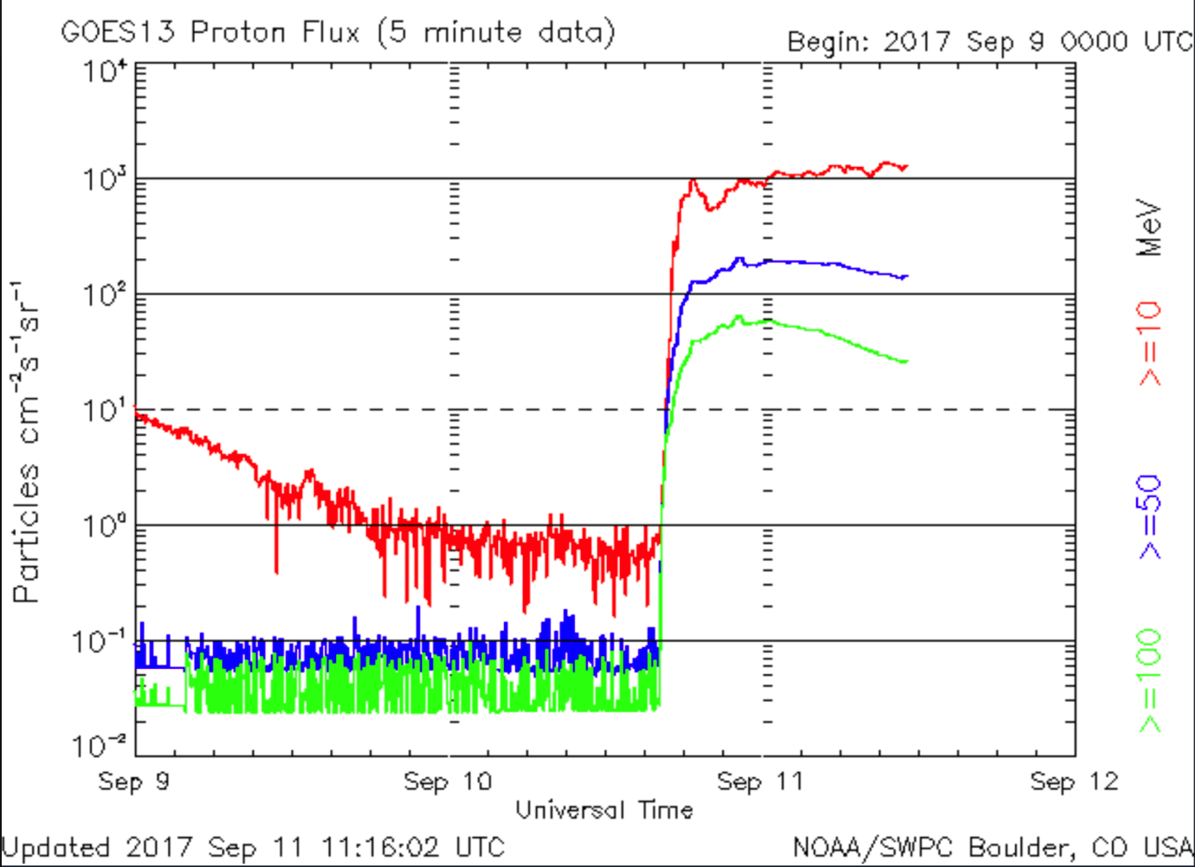
10 Sept 2017 Solar Storm
Notes:
Proton storms don’t happen so often. The last event was the storm of september 2017. following NOAA scale, this storm was a strong solar radiation storm.
On the picture on the left we can see the doses rising to 20-25µSv/hour

Slide 17
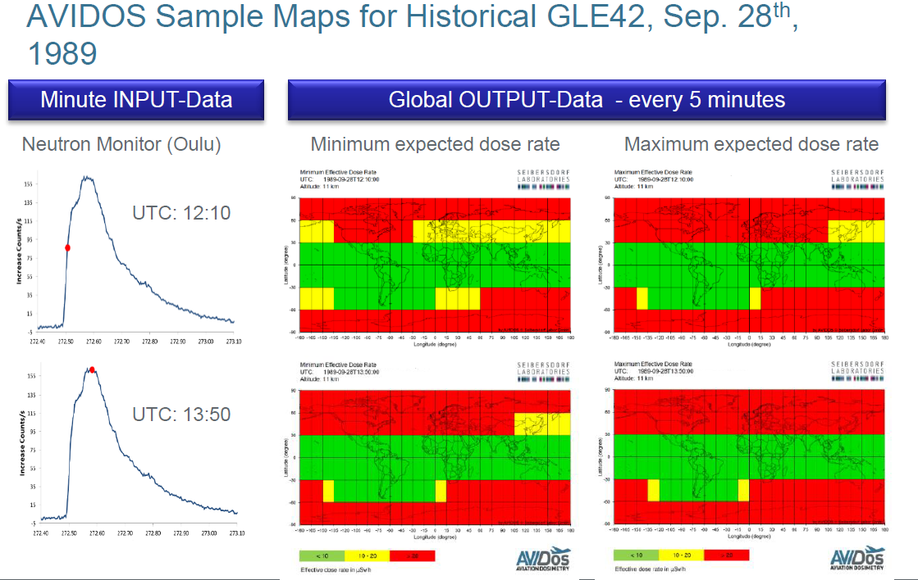
AVIDOS Sample
Notes:
Aviation Dosismeter
Modelisation of radiation based on numerous on-board aircraft measurements
Largest events are seen as GLE observed by ground based neutron detectors
Cross continent flights in nominal conditions: 50μSv
• Model estimates for strong Solar Proton Events: 570-870μSv
• Annual dose in Finland due to natural background: 3200μSv
• If the annual dose for air crew is estimated to exceed 1000μSv the flight company shall establish monitoring routines
PECASUS thresholds :
MOD : 30µSv/h
SEV : 80µSv/h

Slide 18
Question

