Slide 2


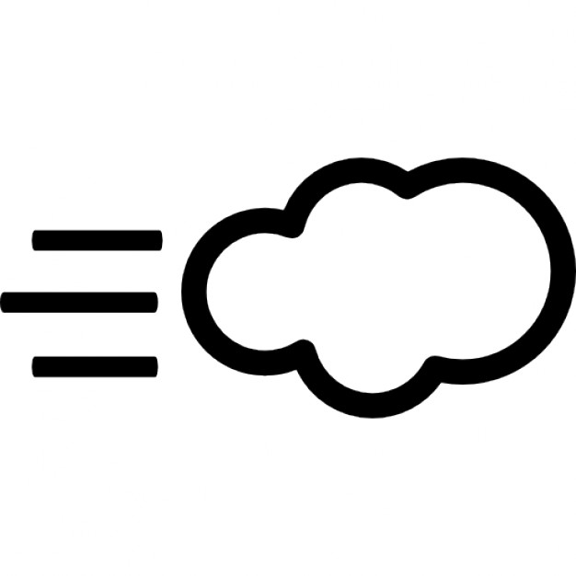
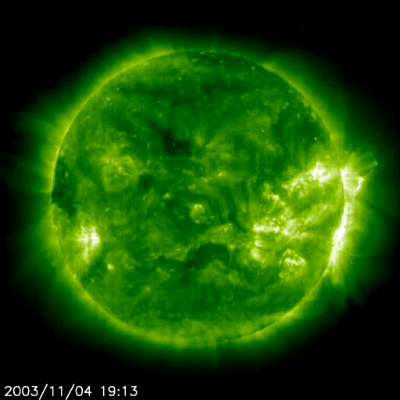
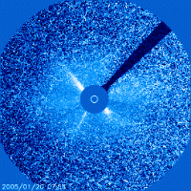
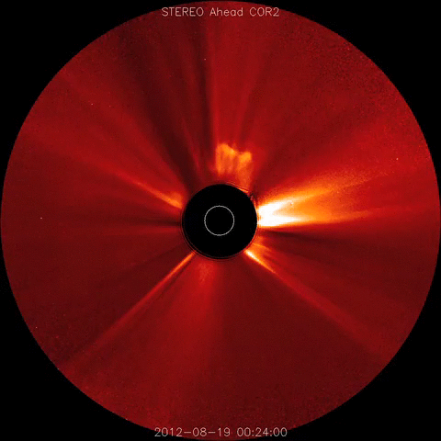

Solar eruptions
Magnetic Reconnection
Radiation
Particles
Solar flares
Proton events
Coronal Mass Ejections
SOHO/EIT
SOHO/LASCO
SOHO/LASCO

Slide 3
Solar eruptions
Magnetic Reconnection
Radiation
Particles
Solar flares
Proton events
Coronal Mass Ejections
SOHO/LASCO

Slide 4

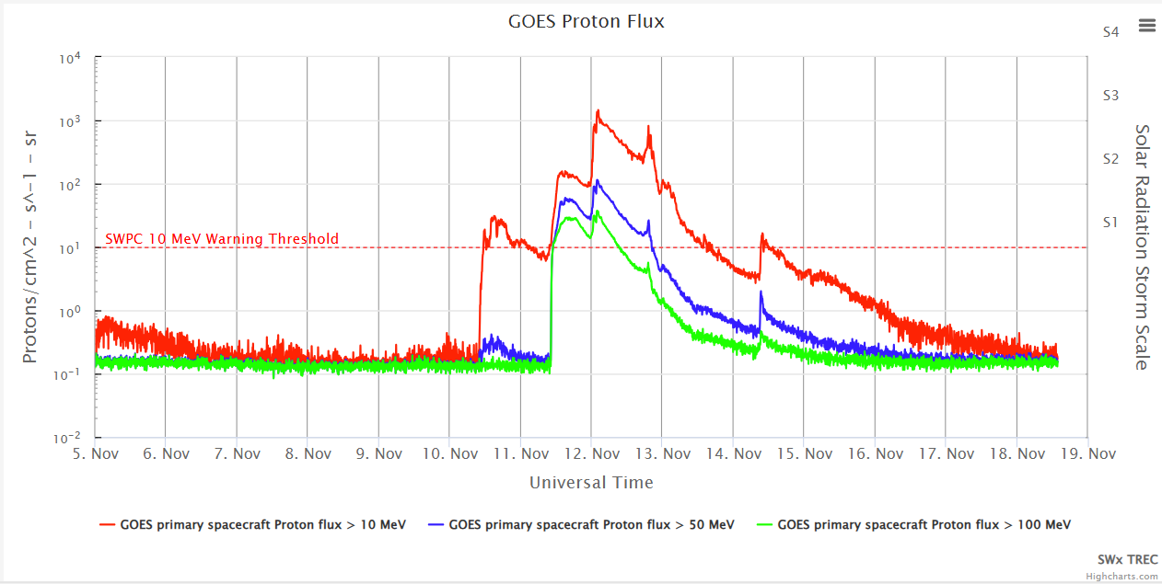
Energetic particles
MEASURED by GOES
GOES
Check out: https://www.swpc.noaa.gov/products/goes-proton-flux
Notes:
Along with the ejected plasma, highly energetic and very fast particles may escape into space during a solar eruption. Because they are charged particles, they follow the interplanetary magnetic field lines.
Solar radiation storms occur when a large-scale magnetic eruption, often causing a coronal mass ejection and associated solar flare, accelerates charged particles in the solar atmosphere to very high velocities. The most important particles are protons which can get accelerated to 1/3 the speed of light or 100,000 km/sec. At these speeds, the protons can traverse the 150 million km from Sun to Earth in just 30 minutes.

Slide 5
Energetic particles
MEASURED by GOES
GOES
Proton flux : Number of protons on a given „surface“ per seconds
Unit : PFU = Particle Flux Unit
Notes:
SWPC ’s « The Weekly » User guide (https://www.swpc.noaa.gov/sites/default/files/images/u2/Usr_guide.pdf ; page 15) on Proton Events:
A proton event starts when the integrated proton flux (5-minute average) rises above a specific threshold for at least three points.
From: SESC: https://umbra.nascom.nasa.gov/SEP/ (contains list of all proton events since 1976)
The end of an event is the last time the flux was greater than or equal to 10 pfu. This definition allows multiple proton flares and/or interplanetary shock proton increases to occur within one SESC proton event. Additional data may be necessary to more completely resolve any individual proton event.
From: http://www.stce.be/news/232/welcome.html
The issue here is that proton flares are not considered as separate events if the proton flux (particle energies larger than 10 MeV) at the time of the event is still above the threshold of 10 protons per flux unit (pfu). Example: 6 January 2014 X1 proton flare.
SEP definition: from SWPC’s glossary
https://www.swpc.noaa.gov/content/space-weather-glossary#Solar%20Energetic%20Particles
Solar Energetic Particles are high energy (keV to GeV) protons, electrons and ions which come from the Sun.
The third driver of space weather are the Proton Events.
Proton events are measured by GOES statellites, so similar to the X-ray flux for the flares. Geostationary satellites.
They measure the flux of protons, with given energy, and they key energy we look at is the 10MeV, it is the first one to rise.
But we start to speak of proton events when the 10 MEV flux rises above 10PFU (Particles flux Units).
As long as the fux doesn’t go below 10PFU, it is per definition the same Sroton event.
Sometimes there is only small increase and doesn’t go above the 10PFU. This we call Proton Enahncement, not “Event”. And then there is a more general name, when we speak about other particles too , withi is SEP

Slide 6
Energetic particles
MEASURED by GOES
GOES
Different energies
Different energies: >10MeV proton but also higher energies

Slide 7
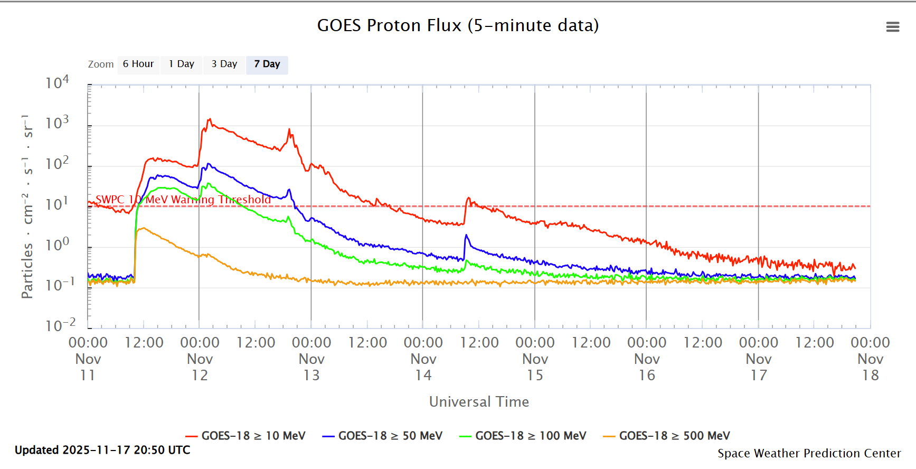
Energetic particles
MEASURED by GOES
GOES
Proton flux >500MeV protons: Very rare…

Slide 8
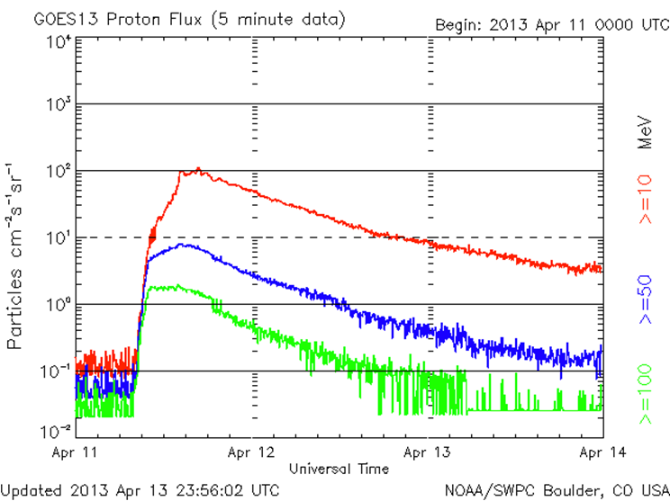
Energetic particles
Proton Event
GOES
Some definitions
Start
Peak
End
10 PFU threshold
10 MEV Proton flux > 10 PFU

Slide 9
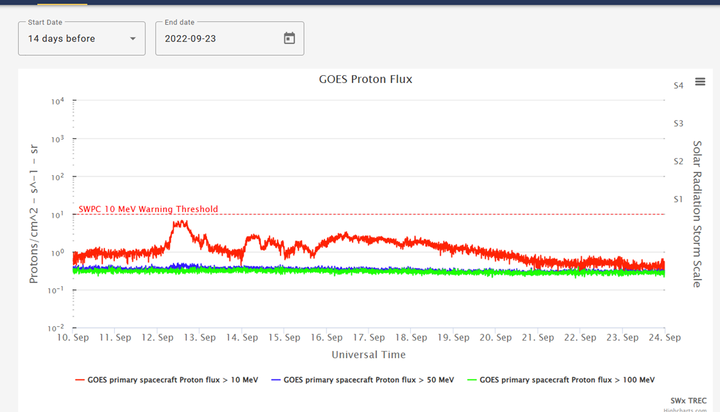
Energetic particles
Proton Enhancement
GOES
Not a “proton event” per definition

Slide 10
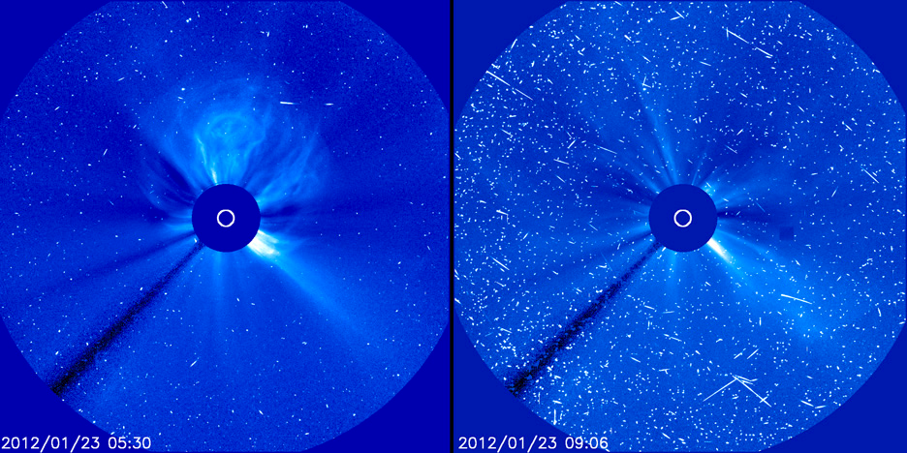
Energetic particles
SEEN by SOHO/LASCO C3
SOHO/LASCO C3

Slide 11
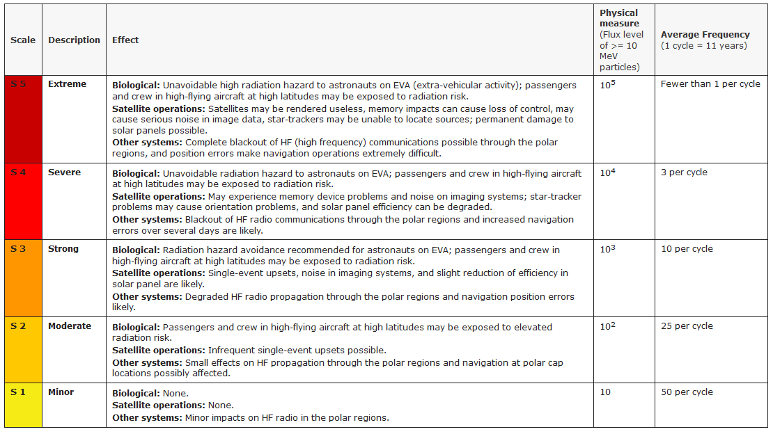
Proton event classification
NOAA-scales: S-scale (Solar Radiation Storm)
SWIC - Collaboration between STCE, Koninklijke Luchtmacht, KNMI
Notes:
From the SWPC webpage (https://www.swpc.noaa.gov/noaa-scales-explanation )
The NOAA Space Weather Scales were introduced as a way to communicate to the general public the current and future space weather conditions and their possible effects on people and systems. Many of the SWPC products describe the space environment, but few have described the effects that can be experienced as the result of environmental disturbances. These scales are useful to users of our products and those who are interested in space weather effects. The scales describe the environmental disturbances for three event types: geomagnetic storms, solar radiation storms, and radio blackouts. The scales have numbered levels, analogous to hurricanes, tornadoes, and earthquakes that convey severity. They list possible effects at each level. They also show how often such events happen, and give a measure of the intensity of the physical causes.
The « S » stands for Solar radiation Storm. Since observations started in 1976, no S5 event has been recorded.
More at http://www.stce.be/news/366/welcome.html

Slide 12
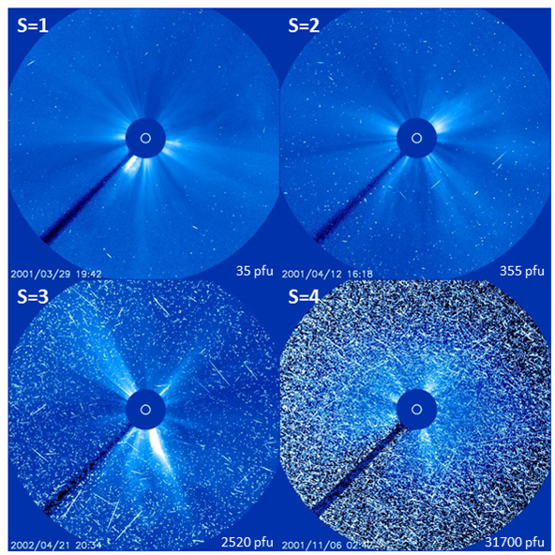
Proton event classification
NOAA-scales: S-scale
SOHO/LASCO
Notes:
The « S » stands for Solar radiation Storm. Since observations started in 1976, no S5 event has been recorded.
More on NOAA scales at http://www.stce.be/news/366/welcome.html
More on proton intensity at http://www.stce.be/news/233/welcome.html

Slide 13


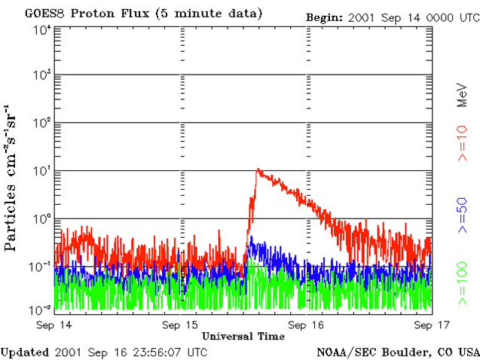
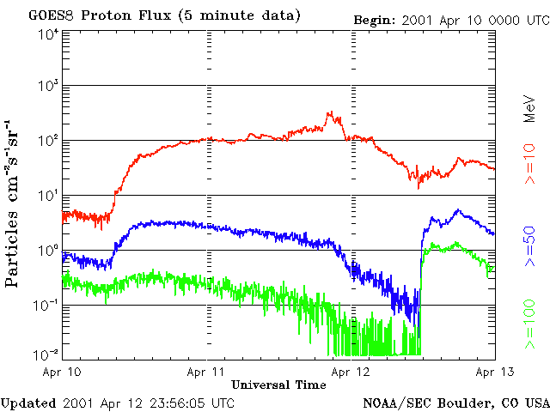
Proton events
DRIVERS
STRONG FLARES
CME
(Fast & Wide)
Impulsive
Gradual
Impulsive solar flares
CME-driven shocks
  Wide and fast shocks
  Type II and IV radio bursts
Notes:
Park et al. , 2015: Study of Solar Energetic Particle Associations with Coronal Extreme-ultraviolet Waves
http://iopscience.iop.org/article/10.1088/0004-637X/808/1/3/pdf
Impulsive SEP events, having short durations of several hours, are associated with impulsive flares. They are electron rich and are generally distributed within a narrow propagation cone. Gradual SEP events are associated with gradual X-ray flares and type II and type IV radio emission. They are produced by wide and fast CME-driven shocks (Gopalswamy 2003) and have a broad range of source longitudes (Kahler 1994; Reames 1999). Gradual events are proton rich in contrast to impulsive events.
Many events have characteristics of both gradual and impulsive events due to a combination of both flare- and shock-associated particles (Cane et al. 2006).
A very good site on the characteristics between gradual and impulsive events is at
SEPEM: http://dev.sepem.oma.be/help/sep_intro.html (alternate: http://sepem.eu/help/index_intro.html )
Papaioannou et al. (2016): Solar flares, coronal mass ejections and solar energetic particle event characteristics
https://www.swsc-journal.org/articles/swsc/pdf/2016/01/swsc150076.pdf
Reames, 2013: The Two Sources of Solar Energetic Particles
http://adsabs.harvard.edu/abs/2013SSRv..175...53R

Slide 14
Proton events
DRIVERS
STRONG FLARES
Shock of CME
(Fast & Wide)
Impulsive
Gradual
The onsets are not necessarily fast, but the events are of rather short duration (1 to 20 hours)
The onsets are not necessarily gradual, but the events are of long duration
  1 to 3 days
  Partly due to continuing acceleration of shock
Rather narrow propagation cones
Events from eastern hemisphere may not be observed
Notes:
Park et al. , 2015: Study of Solar Energetic Particle Associations with Coronal Extreme-ultraviolet Waves
http://iopscience.iop.org/article/10.1088/0004-637X/808/1/3/pdf
Impulsive SEP events, having short durations of several hours, are associated with impulsive flares. They are electron rich and are generally distributed within a narrow propagation cone. Gradual SEP events are associated with gradual X-ray flares and type II and type IV radio emission. They are produced by wide and fast CME-driven shocks (Gopalswamy 2003) and have a broad range of source longitudes (Kahler 1994; Reames 1999). Gradual events are proton rich in contrast to impulsive events.
Many events have characteristics of both gradual and impulsive events due to a combination of both flare- and shock-associated particles (Cane et al. 2006).
A very good site on the characteristics between gradual and impulsive events is at
SEPEM: http://dev.sepem.oma.be/help/sep_intro.html (alternate: http://sepem.eu/help/index_intro.html )
Papaioannou et al. (2016): Solar flares, coronal mass ejections and solar energetic particle event characteristics
https://www.swsc-journal.org/articles/swsc/pdf/2016/01/swsc150076.pdf
Reames, 2013: The Two Sources of Solar Energetic Particles
http://adsabs.harvard.edu/abs/2013SSRv..175...53R

Slide 15
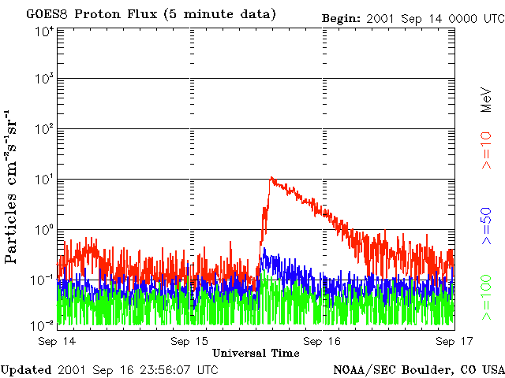
Proton events
GOES
Notes:
The cartoons were taken from:
Reames (1999): Particle acceleration at the Sun and in the heliosphere
http://adsabs.harvard.edu/abs/1999SSRv...90..413R
The 15 Sep 2001 event (11 pfu) resulted from an M1 (1N) flare on 11:28UT
The 10 Apr 2001 event (355 pfu) resulted from an X2 (3B) flare on 05:26UT. The (halo) CME arrived on 11 April around 15UT, hence the maximum proton flux (near 21UT) coincides with the passage of the ICME.

Slide 16
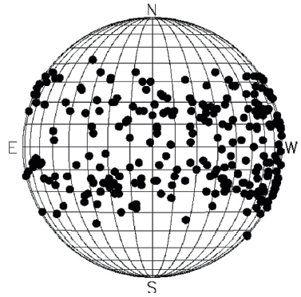
FORCASTING PROTON EVENTS
1. LOCATION
Higher likelihood for SEP events from the regions on western hemisphere
Does not exclude SEPs from the eastern hemisphere or even from the Sun’s backside!
    E.g. Major flare on 23 July 2012
    Mechanism?
  Eastern SEPs: slower rise
Notes:
Papaioannou et al. (2016): Solar flares, coronal mass ejections and solar energetic particle event characteristics
https://www.swsc-journal.org/articles/swsc/pdf/2016/01/swsc150076.pdf
Top figure taken from their Figure 5 (D).
Bottom: SEP heat maps, showing how the SEP association rate varies with the source longitude and speed of the CME. Panels (a) and (b) show, respectively, a heat map for SEP events >10 pfu and >100 pfu. Higher (lower) association rates are shown in red (yellow). Cells in gray indicate no CMEs in those ranges of speed and source longitude. Cells in white indicate no SEP association.
From: https://iopscience.iop.org/article/10.3847/1538-4357/aba621
Major farside flare from 23 July 2012: http://www.stce.be/news/152/welcome.html
Example from 29 October 2015 event: http://www.stce.be/news/325/welcome.html
https://spaceweather.com/archive.php?view=1&day=15&month=07&year=2021
https://www.stce.be/news/543/welcome.html
It is believed that the coronal waves associated to strong CMEs widen the access possibilities of the energetic particles to Earth through the coronal Parker spiral magnetic field lines. This would allow some of the backside events still to create a proton event at Earth. But even then, there’s still a problem of the eastern hemisphere events, in particular e.g. at locations E120.
Aside GOES, there are other satellites equipped with SREM that also measure proton fluxes:
http://space-env.esa.int/index.php/SREM_Plots.html
Currently (2017), only the Integral satellite has an operational SREM.
Finally, STEREO and SOHO also measure proton fluxes:
ACE: https://services.swpc.noaa.gov/images/ace-sis-3-day.gif
STEREO: https://stereo-ssc.nascom.nasa.gov/beacon/beacon_insitu.shtml (click plots, scroll down to « IMPACT »).

Slide 17
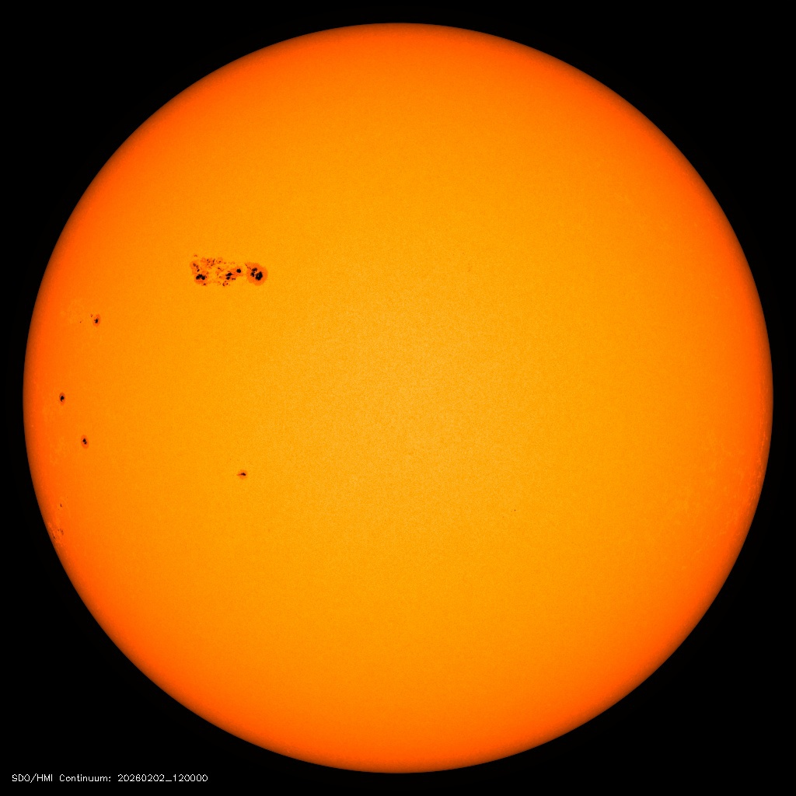
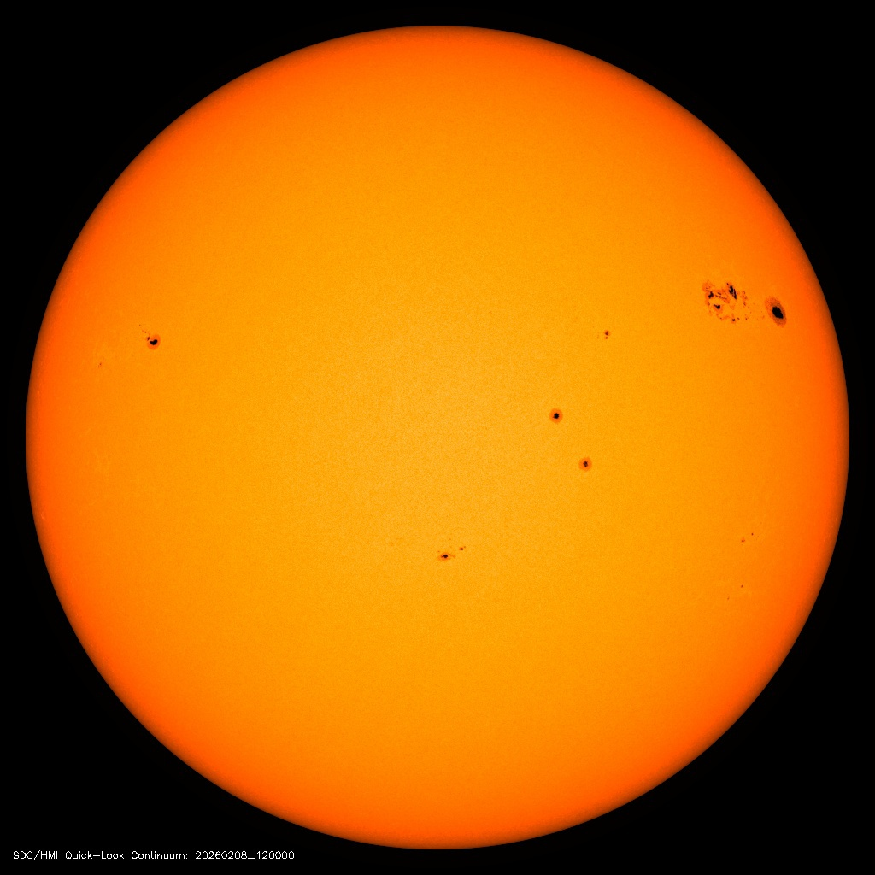
FORCASTING PROTON EVENTS
1. LOCATION
Higher likelihood for SEP events from the regions on western hemisphere
Beginning of this Week:
Active Flaring region on eastern hemisphere: lower probability for proton event given by forecaster
End of this Week:
Active Flaring region on western hemisphere: higher probability for proton event given by forecaster

Slide 18
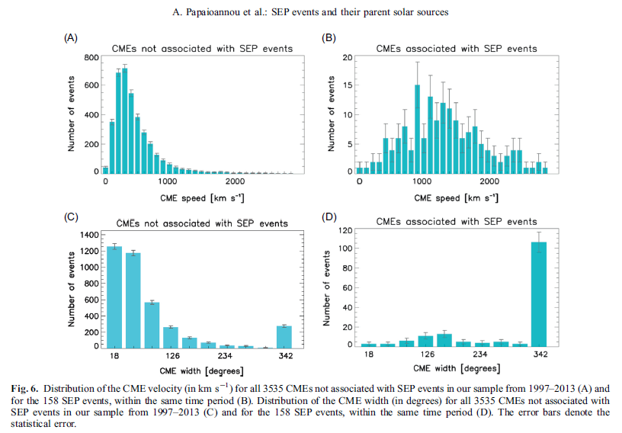
Forecasting Proton events
2. CME Speed
3. CME width
Fast CMEs
wide CMEs
Notes:
From these distributions we can conclude that coronal mass ejections associated with solar energetic particle events are generally wider and faster.
Papaioannou et al. (2016): Solar flares, coronal mass ejections and solar energetic particle event characteristics
https://www.swsc-journal.org/articles/swsc/pdf/2016/01/swsc150076.pdf
Dierckxsens et al., 2015: Relationship between Solar Energetic Particles and Properties of Flares and CMEs: Statistical Analysis of Solar Cycle 23 Events
http://link.springer.com/content/pdf/10.1007%2Fs11207-014-0641-4.pdf

Slide 19
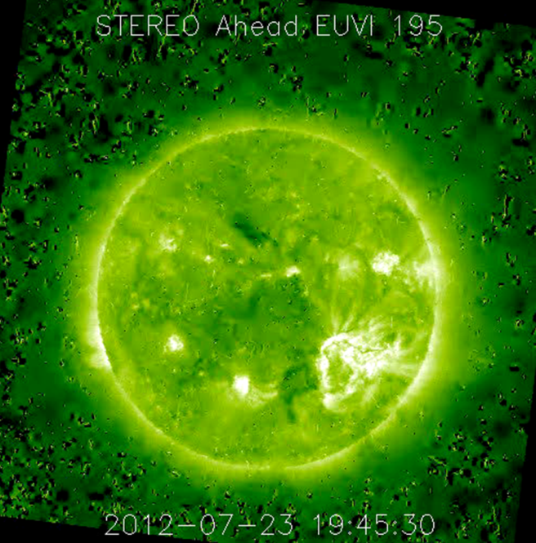
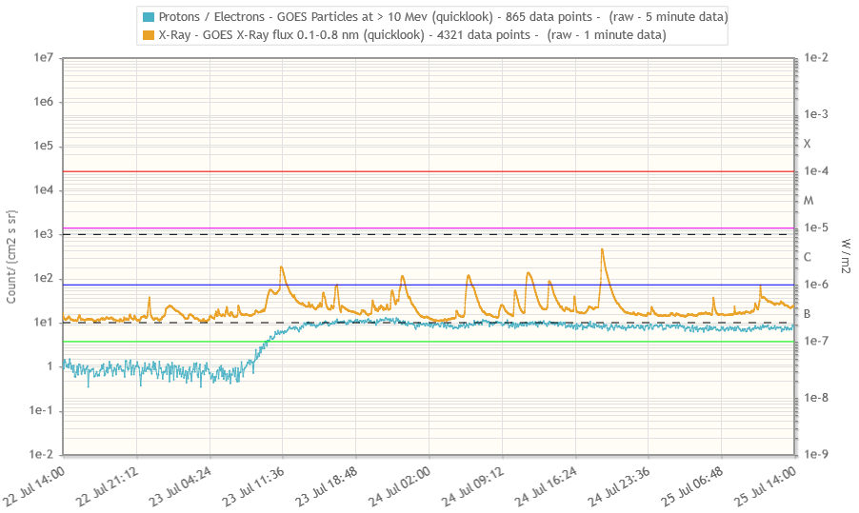
Forecasting proton events
Look for active regions & filaments that can:
  Produce strong x-ray flares
  Fast CMEs (~1000 km/s or more)
  Wide CMEs (partial or full halo CMEs)
  Preferably on the western solar hemisphere
Finetune from history on farside/eastern hemisphere
Notes:
Probabilities and intensities for proton events for a variety of the above parameters can be found in:
Dierckxsens et al., 2015: Relationship between Solar Energetic Particles and Properties of Flares and CMEs: Statistical Analysis of Solar Cycle 23 Events
http://link.springer.com/content/pdf/10.1007%2Fs11207-014-0641-4.pdf
More info on SEP events at http://dev.sepem.oma.be/help/solpenco2_intro.html

Slide 20

:Issued: 2023 Mar 18 1231 UTC
:Product: documentation at http://www.sidc.be/products/meu
#--------------------------------------------------------------------#
# DAILY BULLETIN ON SOLAR AND GEOMAGNETIC ACTIVITY from the SIDC #
# (RWC Belgium) #
#--------------------------------------------------------------------#
SIDC URSIGRAM 30318
SIDC SOLAR BULLETIN 18 Mar 2023, 1230UT
SIDC FORECAST (valid from 1230UT, 18 Mar 2023 until 20 Mar 2023)
SOLAR FLARES : C-class flares expected, (probability >=50%)
GEOMAGNETISM : Quiet (A<20 and K<4)
SOLAR PROTONS : Quiet
PREDICTIONS FOR 18 Mar 2023 10CM FLUX: 138 / AP: 007
PREDICTIONS FOR 19 Mar 2023 10CM FLUX: 140 / AP: 019
PREDICTIONS FOR 20 Mar 2023 10CM FLUX: 138 / AP: 029
COMMENT: The solar flaring activity was at moderate levels during the last 24 hours with one M-class flare and several C-class flares detected, with the most frequent sources being NOAA active regions 3254 and 3256. The largest flare was a M1.1 flare, peaking at 15:07 UTC on March 17, associated with active region NOAA 3254 (beta class). NOAA active region 3256 produced an impulsive C9.4 flare at 07:10 UTC on March 18. This event was also associated with Type IV radio emission. Other regions on the disc did not show any significant flaring activity. Further M-class flare activity is possible but not probable, while frequently C-class activity is expected in the next 24 hours.
A filament eruption in the southwestern quadrant was observed on March 17 from around 09:20UTC. The associated CME appears in SoHO/LASCO C2 coronagraph data from 10:23UTC onwards. The CME is directed to the south-west and the bulk of the CME is not expected to be Earth directed. However, a glancing blow of the shock may impact Earth at around 19:00 UTC on March 19. Another small filament eruptions occurred in the northwestern quadrant from around 17:09UTC and 20:09UTC on March 17. We are awaiting corresponding coronagraph data for further analysis. During the last 24 hours there were no other potentially Earth-directed CMEs detected in the available coronagraph observations.
The greater than 10 MeV proton flux was at almost nominal levels over the past 24 hours and is expected to remain so for the next 24 hours. The greater than 2 MeV electron flux remained below the 1000 pfu alert threshold and is expected to remain below this threshold during the next 24 hours. The 24h electron fluence was at normal levels and is expected to remain so.
Over the past 24 hours the solar wind parameters (ACE and DSCOVR) have been indicative of slow solar wind conditions. The solar wind speed ranged between 400 km/s and 450 km/s. The interplanetary magnetic field magnitude was about 6 nT. The magnetic field orientation was predominantly in the positive sector (field directed away from the Sun). Similar slow solar wind regime is expected on March 18 with a slight wind speed enhancement possible for late on March 19, due to expected influence of the small equatorial coronal hole of positive polarity with a chance of being mixed with glancing blow from a CME which left the solar surface around 10 UTC on March 17th.
The geomagnetic conditions over the past 24 hours were globally and locally quiet to unsettled (NOAA Kp and K Bel 1-3). Quiet conditions are expected for Mach 18 with active to minor storm conditions possible for late on March 19 and March 20, due to expected arrival of the high speed stream and a possible glancing blow from a CME.
TODAY'S ESTIMATED ISN : 044, BASED ON 14 STATIONS.
SOLAR INDICES FOR 17 Mar 2023
WOLF NUMBER CATANIA : 110
10CM SOLAR FLUX : 134
AK CHAMBON LA FORET : 014
AK WINGST : 007
ESTIMATED AP : 007
ESTIMATED ISN : 073, BASED ON 18 STATIONS.
NOTICEABLE EVENTS SUMMARY
DAY BEGIN MAX END LOC XRAY OP 10CM Catania/NOAA RADIO_BURST_TYPES
17 1504 1507 1511 S22W65 M1.0 SN 12/3247
END
Finding your way in the
URSIgram
Proton flux / events
Notes:
fluence = flux accumulation over 24 hours

Slide 21
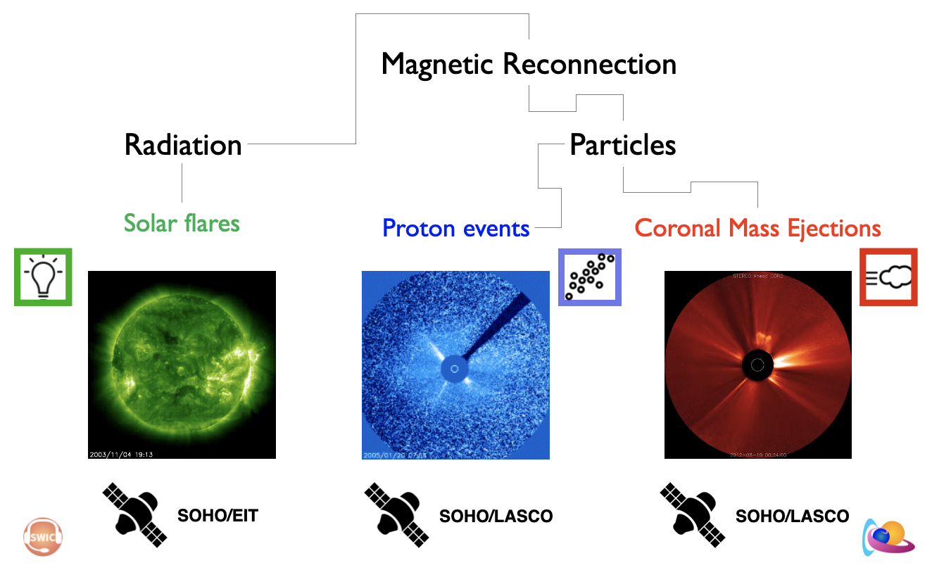
Summary 1/2
Solar flares
  Standard model
  Classification
    Hα, x-ray, NOAA scale (R)
  Flare predictions
    McIntosh, Hale

Slide 22
Summary 2/2
Proton events
  >10 MeV proton flux > 10 pfu
  Classification
    Impulsive vs. Gradual
    NOAA Scale (S)
  Forecasting
    Strong flare
    Wide and fast CME
    Western solar hemisphere
Coronal Mass Ejection
  Model
  On-disk signatures
  Classification & Terminology
    Stealth, Cannibalism, Deflection
  True vs. Plane-of-the-Sky speed
  Interplanetary CME & Bz

