Slide 1
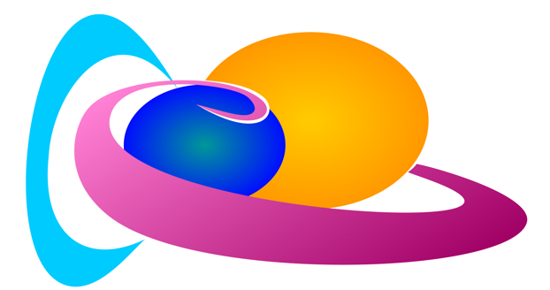
Practical Tools, Resources, Dashboard
Course by the
Solar Terrestrial Center of Excellence

Slide 2
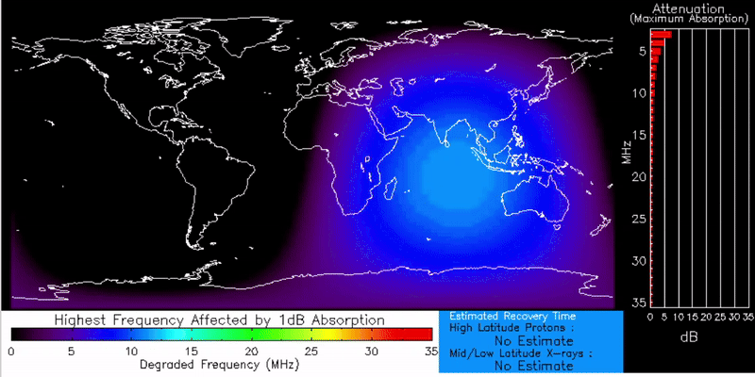
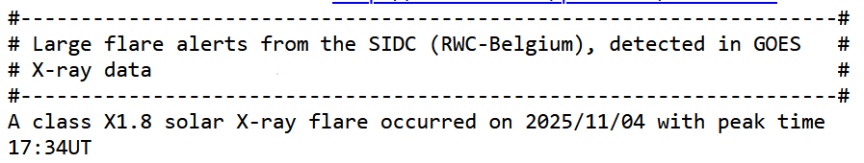
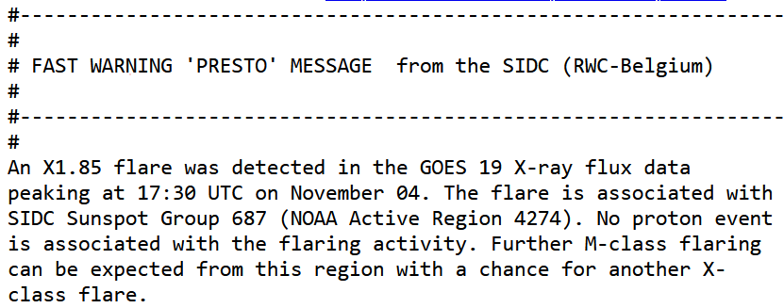
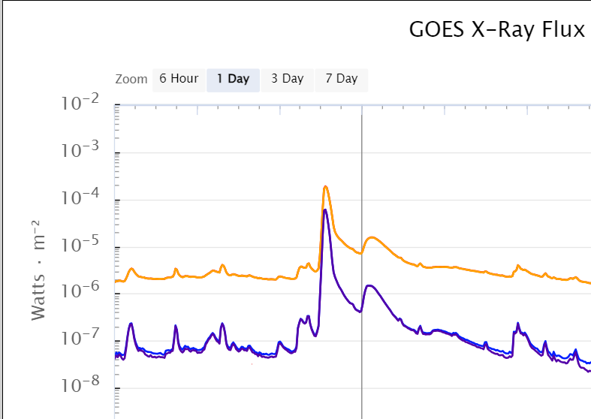
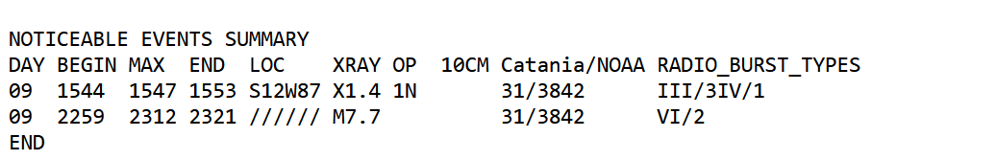
Flare – SWF Absorption
SIDC Flaremail automated alert:
SIDC Presto manual alert:
https://www.swpc.noaa.gov/products/d-region-absorption-predictions-d-rap
SIDC Daily Ursi (including forecast) - extract :
https://sidc.be
https://sidc.be/registration/registration_step1.php
https://www.swpc.noaa.gov/products/goes-x-ray-flux

Slide 3
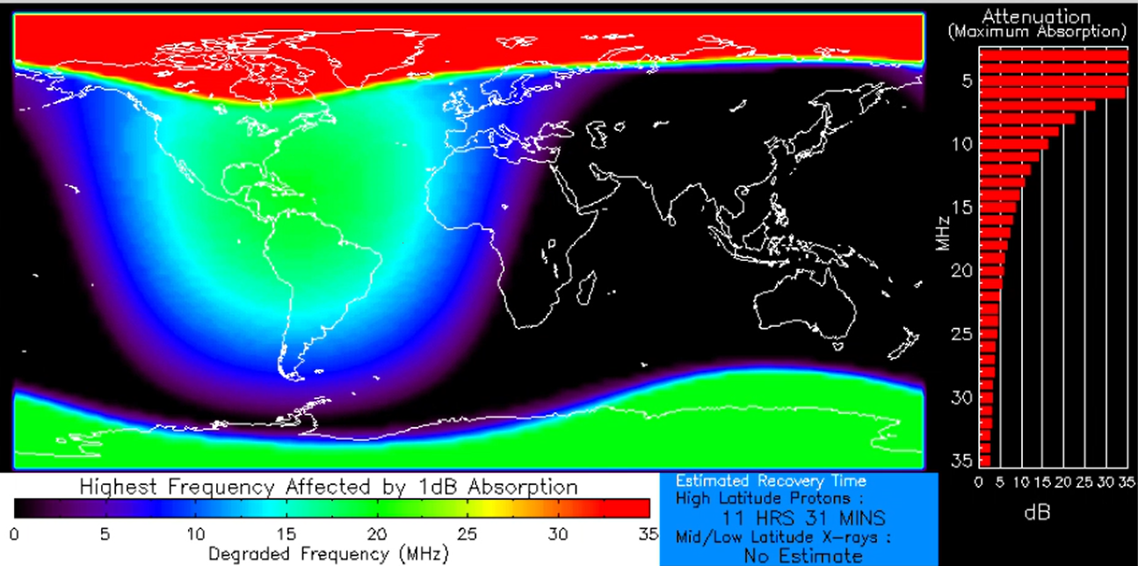
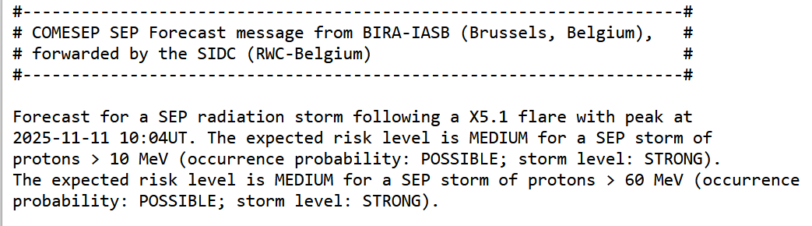
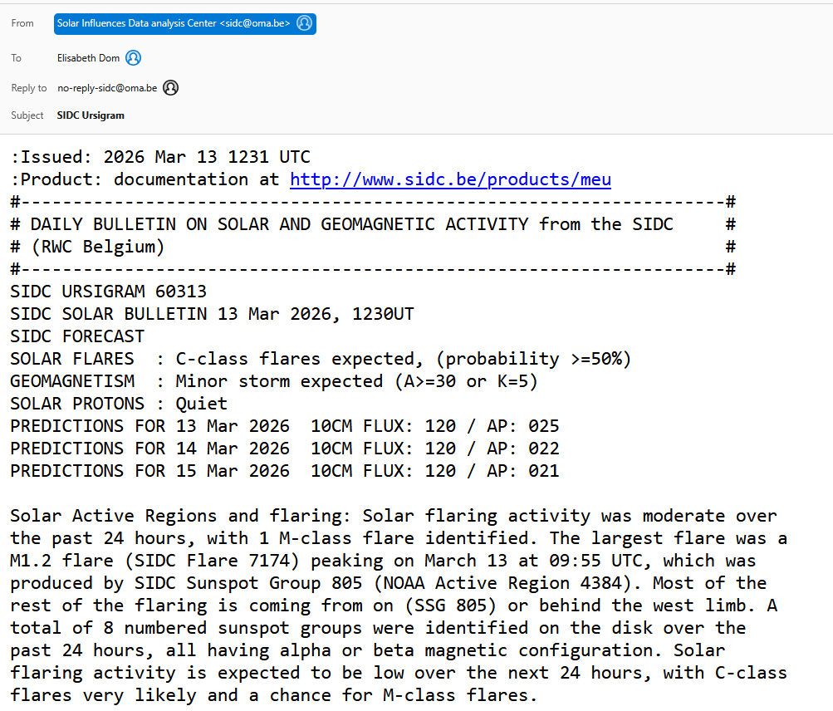
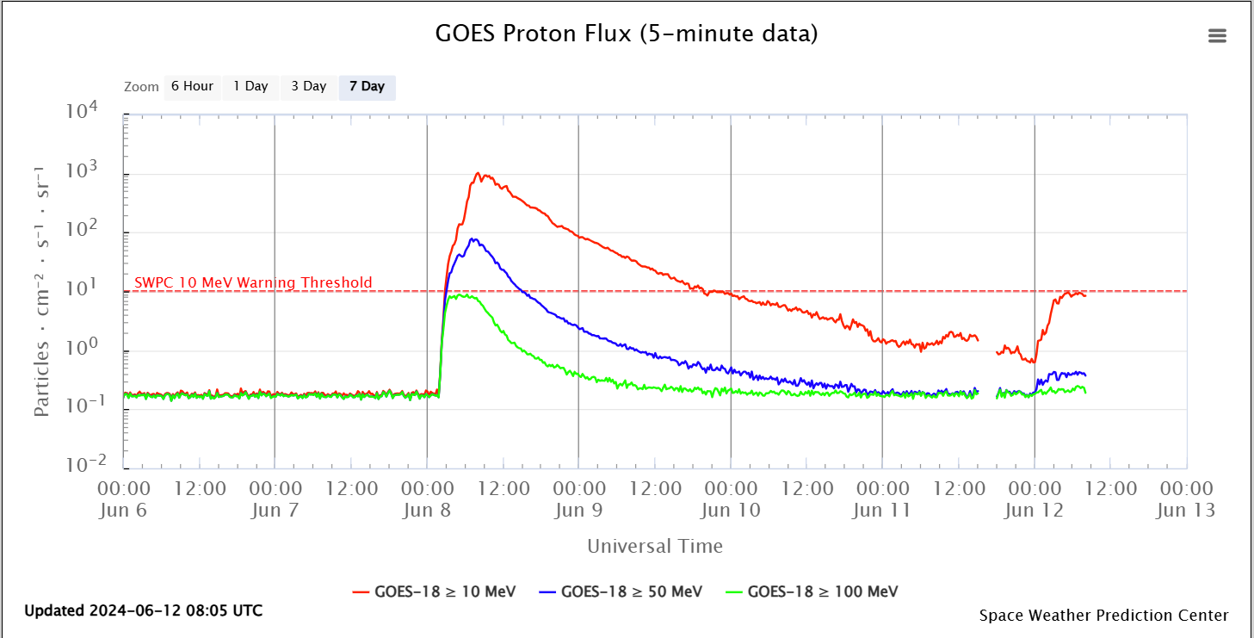
Proton Storm – Polar Cap Absorption
Comesep automated alert:
SIDC Presto manual alert:
SIDC Daily Ursi (including forecast):
https://www.swpc.noaa.gov/products/d-region-absorption-predictions-d-rap
https://sidc.be
https://sidc.be/registration/registration_step1.php
https://www.swpc.noaa.gov/products/goes-proton-flux
Notes:
.

Slide 4
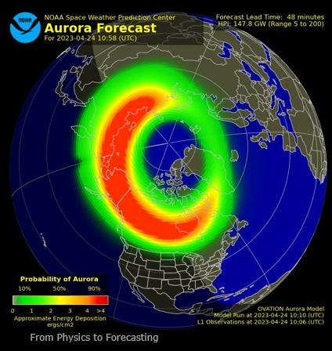
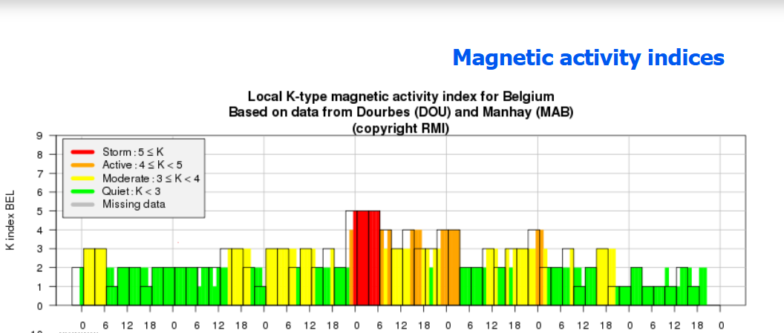
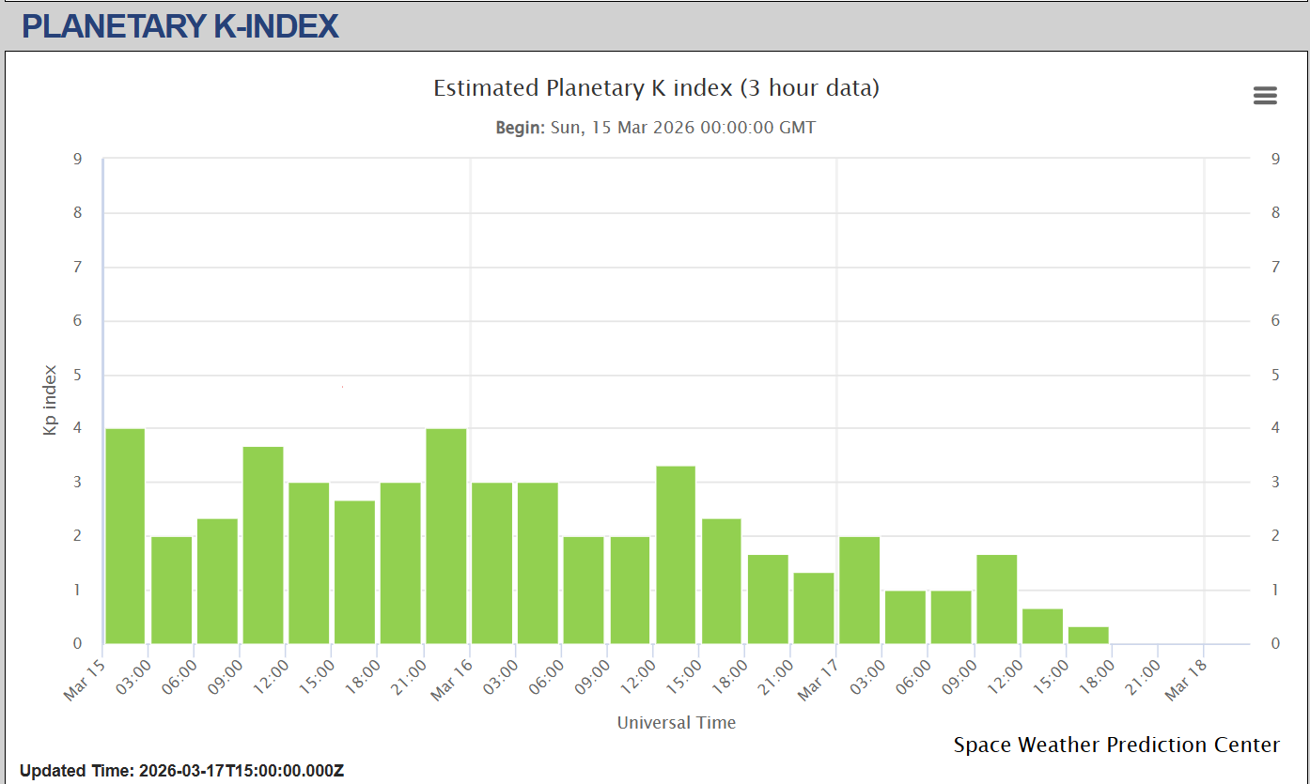
Geomagnetic Storm – Auroral Absorption
SIDC Presto
SIDC Ursigram
SIDC CME arrival alert
https://sidc.be
https://sidc.be/registration/registration_step1.php
https://www.swpc.noaa.gov/communities/aurora-dashboard-experimental
http://ionosphere.meteo.be/geomagnetism/K_BEL/
https://www.swpc.noaa.gov/products/planetary-k-index

Slide 5
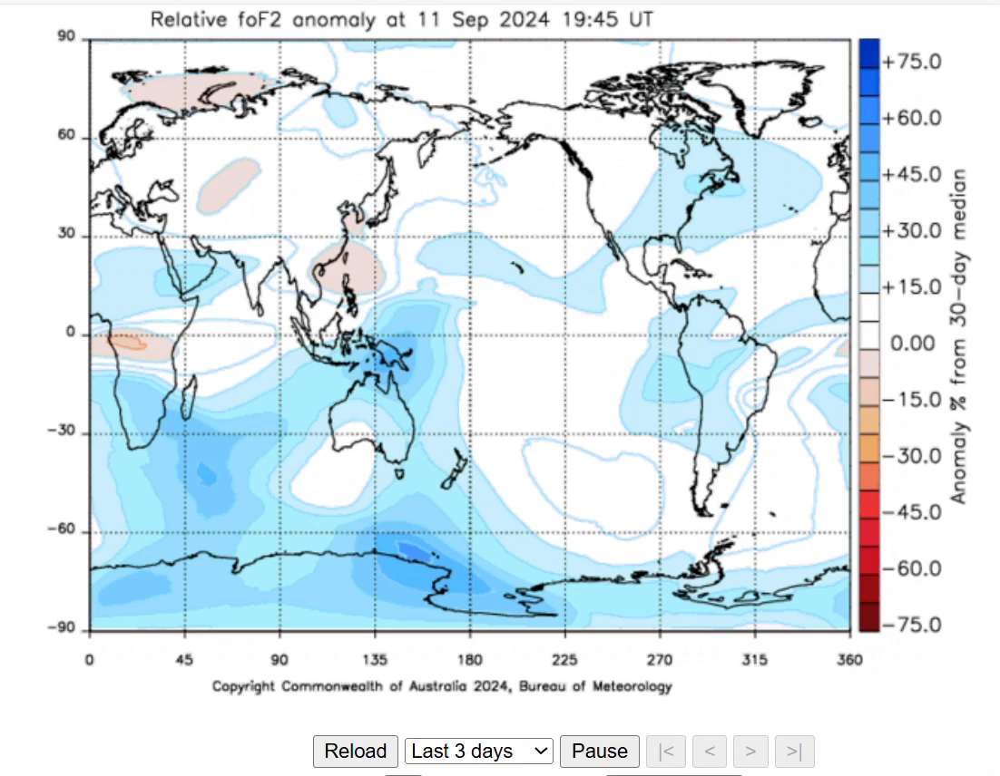
Geomagnetic Storm – Post Storm Depression
Several days after high Kp MUF is reduced worldwide (patch and unstable)
https://www.sws.bom.gov.au/HF_Systems/6/5
Directly at the Ionosondes data : see later slides

Slide 6
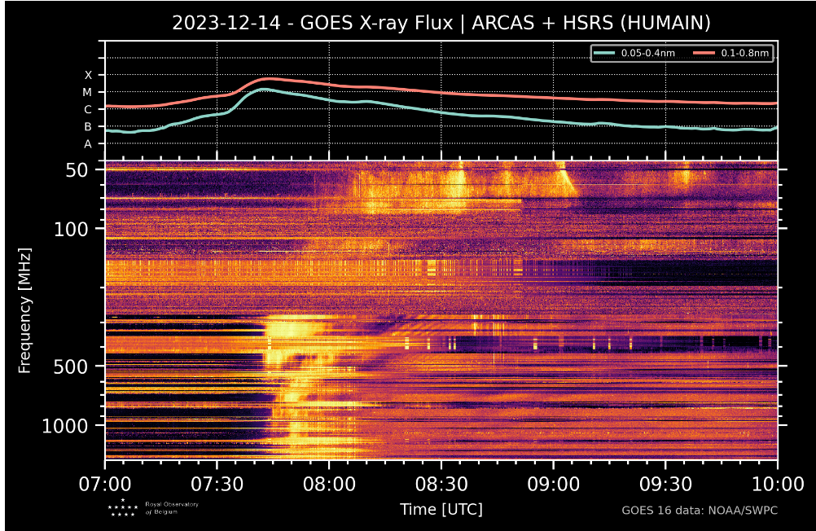
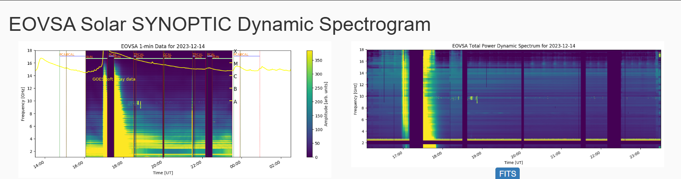
Solar Radio Burst
SIDC Daily Ursi (including forecast):
https://sidc.be
https://sidc.be/registration/registration_step1.php
Belgium: https://sidc.be/humain/callisto_latest
https://sidc.be/humain/ah_last_hours
California (eg 13/12/2023):
https://ovsa.njit.edu/browser/
index.html?suntoday_date=2023-12-13

Slide 7
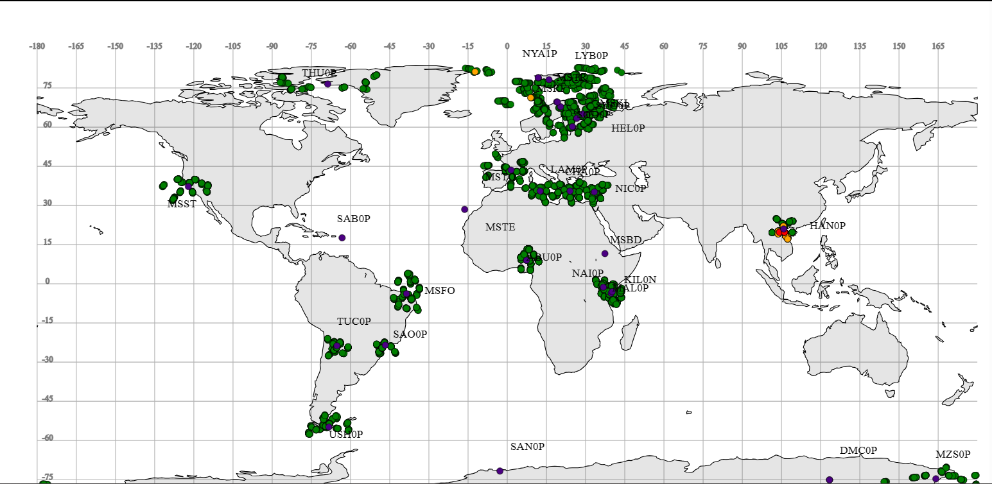
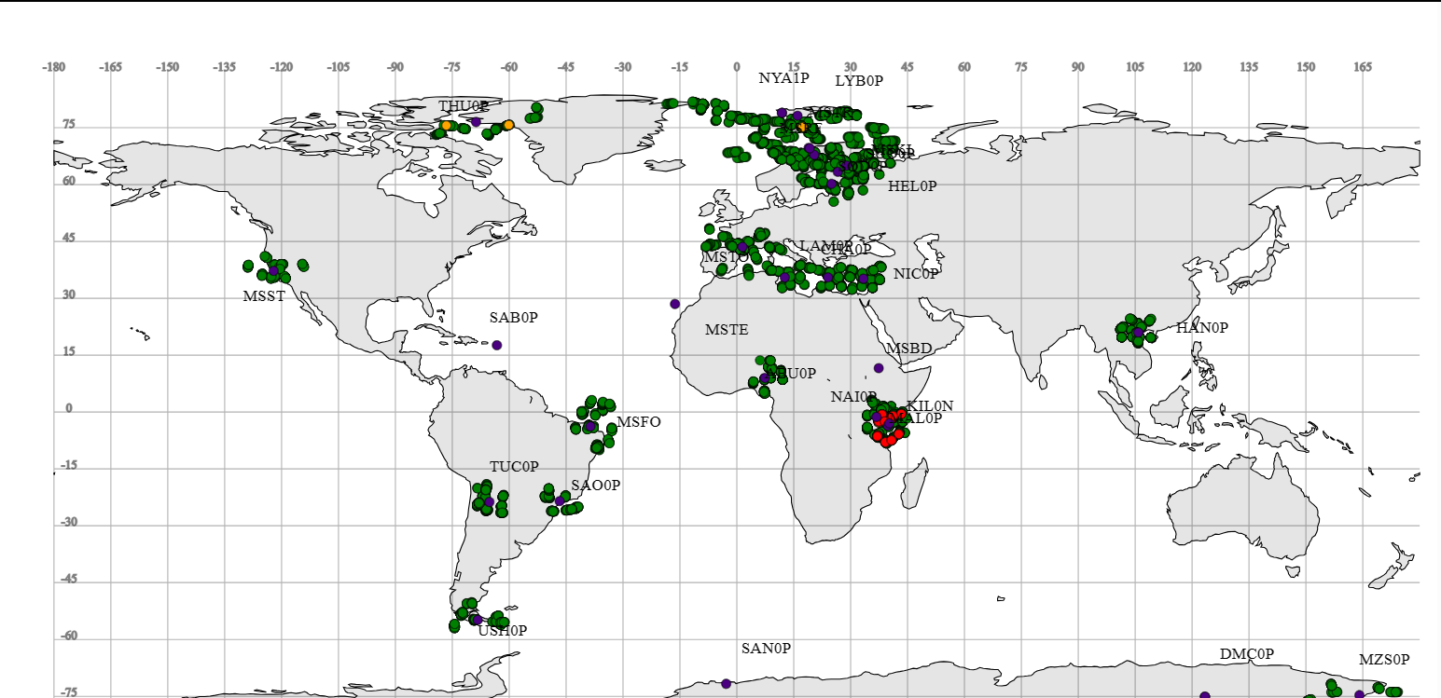
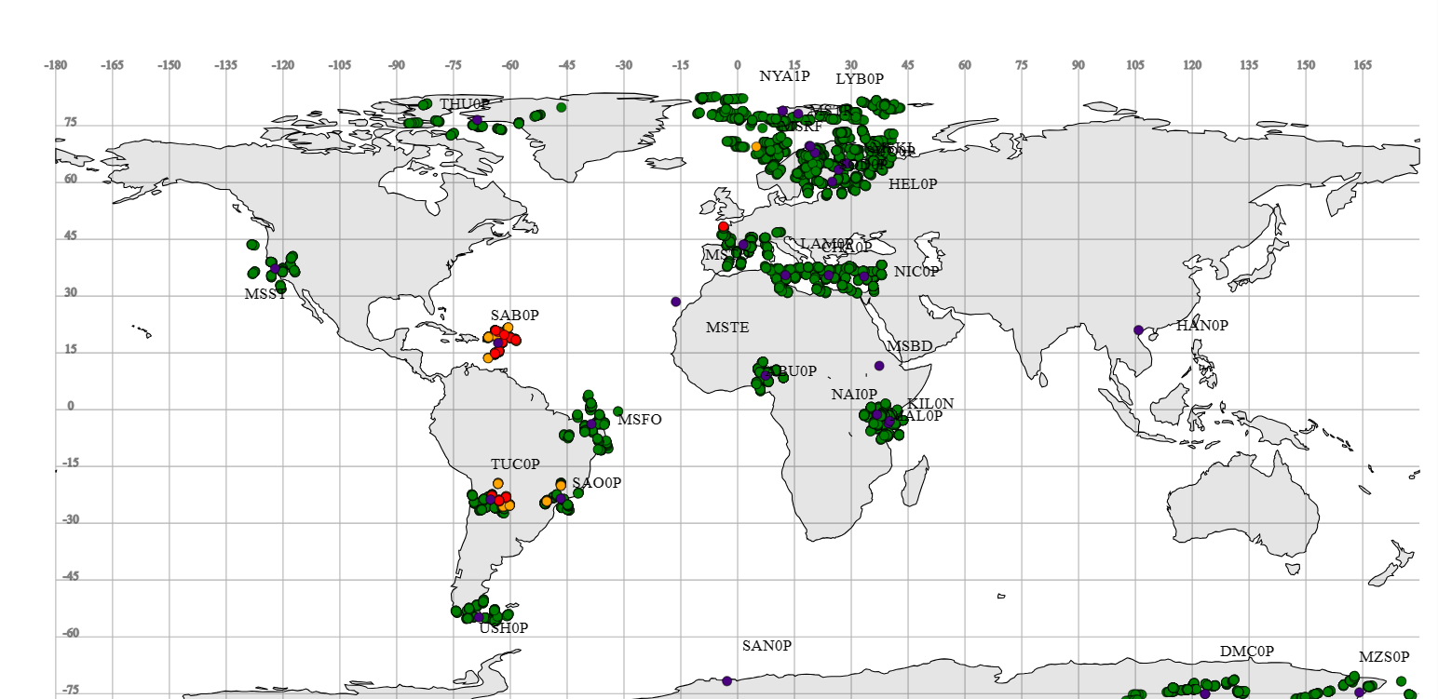
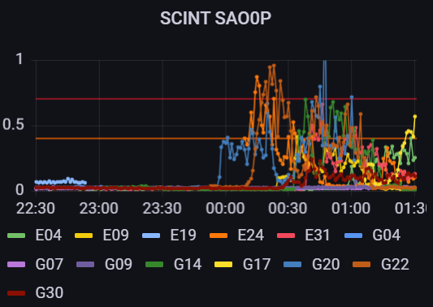
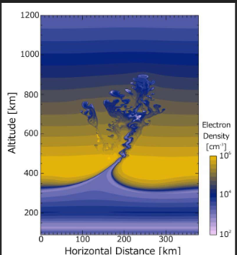
GNSS scintillation – Equatorial “bubbles”
Where: Around the (magnetic) equator
Effect: Phase and amplitude scintillation on GNSS data
When: Starts around local sunset, duration: several hours
seasonal, not liked to eruptive events:
stronger in autumn and spring
stronger during solar max)
Around Local Sunset Hanoi : 16:29 UTC
Around Local Sunset Nairobi: 19:29 UTC
Around Local Sunset Sao Paulo: 01:29 UTC

Slide 8
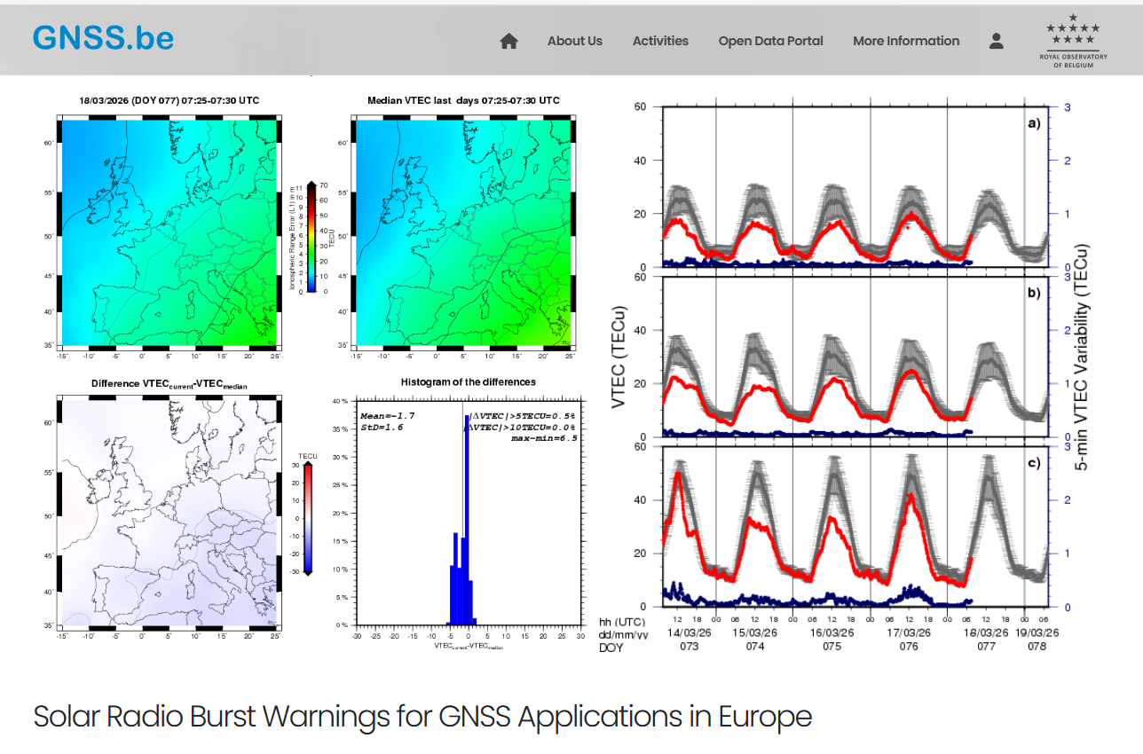
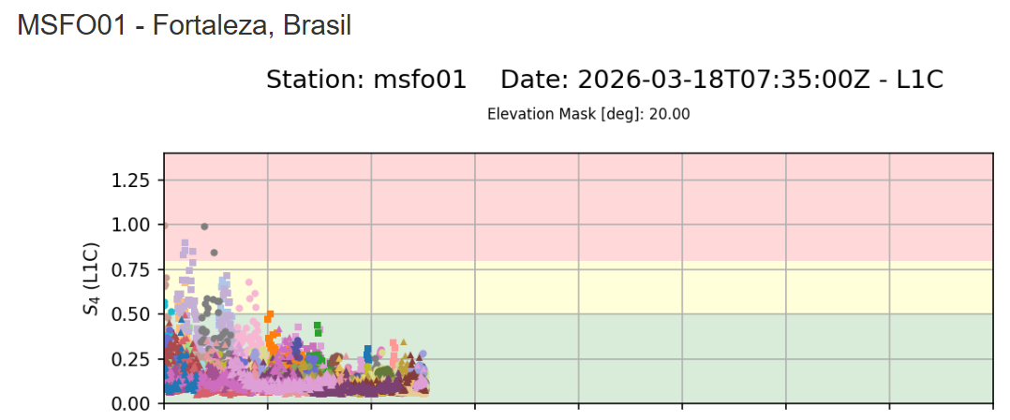
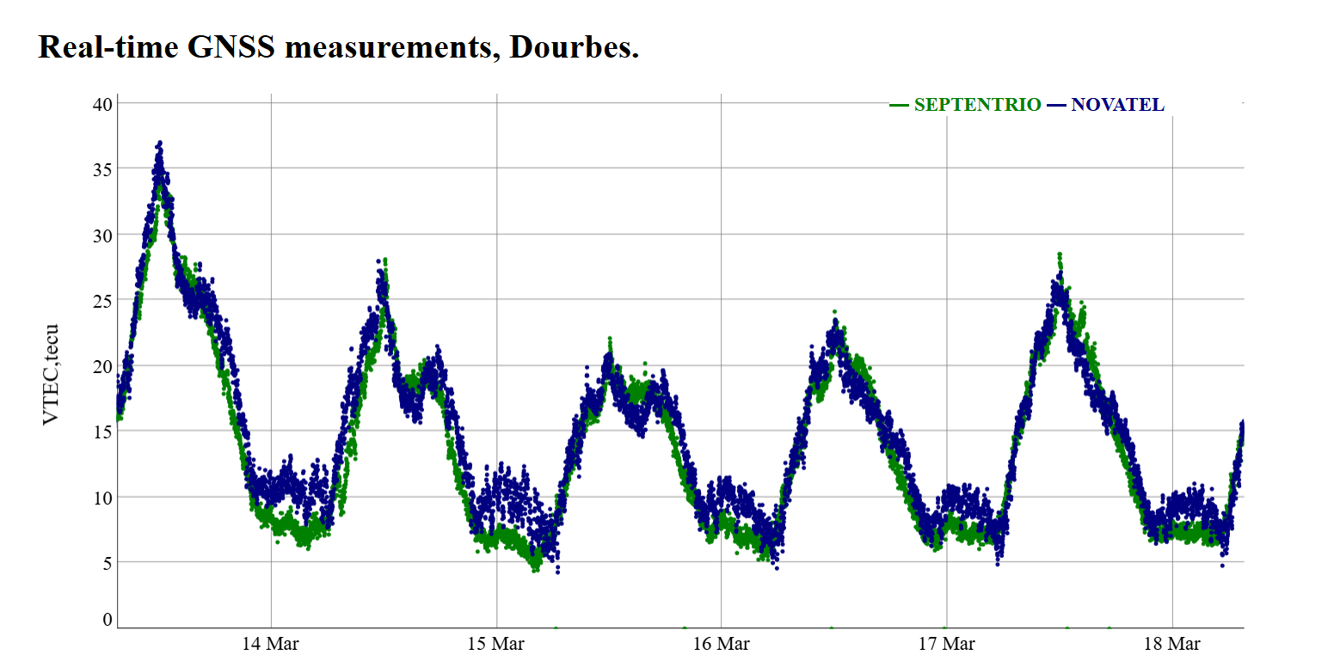
VTEC & Scintilation & GNSS related
https://impc.dlr.de/products/ionospheric-perturbations/
local-scintillation-measurements/
https://gnss.be/SpaceWeather/
http://gnss.meteo.be/

Slide 9
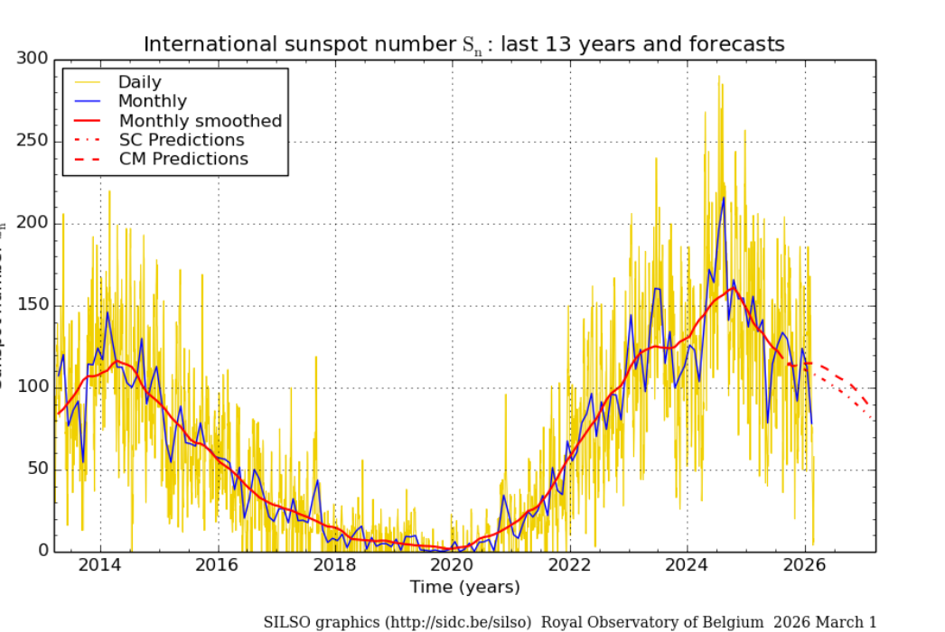
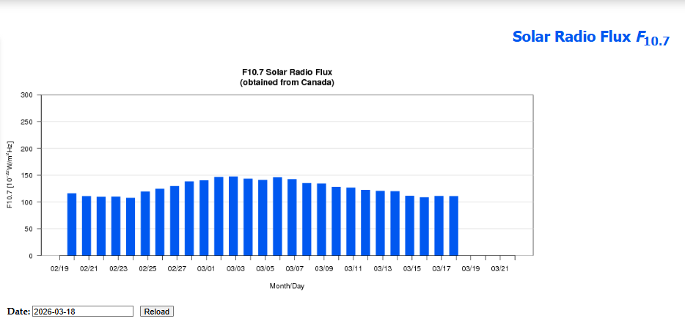
Solar Cycle related
SUNSPOT NUMBER:
https://sidc.be/SILSO/eisnplot
https://sidc.be/SILSO/dayssnplot
F10.7:
http://ionosphere.meteo.be/sun/solarRadioFlux/

Slide 10
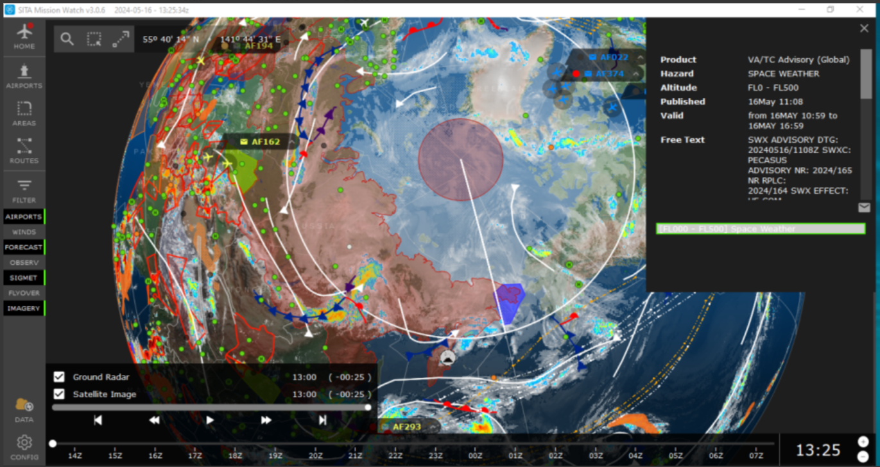
Dashboards & Services
ICAO Space Weather Advisories for Aviation
https://pecasus.eu/ (then „Dissimination“)
https://www.ilmailusaa.fi/warnings.html#top=0#id=swx#select-area=4#FMILang=en
Meteo service for aviation eg. Meteo France via Aeroweb
Weather Apps for Pilots (eg eWAS has option to activate Space Weather)

Slide 11
Ionosondes
Dourbes:
http://ionosphere.meteo.be/ionosphere/ionosonde/
https://digisonde.oma.be/
https://digisonde.oma.be/ionogif/latest.html
Worldwide:
https://giro.uml.edu/didbase/scaled.php https://giro.uml.edu/ionoweb/#
https://giro.uml.edu/IRTAM/
https://www.dxpredictor.com/ionosonde

